Slide 1



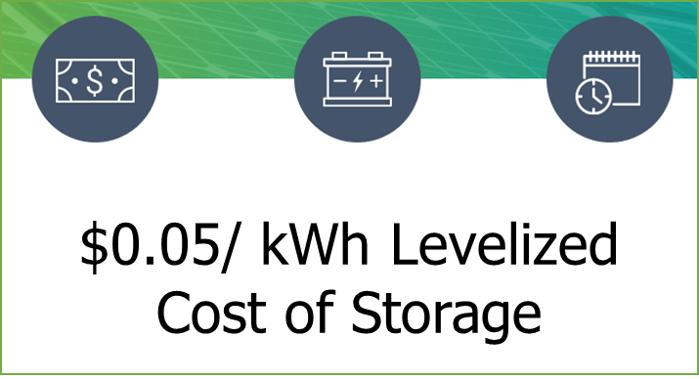
DOE’s Office of Electricity is co-leading the Energy Storage Grand Challenge (ESGC) and has announced $30 million to help enable the Long Duration Storage Shot
Cost Reduction
      Storage Innovations 2030
      10 Long Duration Storage Shot Technology Strategy Assessments report
      $15 million
      Storage Innovations Technology Liftoff FOA
ESGC
Technology Development
Mfg & Supply Chain
Technology Transition
Policy & Valuation
Workforce Development
Long Duration Storage Shot
Performance Validation
Storage Validation
Rapid Operational Validation Initiative (ROVI)
$15 million
Demonstration and Validation FOA

Slide 2
Energy Storage as a Grid Asset
Valuation Framework for Reliability and Resilence

