Slide 1
CHBWV Project Update
Ray Geimer
CH2M HILL B&W West Valley, LLC.
Quarterly Public Meeting
August 27, 2014
www.wv.doe.gov

Slide 2
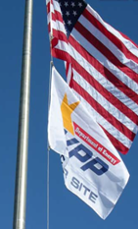
Safety Share
  1 Million Safe Work Hours without a Lost Time Accident
    48,000 man-hours per month
    More than 20 months
  Our team is committed to delivering results that matter to our customers and taxpayers, workplace safety, active community involvement, and responsible environmental stewardship.
  Dan Coyne, President and General Manager

Slide 3
Milestone 1: High-Level Waste Canister Project
Presented by: Heatherly Dukes

Slide 4
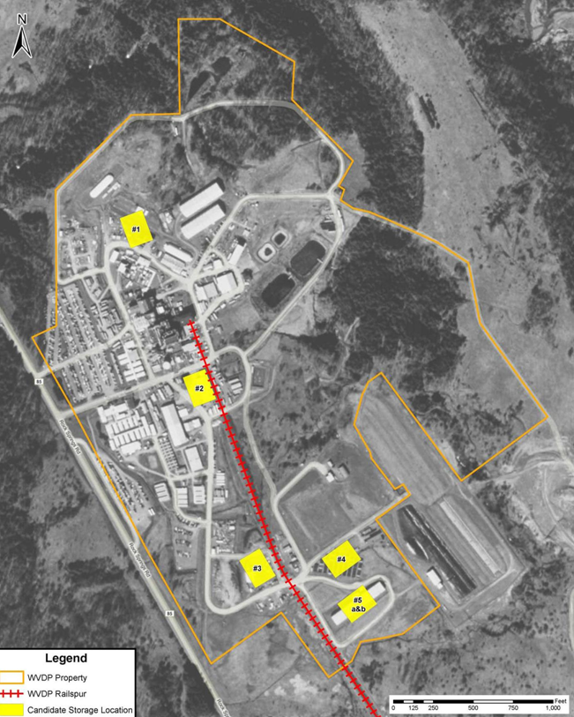
HLW Canister Relocation & Storage Project
  WVDP is relocating high level waste from high level waste (HLW) interim storage in the Main Process Plant Building to a stand-alone dry cask storage system:
  275 HLW canisters
  2 evacuated canisters
  1 non-routine HLW canister
  2 miscellaneous debris drums
Use current licensed spent nuclear fuel (SNF) shipping cask, overpacks and SNF cask designs

Slide 5
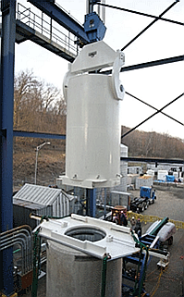
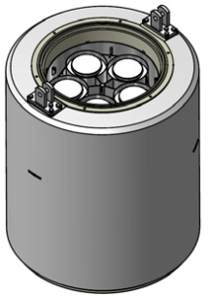
HLW Canister Relocation & Storage
Technical Approach
Canisters decontaminated in place in the Chemical Process Cell racks
5 canisters loaded into an overpack within a shielded cask
Overpack lid remotely welded/lid secured
Cask lids secured and transferred to the High Level Waste (HLW) Cask Storage Pad
Loaded Overpack in Cask
Eventual transfer of overpack for shipping

Slide 6
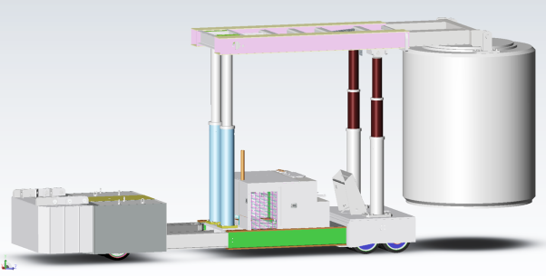
HLW Canister Relocation & Storage
In-Facility Canister
Removal Pathway
Low Profile Rail Cart
TL220 Transporter

Slide 7
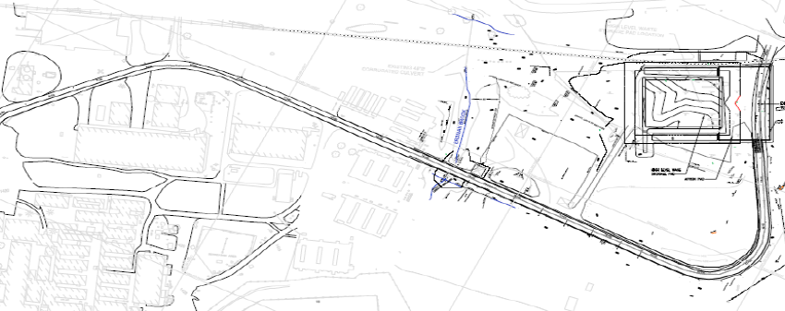
Haul Road Upgrades
Complete upgrades to 1,400 feet of site roadway
Task Order in review for issuance

Slide 8
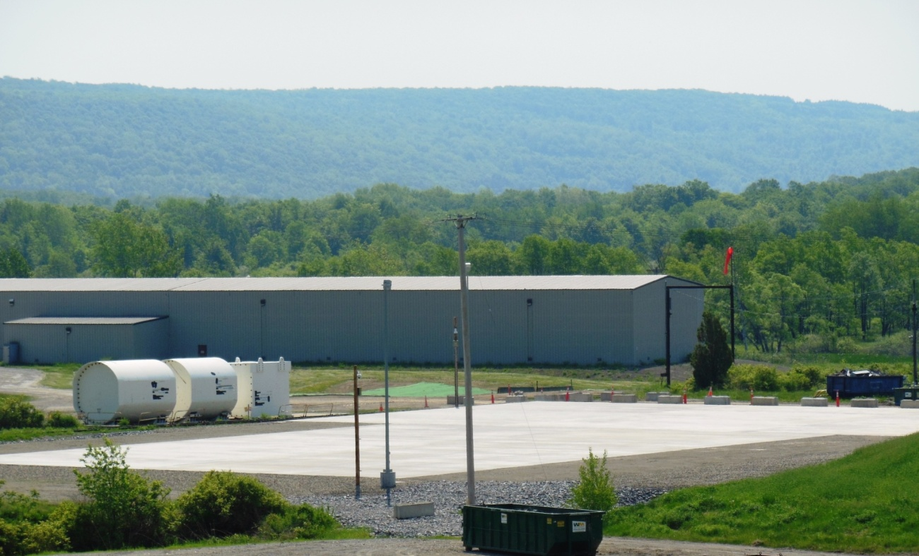
HLW Cask Storage Pad Complete
Main Pad
144 feet by 110 feet by 3-feet thick
133 tons of reinforcing steel
1,800 cubic yards of concrete
Approach Apron
98 feet by 170 feet by 18-inch thick
110 tons of reinforcing steel
935 cubic yards of concrete

Slide 9
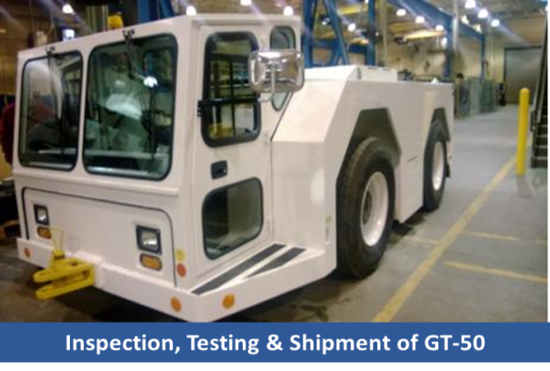
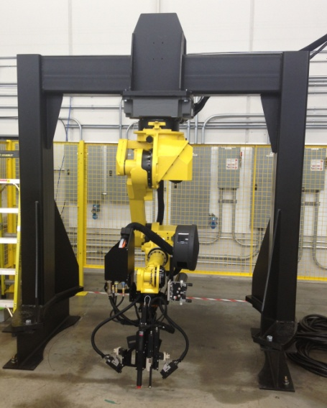
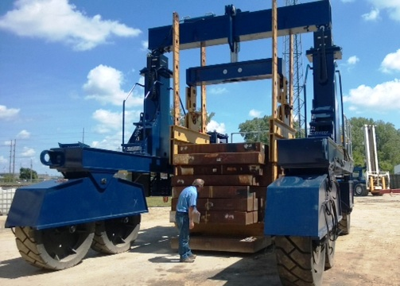
HLW Storage System Progress
GT-50 Tugger – On Site and Tested
TL220
75% Fabrication Complete
September Delivery
Automatic Welding System
Acceptance Testing Completed
September Delivery
Vertical Cask Transporter On Site and Being tested
Low-Profile Rail Cart (35%)
December Delivery

Slide 10
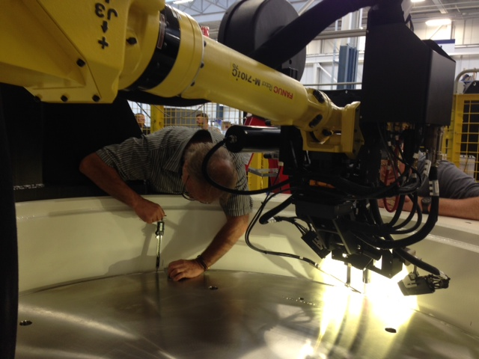
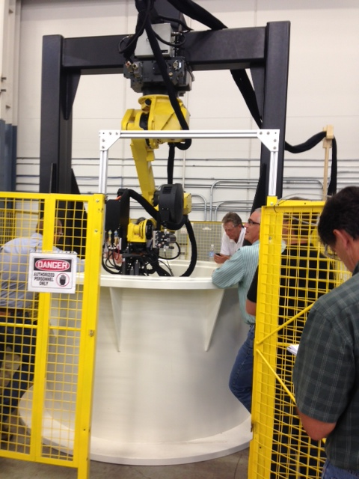
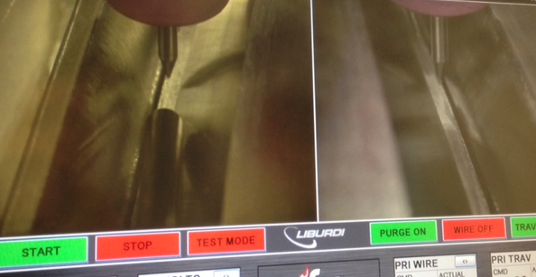
HLW Storage System Progress, cont.
Welding Factory Acceptance Testing
Measuring Backing Ring/Lid Gap
Welding System Mounted
on Mockup
Setting Up For Test Weld

Slide 11
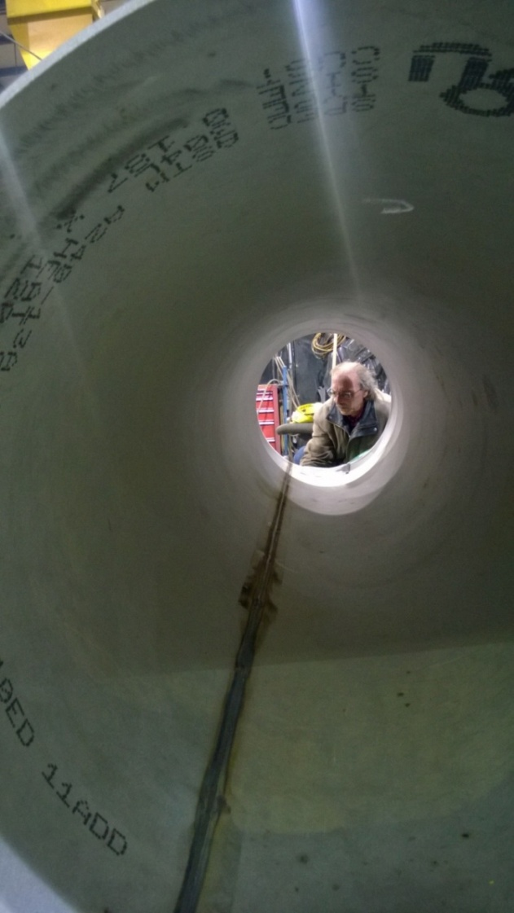
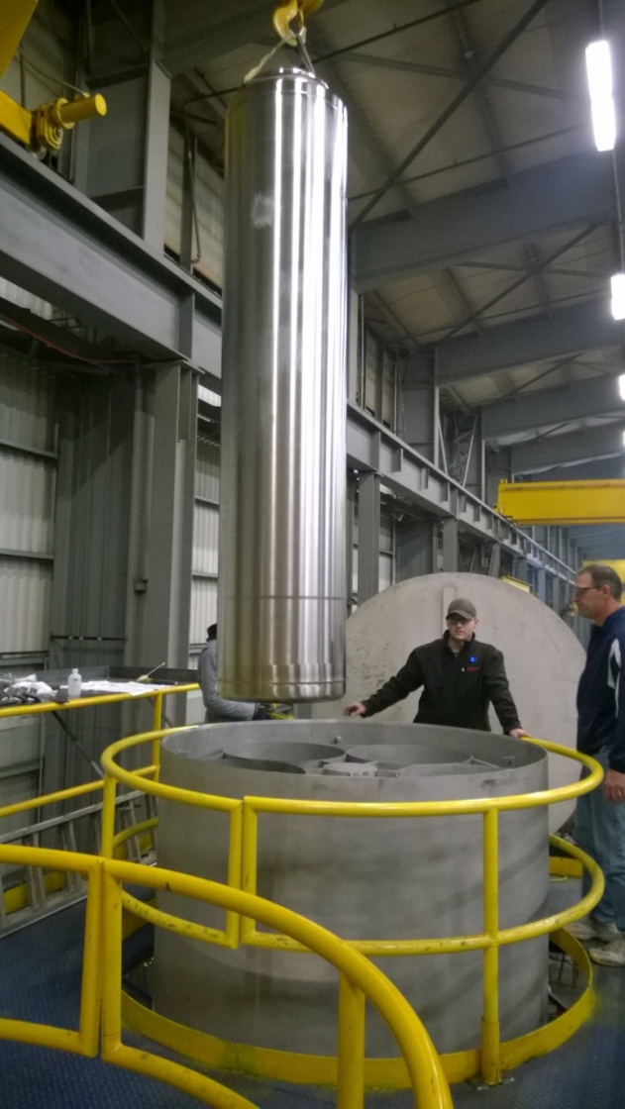
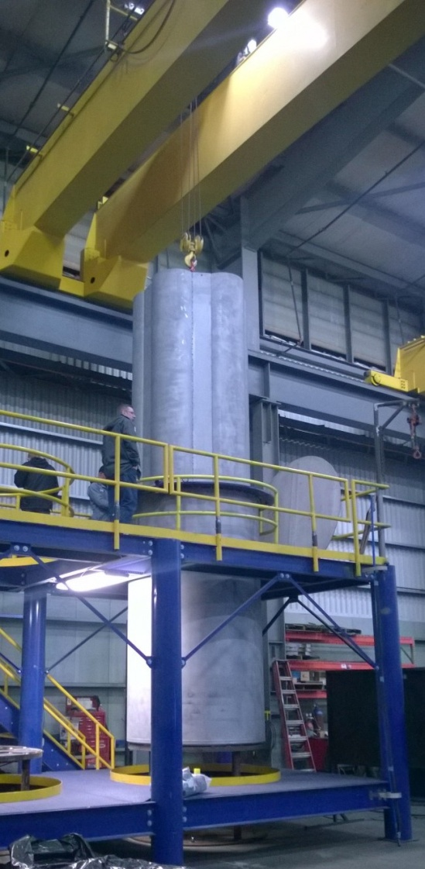
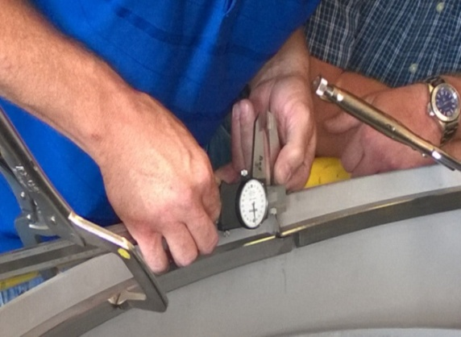
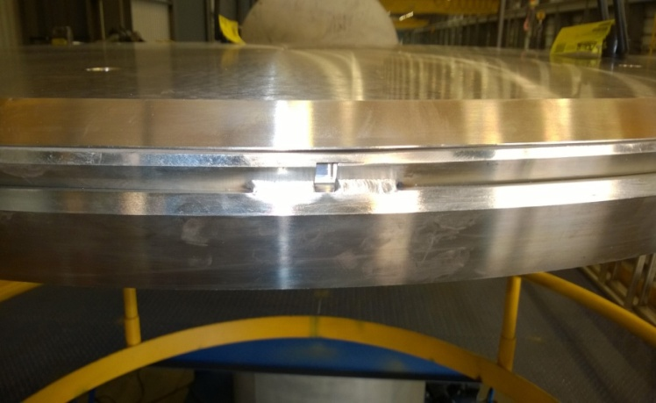
Overpack Progress
8 Completed
8 In-process

Slide 12
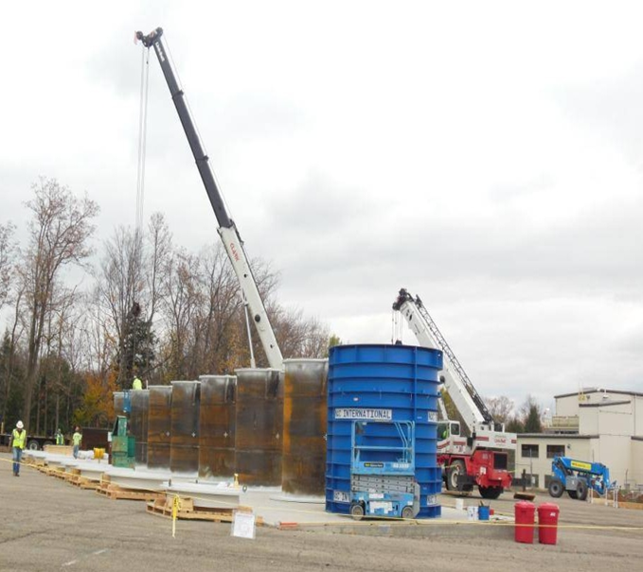
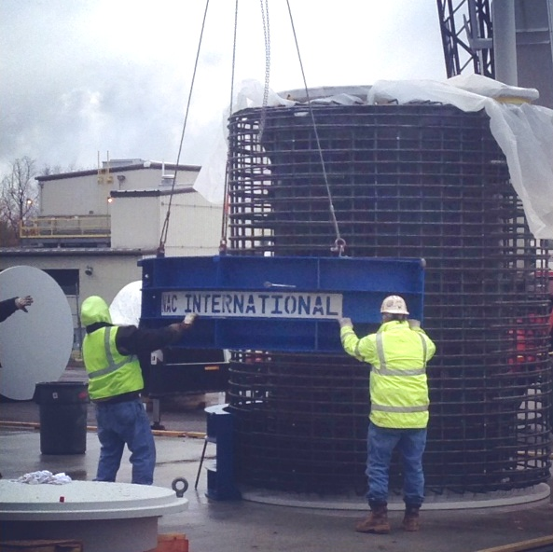
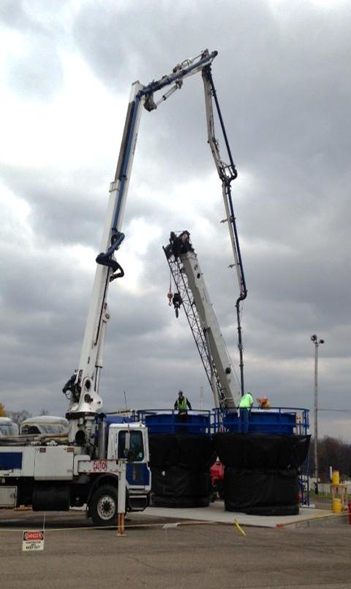
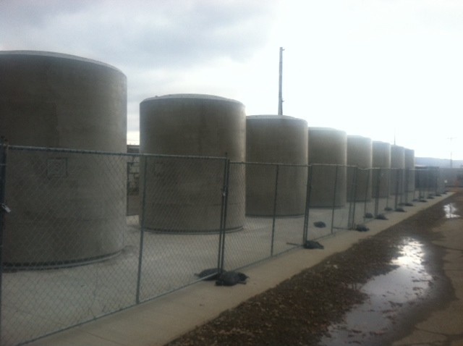
Vertical Storage Casks Progress
Cask Liners
Constructing Cask Rebar/Form
Cask Concrete Placement
8 Vertical Storage Casks (VSCs) Completed;
8 more fabricated in September

Slide 13
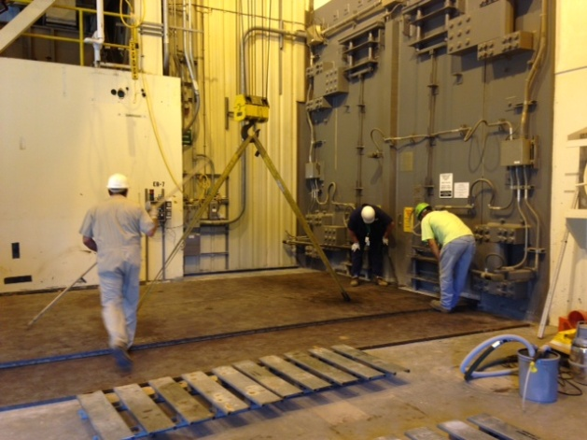
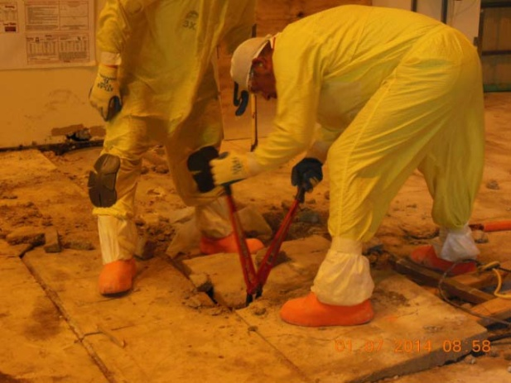
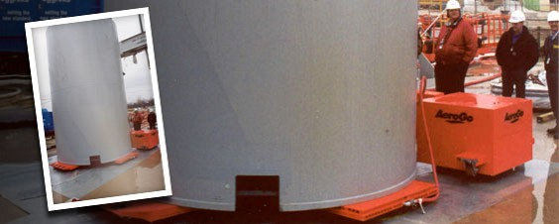
Load-In Facility Modifications in Progress
Demolished slab and added steel plating runway
Procuring air pallets
Modifications initiated for welding system
Planning final floor modifications
Steel Plate Installment
LIF Concrete Slab Demolishment
Air Pallets on Order

Slide 14
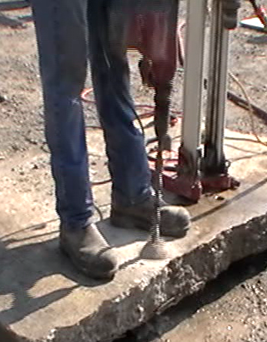
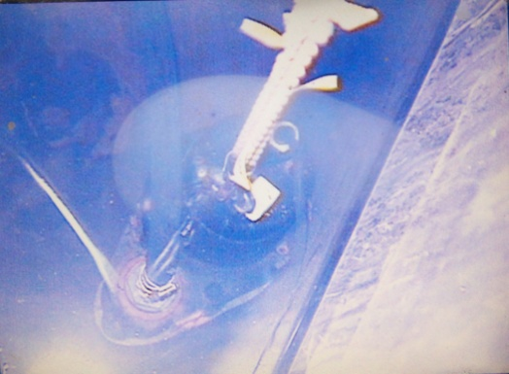
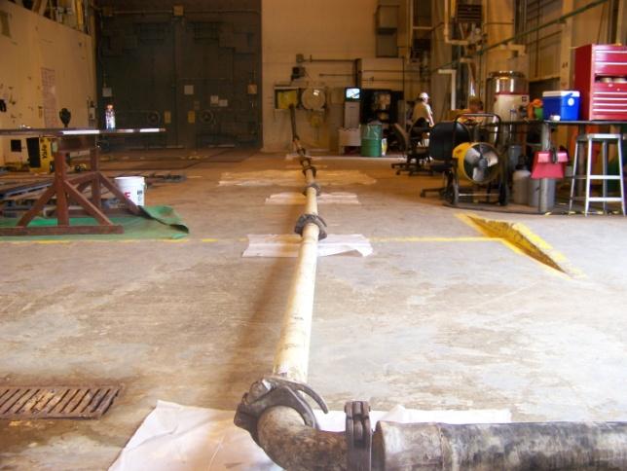
EDR Modifications in Progress
Soaking Pit grouting initiated
Second structural analysis in progress
Mockups performed for filling subsurface soil subsidence voids
Pumping Out Water and Placing Concrete in EDR Soaking Pit
EDR Floor Core Boring Mockup

Slide 15
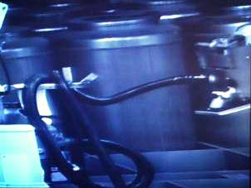
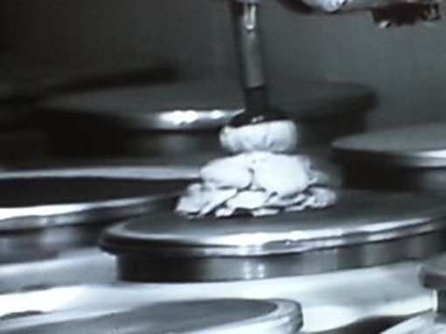
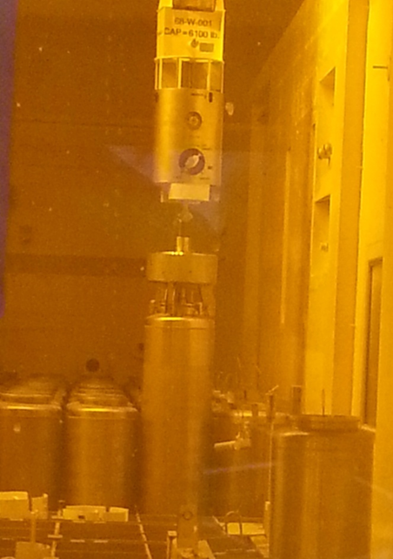
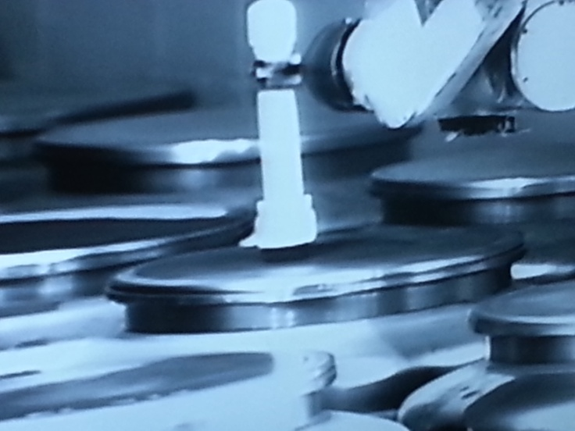
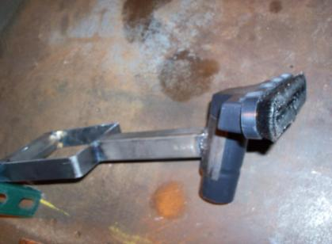
Chemical Process Cell (CPC) Modifications Progress
Scouring Pad with Vacuum
Wet/Dry Microfiber Mop
Moving Lower Rack Canister
Radiological Smears
Bristle Brush Vacuum

Slide 16
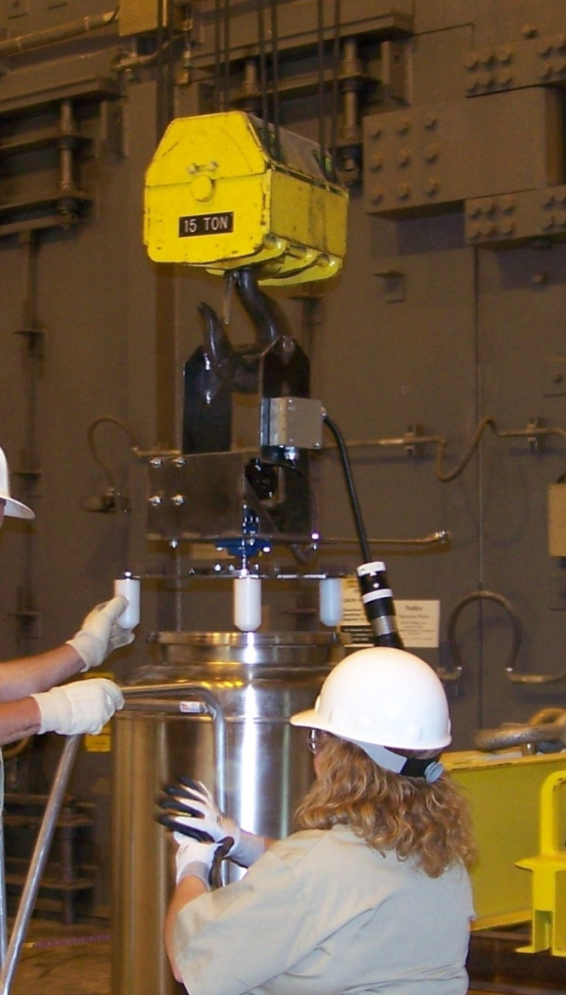
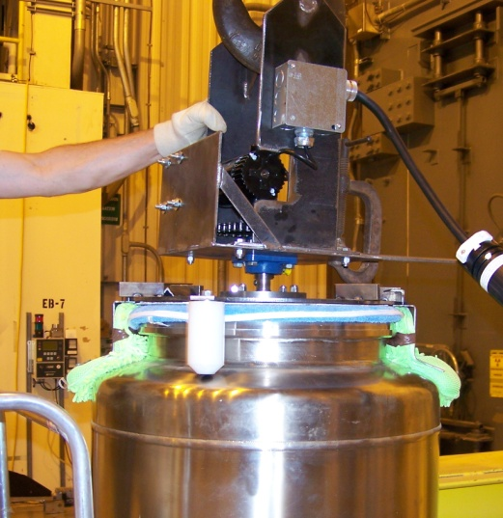
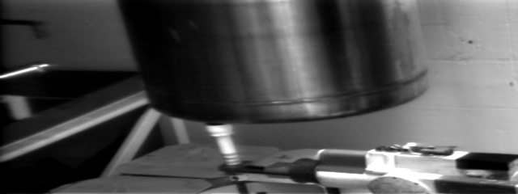
CPC Modifications Progress, etc.
Received DOE approval for canister overpack approach (operational decon only)
Fabricated and tested Canister Decon prototype
Camera modifications initiated
Prototype Testing
HLW Canister Survey Testing

Slide 17
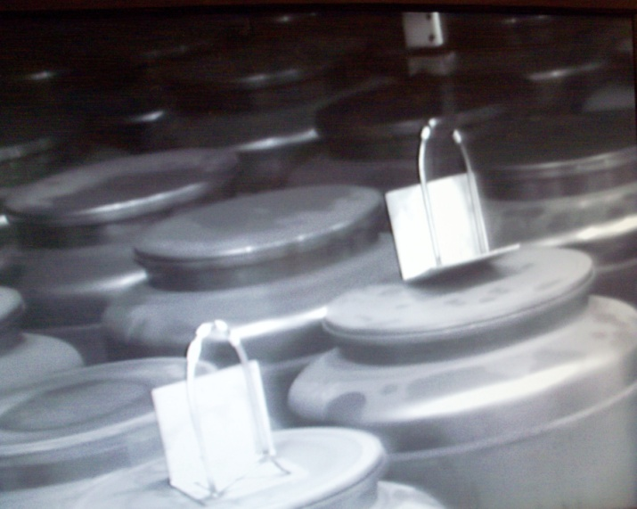
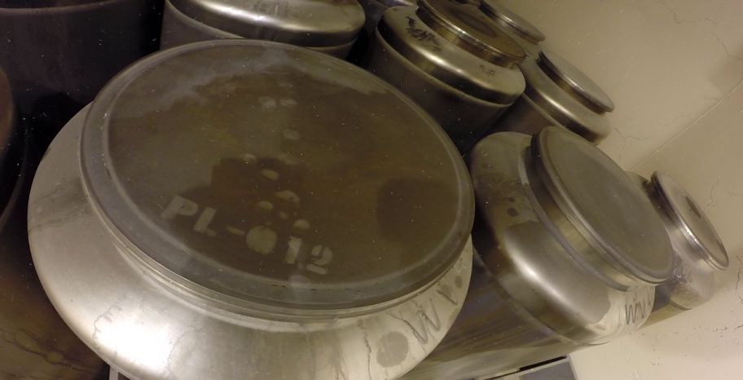
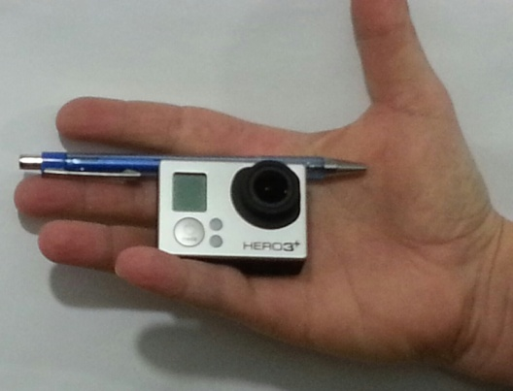
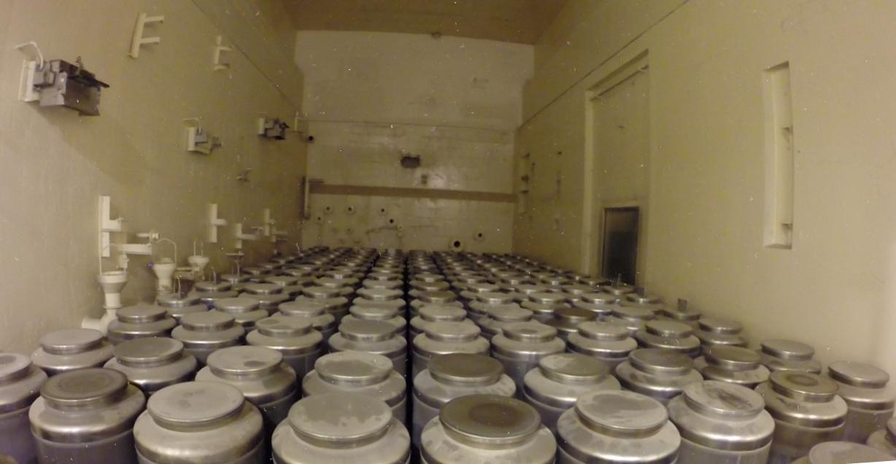
CPC Modifications Progress, cont.
Airborne Contamination
Rate Testing
Canister Inspection

Slide 18
Current HLW Project Schedule
Major Tasks | Projected Date
Construct Storage Pad | Completed
Obtain NRC Certificate of Compliance (CoC) for Shipping HLW | November 2014
Complete Facility Modifications | January 2015
Approved Start of Transfers (Operations) | March 2015
Complete Relocation of Canisters etc. | March 2018

Slide 19
Milestones 2, 3, 4
Presented by: Ray Geimer

Slide 20
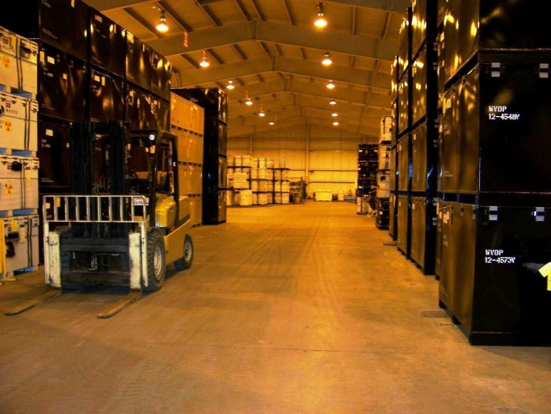
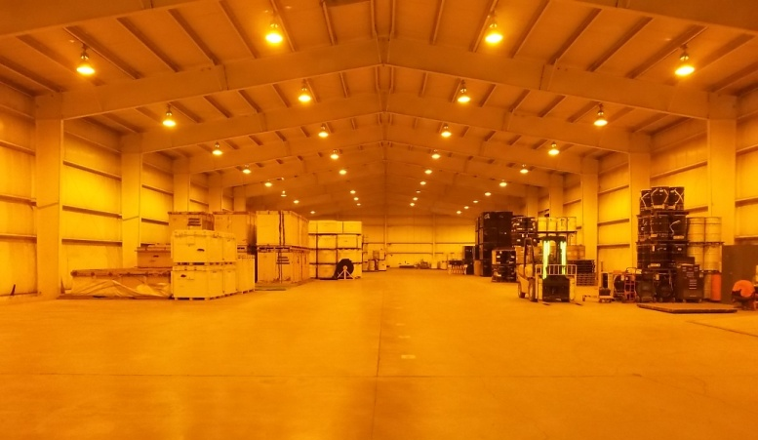
Legacy Waste Disposition Status
Legacy Waste Disposition Status through July 2014
Approximately 140,000 ft³ in storage at start of contract
Processed and shipped ~77,000 ft³ for disposal to date
  LLW: 53% complete (70,842 ft³)
  MLLW: 79% complete (5,000 ft³)
  Industrial: 100% complete (984 ft³)
  Hazardous: 100% complete (163 ft³)
  84 shipments to date
244 LLW/MLLW containers available for shipment
Lag Storage Facility Before and After 2013 Shipping Campaign

Slide 21
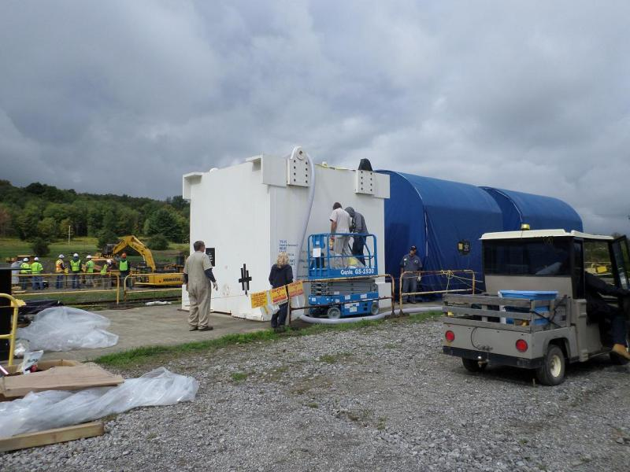
Melter, CFMT, MFHT Shipment
Shipment of Vitrification Melter, Concentrator Feed Make-up Tank (CFMT) and Makeup Feed Hold Tank (MFHT)
    CHBWV continues to work with the Savannah River Nuclear Solutions, Savannah River National Lab (SRNL) to prepare an NRC application for a special authorization
    Part of this work includes evaluation of package modification options
    Work continues between CHBWV and Department of Transportation (DOT) on the correct categorization of the CFMT and MFHT containers
Melter Grouting Operations

Slide 22
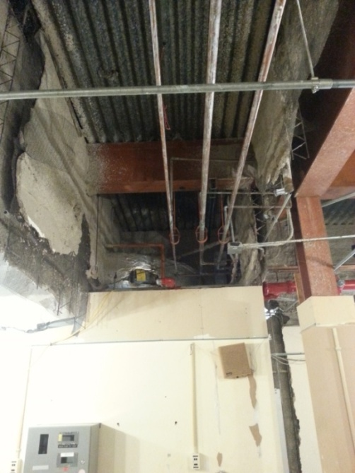
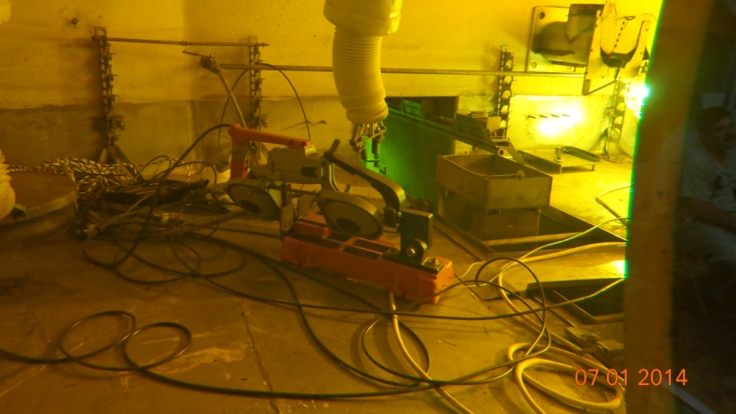
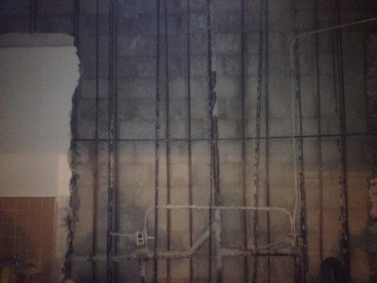
MPPB Deactivation Continues
Liquid Waste Cell – Raschig ring removal
Plant Office – Asbestos-Containing Material (ACM) Removal
Off-Gas Trench – Hatch cover containment installation
Analytical Aisle – Sample Storage Cell (SSC) equipment cleanout
Extraction Cell (XC)-1 – Return equipment to service – Artisan arm and Wachs’ saw
Plant Office First Floor after ACM Removal
Sample Storage Cell Equipment Cleanout
Notes:
For Milestones –
Provide description, baseline due date, current expected completion and any issues
For Metrics –
Provide description, quantity planned to date, quantity completed to date and any issues

Slide 23
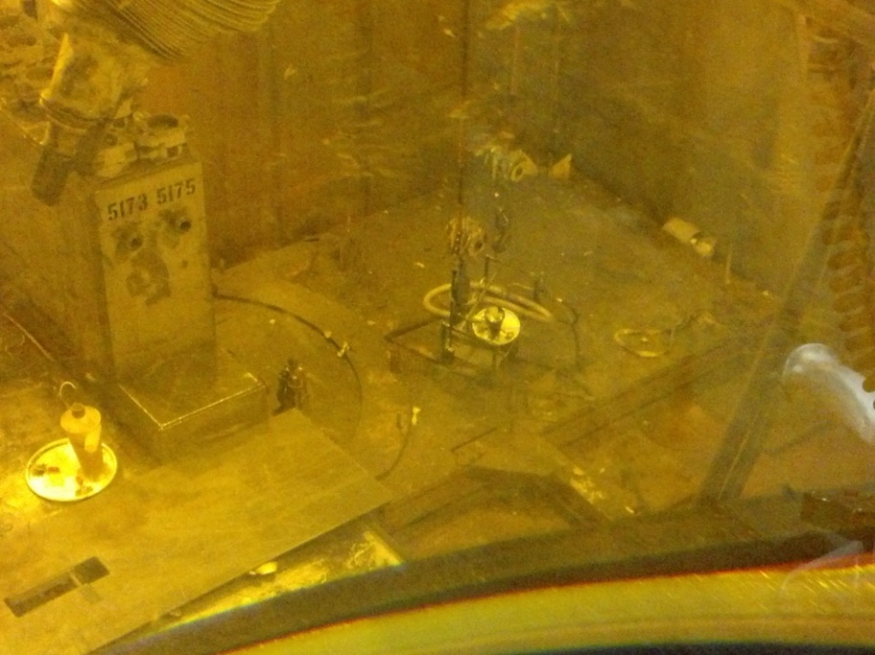
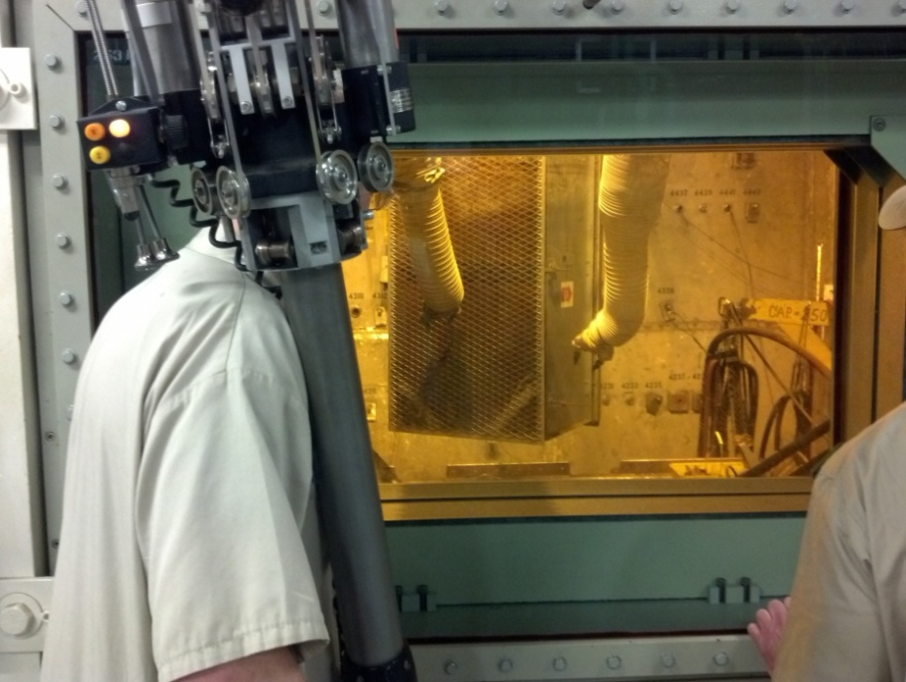
Vitrification Facility Deactivation
Vitrification Cell – Vacuum Pit Floor debris, setup, pre-filter changeout, and waste loadout
Vit Cell Equipment Pit West Side Vacuuming
Vit Cell Pre-filter Changeout
Notes:
For Milestones –
Provide description, baseline due date, current expected completion and any issues
For Metrics –
Provide description, quantity planned to date, quantity completed to date and any issues

Slide 24
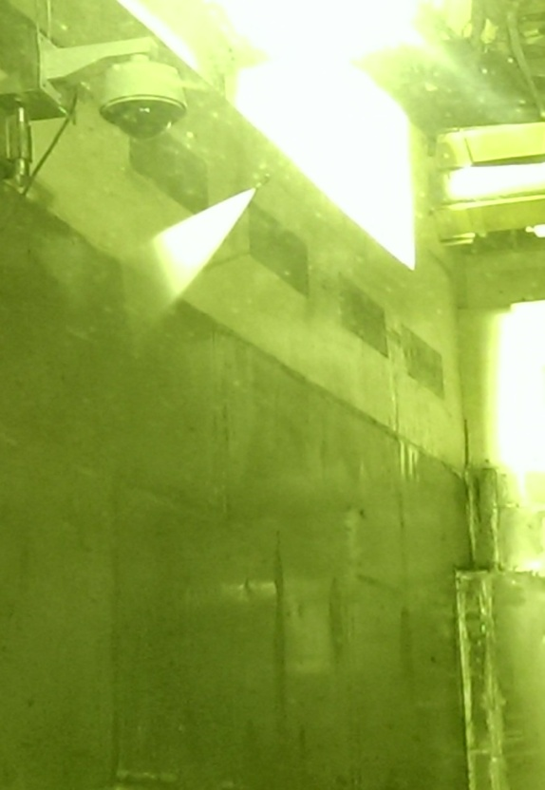
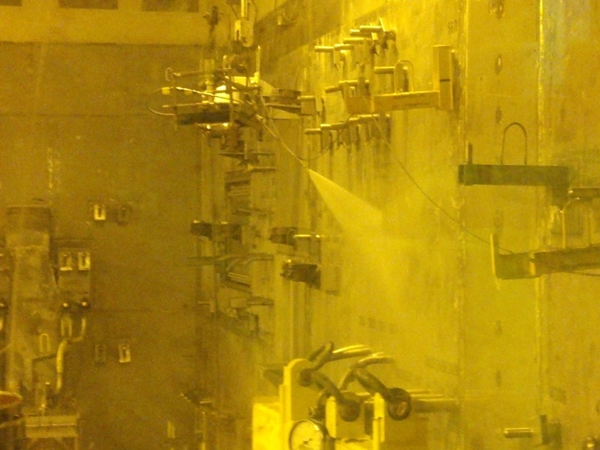
Vitrification Facility Deactivation Continues
Vitrification Facility –Wash down of Cell
Vit Cell Washdown
Notes:
For Milestones –
Provide description, baseline due date, current expected completion and any issues
For Metrics –
Provide description, quantity planned to date, quantity completed to date and any issues

Slide 25


Balance of Site Facilities (BOSF)
Restoration at Environmental Lab (E-Lab) and T-FS-04 Building
Con-Ed – Deactivation and demolition
E-Lab Demolition and Waste Loadout
E-Lab Area Restoration
Notes:
For Milestones –
Provide description, baseline due date, current expected completion and any issues
For Metrics –
Provide description, quantity planned to date, quantity completed to date and any issues

Slide 26

Newly Generated Waste Disposition
  Contract-to-date shipping status (through July 2014)
    Industrial Waste: 150,546 ft³
    Hazardous/Universal Waste: 472 ft³
    LLW: 114,933ft³
    MLLW: 991 ft³
    195 Newly Generated Waste Shipments (Balance of Site Facilities)
Weighing Second Newly Generated Waste Packaging of Con-Ed Building

Slide 27




Lake 1 Spillway
Initiated work on the Lake 1 Spillway Repair
Placement of Slit Fence, Boundaries and Barricades
at Lake 1 Spillway
Access Road to Project Site was Repaired
Single Pour Concrete Blocks Staged for Placement
along Stream Bank of Buttermilk Creek
  Removed Clay Dam at Lake 1 Canal Inlet
Notes:
For Milestones –
Provide description, baseline due date, current expected completion and any issues
For Metrics –
Provide description, quantity planned to date, quantity completed to date and any issues

Slide 28
QUESTIONS?

