Slide 1
Solar-Wildlife Interactions:
Summary of SETO Request for Information
SETO’s Strategic Analysis and Institutional Support (SAIS) team

Slide 2
Agenda
Land Needed for Ground-Mounted Solar
SETO Stakeholder Engagement on Solar-Wildlife Interactions
Overview of RFI
Summary of RFI Responses

Slide 3
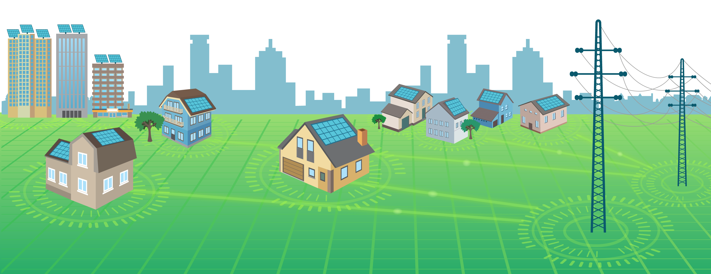
Solar Energy Technologies Office (SETO) Overview
MISSION
We accelerate the advancement and deployment of solar technology in support of an equitable transition to a decarbonized energy system by 2050, starting with a decarbonized power sector by 2035.
WHAT WE DO
Advance solar technology and drive soft cost reduction to make solar affordable and accessible for all Americans
Enable solar to support grid reliability and pair with storage to provide new options for community resilience
Support job growth, manufacturing, and the circular economy in a wide range of applications

Slide 4
Solar Futures Study
Released in September 2021
Charts pathways to providing 45% of U.S. electricity through solar by 2050 (3% in 2020)
Achieves 95% decarbonization by 2035
Every Census region has more solar in 2035 than the highest regions do today
Lots of capacity deployed in Georgia, Florida, Texas

Slide 5
Solar Futures Study: Land-Use
Ground-mounted solar is projected to require about 5.7 million acres by 2035 (0.3%), increasing to as much as 10 million acres in 2050 (0.5%)

Slide 6
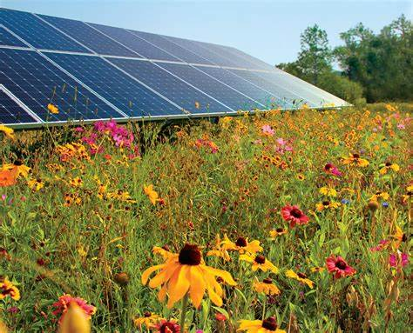
SETO Engagement with Solar-Wildlife Stakeholders
Stakeholder workshops with the Association of Fish and Wildlife Agencies (AFWA) and Solar Energy Industries Association (SEIA), Summer 2021
Request for Information on Solar-Wildlife Interactions
DOE co-sponsorship the AWWI Solar-Wildlife Symposium (December 1-3, 2021)
Presentations to AFWA
Presentations to the Avian-Solar Working Group
Regular conversations with other federal agencies including USFWS and USDA
Calls with stakeholders, as requested

Slide 7
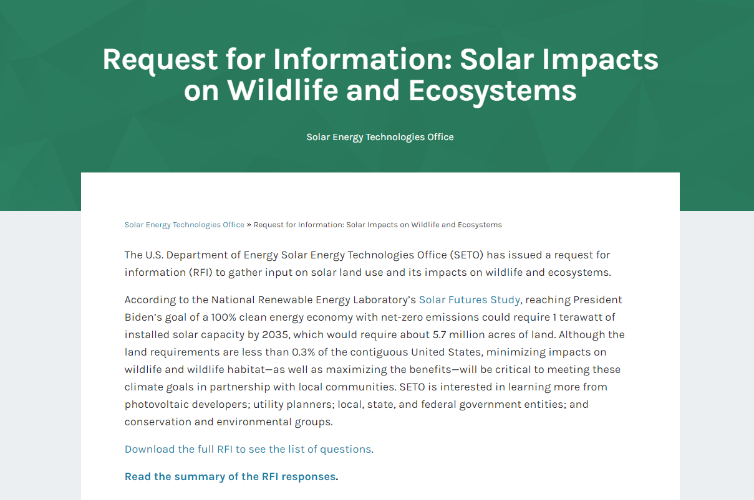
RFI on Solar, Wildlife, and Ecosystems
Objective - To gather information on:
  Solar trends and siting
  Species and habitat impacts
  Avoidance, mitigation, and monitoring
  Data, research, and resource needs
43 respondents, including representatives from:
  Solar industry
  Electric utility industry
  Universities, national labs, research institutes
  Conservation and environmental nonprofits
  Local, state, and federal government
Summary available on SETO website

Slide 8
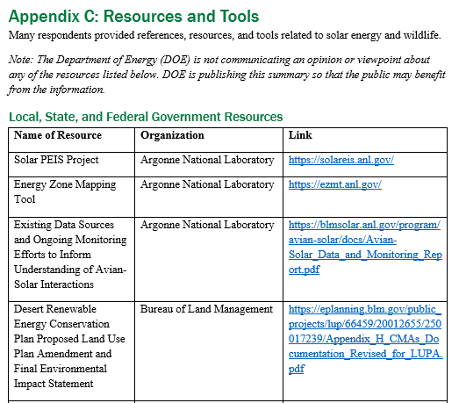
Resources for Stakeholders
RFI summary appendices compile key information and resources based on responses:
  Appendix A: Solar-wildlife research needs
  Appendix B: List of species or taxa of concern
  Appendix C: Compilation of resources, tools, and references

Slide 9
Areas of Respondent Agreement
Climate change is a major threat to wildlife and wildlife habitat
Large-scale solar will play a pivotal role in achieving decarbonization goals
Assessing tradeoffs is difficult: potential benefits versus adverse impacts to wildlife from large-scale solar energy
Wildlife impact assessments vary throughout the country, due to the variation in state/local authorities
  Compliance with federal statute is overarching framework
More research is needed to
  Understand solar-wildlife interactions
  Develop standardized methods and best management practices for assessing costs and benefits to wildlife
Early engagement is key to project success: developers, regulators, and the community

Slide 10
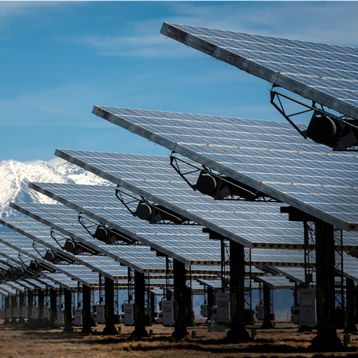
Challenges to Evaluating Solar-Wildlife Interactions
Lack of data and data availability
Regional differences in wildlife and habitat make extrapolation difficult
Cumulative and long-term interactions not yet measurable

Slide 11
Current Siting Practices
Stakeholders disagreed about effectiveness of current practices
  Initial siting decisions are primarily based on the economic feasibility of a project (e.g., access to transmission and land availability)
  Wildlife and habitat only considered later in process, primarily through compliance with state and federal statutes
Methods for assessing and mitigating impacts to wildlife vary extensively
  Individual companies have different tools and strategies
  State and local guidance and authorities inconsistent across the U.S.

Slide 12
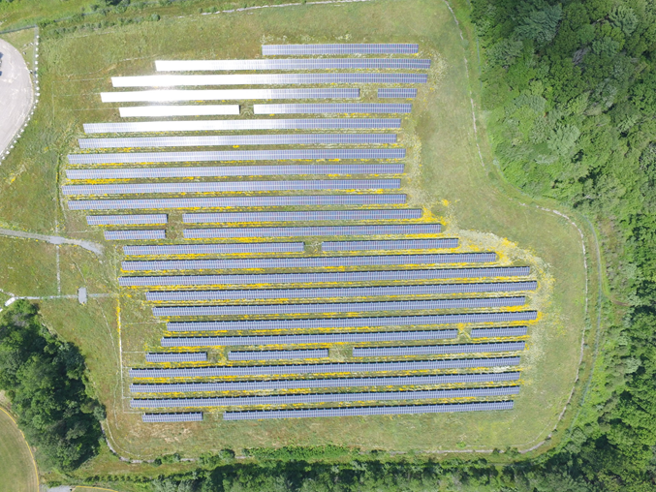
Current Siting Practices: Respondent Recommendations
Voluntary guidelines
  Some states have developed solar guidelines
  Some stakeholders relying on USFWS Wind Energy Guidelines
Landscape-level planning and mapping tools
  Tools also need to include industry considerations, such as access to transmission, land suitability/ availability, market economics, etc.
Incentives to encourage development in low-impact areas
  For example, expedited permitting or tax incentives

Slide 13
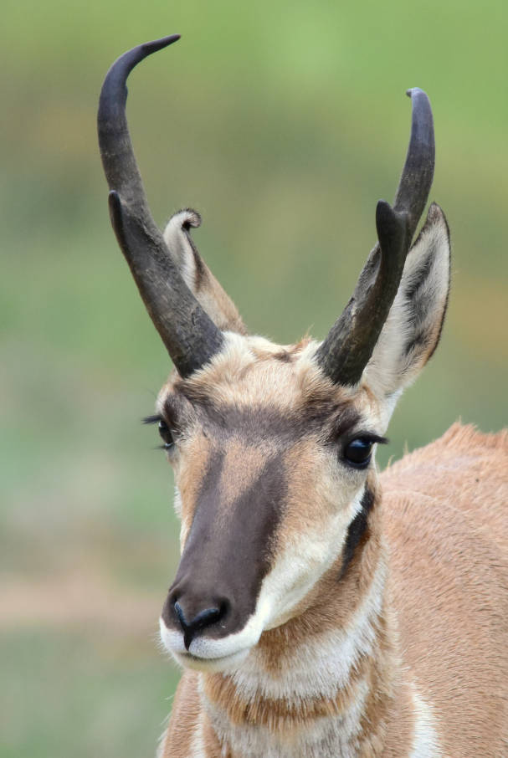
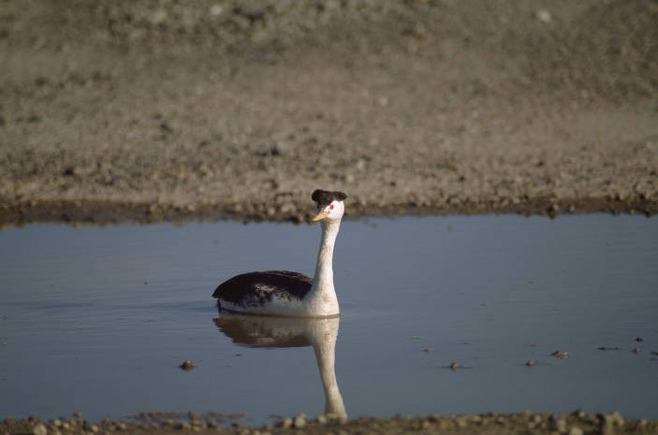
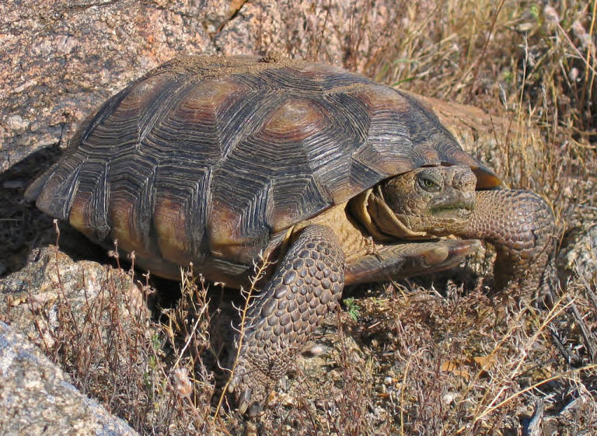
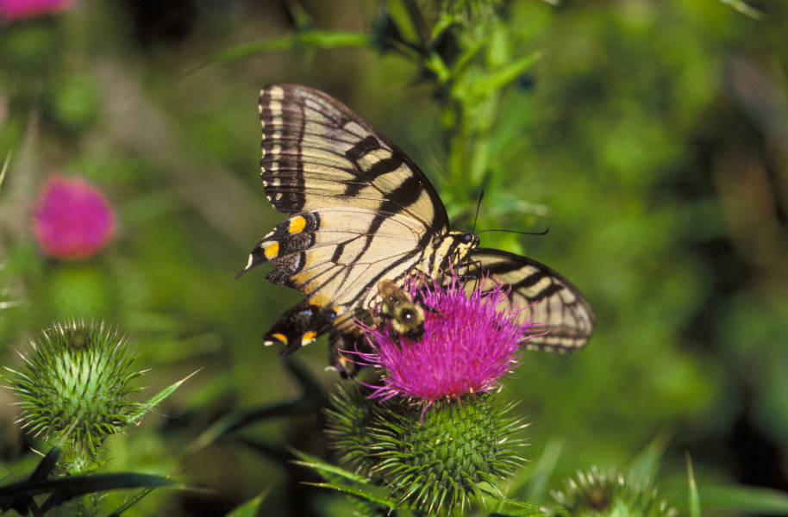
Species and Habitats of Concern
Five broad categories of species of concern were identified:
Avian species that migrate, nest, or forage in and around solar sites
Ungulates with solar sites in their geographic ranges
Small mammals and reptiles that burrow in or around solar sites
Aquatic species that are highly dependent on water quality
Pollinators that can interact with vegetation at a solar site

Slide 14
Solar-Wildlife Research Needs – Appendix A
Topic | Summary of Research Needs
Habitat changes | Impact of solar development on habitat loss and fragmentation, and on associated wildlife, at the population-level; efficacy of mitigation strategies (e.g., wildlife corridors, raised fencing, etc.)
On-site plant and animal habitat | Standardized methods to assess the health of plant and wildlife communities at solar facilities; efficacy of vegetation management strategies
Collisions with supporting infrastructure | Structures, species, and regions with increased collision risk; identification of the mechanisms (e.g., lake effect) driving risk and mitigation strategies
Stormwater and soil impacts | Impacts on water quality downstream; strategies to minimize impacts
Ecosystem services | Standardized methods and empirical data to quantify ecosystem services
Siting | Collaborative development of siting guidance, best management practices, and tools to inform low-impact solar siting decisions
Climate change mitigation | Metrics to quantify climate change mitigation at individual sites and assess tradeoffs between the benefits and adverse impacts on wildlife

Slide 15
Potential Ecosystem Services of Solar Energy Facilities
Ecosystem services: direct and indirect benefits that ecosystems provide to humans, for example carbon sequestration, erosion control, pollination, wildlife habitat
Consideration of ecosystem services could enable a more holistic assessment of benefits and impacts
  Benefits, however, are not typically considered by regulators in the permitting process
  Assessing ecosystem services could take years
Range of responses on the potential wildlife or pollinator benefits
  Potential to create habitats under panels or to preserve habitats that would have gone to other forms of development
  Uncertain costs and regulations (e.g., pollinator scorecards)
  Concern about overemphasizing benefits to species and habitats

Slide 16
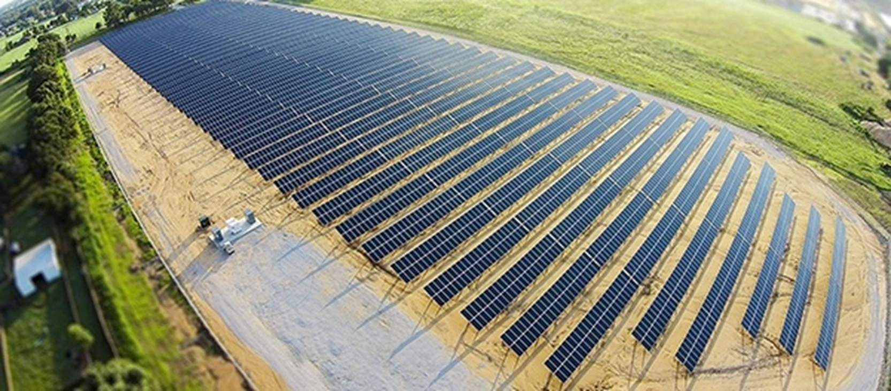
Avoidance, Mitigation, and Monitoring Practices
Site Design - Examples
Planting native vegetation
“Micro-siting” facility around sensitive habitats
Wildlife-friendly fencing
Habitat corridors
Operations - Examples
Wildlife monitoring at operating facilities
Vegetation management (timing of mowing, etc.)

Slide 17
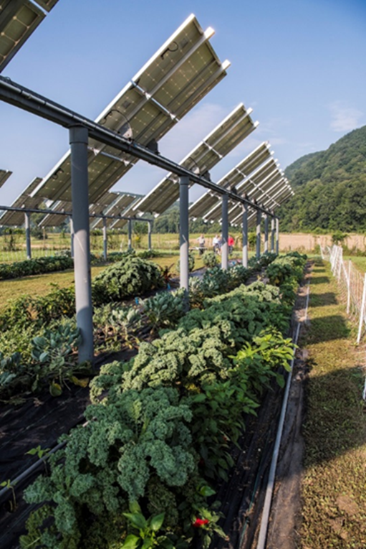
Non-Traditional Siting Strategies
Non-traditional siting strategies include:
  Agrivoltaics (PV + crops, livestock and/or pollinator habitat)
  Previously disturbed land
  Floating PV
Potential Benefits
  Less land-use conflict
  Less high-quality habitat developed
  Ecosystem services maximized
Industry concerns
  Higher cost
  Mandates
  Risk of attracting protected wildlife to solar facilities
  Scaling to large-scale facilities

Slide 18
Non-Traditional Siting Research Needs
Overarching themes:
Comparisons to solar-wildlife interactions at traditional sites
Understanding of species-specific impacts/benefits
Methods to increase efficiency and cost of identifying and developing non-traditional sites
Understanding risk associated with attracting wildlife to solar facilities
Non-traditional strategy | Research Needs
Agrivoltaics | Farming practices best suited for co-location with solar PV Improving array designs to maximize agricultural and energy outputs Evaluating vegetation management strategies for pollinators.
Floating PV | Water quality, aquatic biodiversity, and wildlife impacts
Mine lands | Interactions with bats (e.g., hibernacula)
Previously disturbed land | Quantifying benefits from developing previously disturbed land

Slide 19
Resource Needs
Resource Type | Value Added | Risks and Challenges
Mapping tools | Increase efficiency in making siting decisions | Failure to capture industry considerations (e.g., transmission capacity, land availability, etc.)
Landscape-level planning tools | Enable long-term development planning by industry and regulators | Concern about unrealistic or expensive mandates
Guidance or best management practices | Standardized approach across regions and industry | Potential for increased cost and effort to follow guidance
Repository for wildlife presence and fatality data | Enable more research | Risk to industry of sharing proprietary data

Slide 20
Solar-Wildlife Siting Key Takeaways
Disagreement among stakeholders about research needs, extent of adverse impacts, extent of benefits, efficacy of siting practices, etc.
Stakeholder engagement is key to the success of projects, research initiatives, guidance and BMP development
Needed:
  Research to understand adverse impacts and potential benefits
  Standardized methods, best management practices, and siting and mitigation strategies
  Consolidation of resources and data
  Siting and mitigation tools that include solar industry priorities
Notes:
Talking points

