Slide 1
Smart Manufacturing
Dr. Sudarsan Rachuri, Technology Manager
Advanced Manufacturing Office
AMO Peer Review
June 2020 | Washington, DC
manufacturing.energy.gov

Slide 2
DEFINING SMART MANUFACTURING
Smart Manufacturing (SM)
What it is: business, technology, infrastructure, and workforce practice of optimizing enterprise operations
What it can enable: reduce manufacturing costs from the perspective of real‐time energy management, energy productivity, and process energy efficiency.
What it is as a set of technologies: an integrated platform (like an operating system) seamlessly connecting Operational Technology and Information Technology thus enabling cyber-physical manufacturing systems to convert data into actionable insights using data analytics.
Opportunity Addressed: enable cost-effective information and communication technologies for the real-time management and control of energy in manufacturing across the unit-process, facility, enterprise, and supply network.

Slide 3
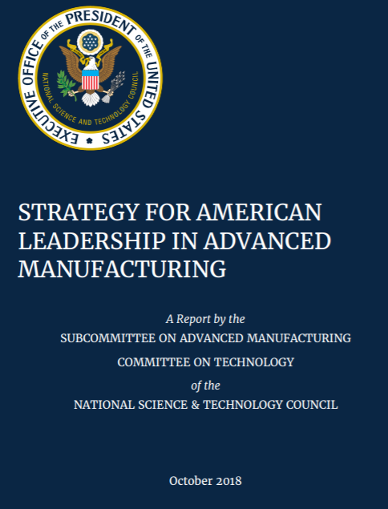
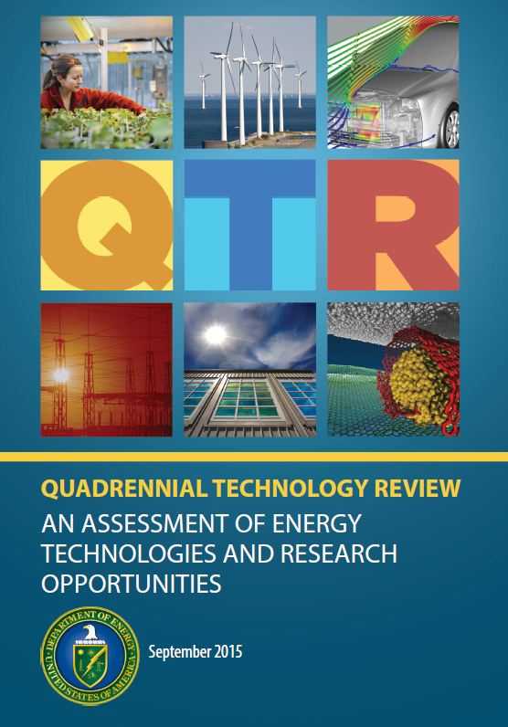
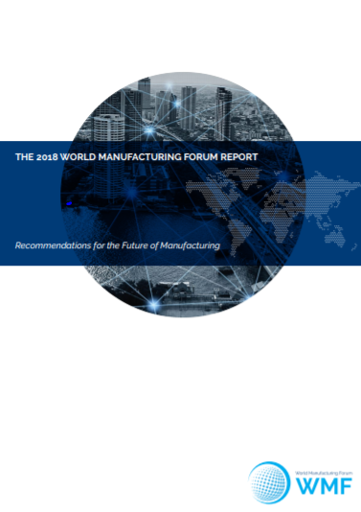
Technical Topic Background : Smart Manufacturing – A national priority
Whitehouse 2018: Smart Manufacturing is a critical priority -- Strategy For American Leadership In Advanced Manufacturing Report.
DOE QTR: Data and automation can accelerate processing, increase real-time feedback, and optimize energy use at every manufacturing systems level.
WMF Report 2018: A major driver of this re-shoring activity is smart and advanced manufacturing.
Notes:
Evans, P.C. and M Annunziata, “Industrial Internet: Pushing the Boundaries of Minds and Machines.” General Electric Company, Fairfield, CT, 2012.
President’s Council of Advisors on Science and Technology, “Accelerating U.S. Advanced Manufacturing,” October 2014. http://www.whitehouse.gov/sites/default/files/microsites/ostp/PCAST/amp20_report_final.pdf
DOE Quadrennial Technology Review (QTR), Chapter 6 “Innovating Clean Energy Technologies in Advanced Manufacturing” http://energy.gov/qtr
https://www.whitehouse.gov/wp-content/uploads/2018/10/Advanced-Manufacturing-Strategic-Plan-2018.pdf
https://www.whitehouse.gov/briefings-statements/america-will-dominate-industries-future/

Slide 4
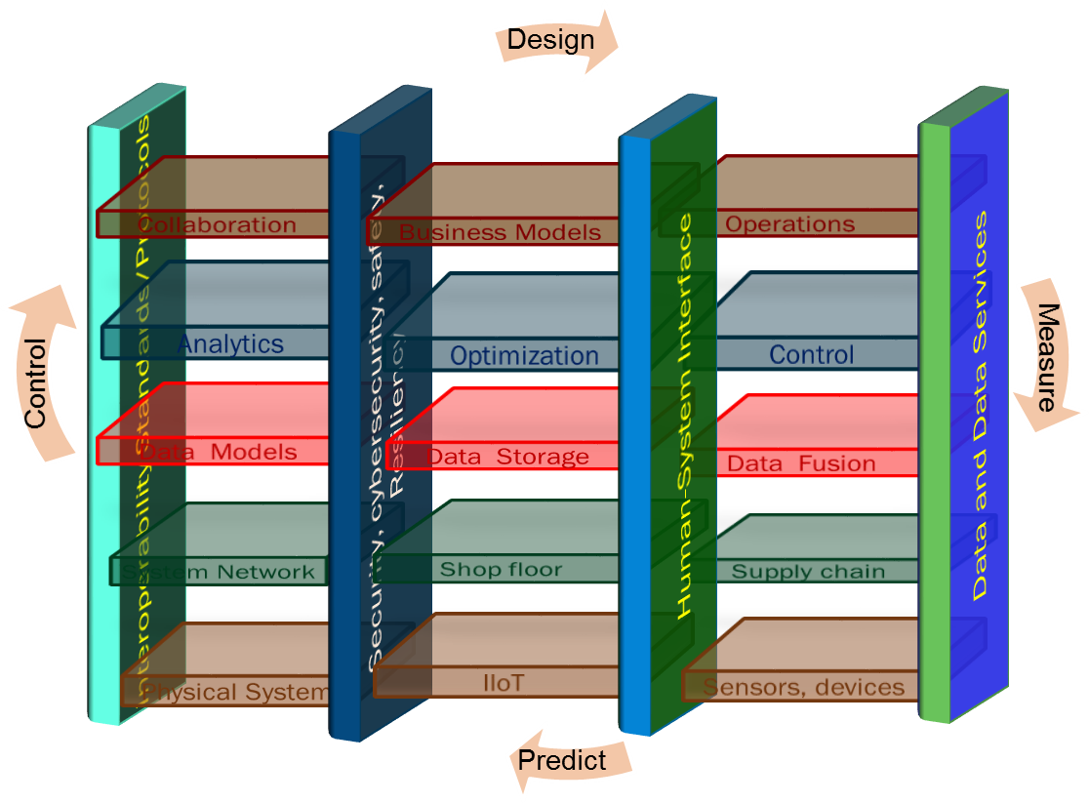
SM relies on converting data into actionable insights using data analytics
We will need a Smart Manufacturing Reference Architecture
Reduce Cost
Autonomy
Improve Quality
Synthesis
Automation
Improve Productivity
Optimize
Improve Resource Productivity
Control
Predict
Improve Flexibility
Monitor
Improve Resiliency

Slide 5
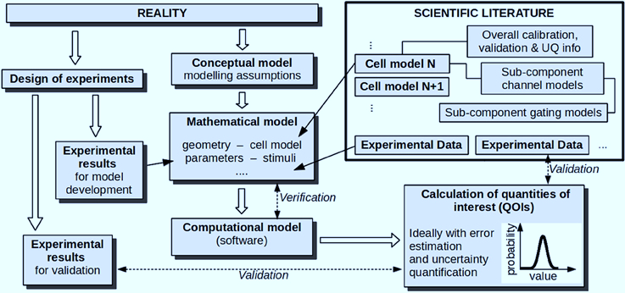
SM relies on converting data into actionable insights using data analytics We need a good Model-based Advanced Analytics
Predict and Control Product Quality
Analytics
Model-based Advanced Analytics
Descriptive
(What happened?)
Product quality - top five reasons industry is implementing IIoT technologies
Data
Science-based Model
Resource Data
Model Transformation
Diagnostics
(Why did it happen?)
Data Driven Model
Process Data
Predict and Control Manufacturing Equipment Efficiency
Hybrid Model
Predictive
(What will happen?)
Input Data
Downtime costs plants an average of $500 per hour, per stand-alone machine.
Model Transformation
Prescriptive
(How do make it happen?)
Standards
Predict and Control Resource Productivity
Measurement Error Uncertainty
Standards
Model Error and Uncertainty
40% on maintenance costs
50% on machine downtime
18% on energy consumption
↗↗ productivity up to 55%

Slide 6
Barriers according to industry analysis
Cost of deployment and Value proposition:
Cost-effective solutions, especially for SMEs
Hardware and software lock-in issues – Fragmented Market
Talent:
Skills gap and workforce development and training
Manufacturing science and data science training
Scalability:
Physics-based machine learning and hybrid models
Data Quality and availability
Verification and Validation
Cybersecurity and risk
Industry 4.0 after the initial hype Where manufacturers are finding value and how they can best capture it, Mckinsey Global Institute

Slide 7
AMO’s role and interest in Smart Manufacturing
Focus on energy intensive and energy dependent industries for enhancing productivity, minimizing waste, and enhancing global competitiveness.
Smart manufacturing technologies are expected to be broadly applicable across all sectors.
To address the challenges and barriers in SM AMO launched in 2016, The Clean Energy Smart Manufacturing Innovation Institute (CESMII).
In addition, AMO also funds R&D in smart manufacturing with a specific focus on Innovations for the Manufacture of Advanced Materials
  Accelerate the Manufacturing Process Design and Development Cycle for Advanced Energy Conversion and Storage Materials
  Innovative Manufacturing Processes for Battery Energy Storage
  AI and ML that can leverage the improved fundamental understanding of extreme and complex conditions to improve design of materials manufacturing processes.
  Drying Modeling, Sensing, and Control Strategies

Slide 8
AMO Cross Collaborations related to SM
SM Traineeship
  Enhanced Preparation for Intelligent Cyber Manufacturing Systems
AMO works collaboratively with other offices within DOE and across other agencies
  Intersecting SM with Building and Construction – EERE Big Ideas
  Basic Research Needs for Transformative Manufacturing Workshop – AMO and Office Science joint workshop
  Planning on Artificial Intelligence in Manufacturing Symposium jointly with Subcommittee on Advanced Manufacturing, National Science and Technology Council
AMO works with many scientific societies
  ASME, ASME V&V Committee, ASTM, AAAS, SME

Slide 9
Technical Topic Objectives and Targets (MYPP)
OBJECTIVE
Advance the development of sensors, controls, platforms, and modeling technologies that are interoperable, secure, and able to function under the harsh conditions specific to certain manufacturing facilities, while also making these systems less expensive to deploy than incumbent technologies, in order to aggressively reduce the energy intensity of complex processes through data-driven prediction, control, optimization, and artificial intelligence.
TARGETS
 | Target | Fiscal Year | Current AMO Activity* | Current Status (2017)
 |  |  |  | 2015 Baseline | Progress to Date
11.1 | Develop advanced sensors, controls, platforms, and models for targeted applications that reduce energy intensity (energy consumed per unit of physical output) by 15% compared to 2015 typical technology. | 2022 | CST, R&D | Analysis needed | Research ongoing
11.2 | Reduce the cost of implementing Smart Manufacturing systems (advanced sensors, controls, platforms, and models) in existing processes by 50% compared to 2015 typical technology. | 2022 | CST, R&D | Analysis needed | 25% decrease in cost for first project and a 62.5% decrease in cost for the second project.
*Key: CST = Funded Institute or Hub R&D = Funded R&D Project SBIR = Funded SBIR Project PRA = Practices NCA = No Current Activity

Slide 10
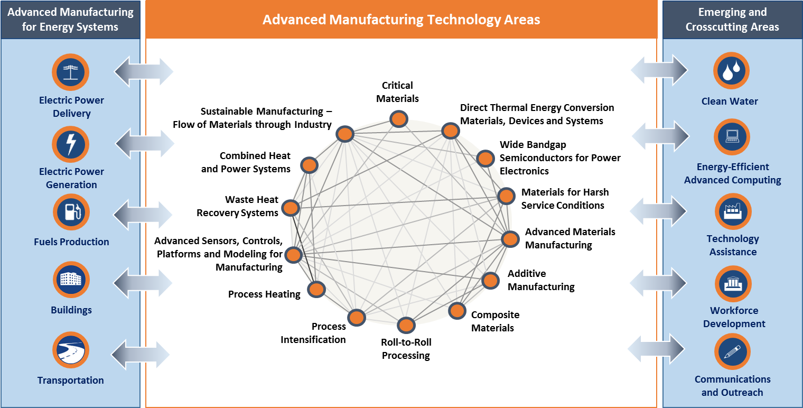
AMO Technology Areas
Smart manufacturing

Slide 11
R&D Projects related to Smart Manufacturing selected for negotiation from Multi-topic FOA
Project Title and Performer | Project Description
Single-step additive manufacturing of thermoelectric devices guided by machine learning and high throughput characterization – University of Virginia | To accelerate the development of the additive manufacturing process for thermoelectric and other energy materials, a data-driven methodology is developed and validated by high-throughput fabrication and experimental characterization.
Machine learning for optimizing the manufacture and operation of intermediate temperature fuel cells - Louisiana State University and Agricultural and Mechanical College | This project adopts machine learning (ML), specifically supervised, unsupervised and deep reinforcement strategies, for improving the efficiency and stability for intermediate temperature fuel cells (IT-PEMFCs, 200 to 250 C operation). The ML strategies will help optimize the composition and material attributes for a new class of proton conducting membranes invented at LSU and new electrode ionomer binders to be developed.
Scalable Ceramic Alignment for Electro-active Structures (SCALES) - Palo Alto Research Center, Inc. (PARC) | The Palo Alto Research Center (PARC) and San Jose State University propose to develop Scalable Ceramic Alignment of Electro-active Structures, a novel framework to optimize manufacturing process of textured ceramics with controllable crystallographic orientation. This project leverages PARC’s innovations in Machine Learning (ML) and advanced manufacturing. The proposed technology is broadly applicable to textured ceramics.
Optimizing Additive Manufacturing of Thermoelectric Materials using Bayesian Optimization-Enhanced Transfer Learning - University of Notre Dame | The goal of our project is to develop a Bayesian Optimization -enhanced transfer learning algorithm to optimize the processes of additive printing and sintering for the manufacturing of high performance and low-cost thermoelectric materials for energy conversion.
Machine-learned processing pathways for solid state electrolytes - Massachusetts Institute of Technology | The proposed work seeks to accelerate the process design and analysis of solid-state electrolytes. The team will automatically probe the composition-processing-property space in an looped fashion by: 1) statistical generative machine learning (ML) models that sample composition-processing-property relationships to identify promising candidate materials and process conditions, 2) high-throughput, low-cost atomistic simulations using learned potentials to refine the set of candidates, 3) rapid materials synthesis and characterization of intrinsic electrochemical performance, and 4) active learning of processing approaches to focus experimental inquiry
Accelerating Additive Manufacturing Process Design for Energy Conversion Materials using In-situ Sensing and Machine Learning - Wright State University | The proposed project will formulate feature inputs from in situ sensing data and an ML approach for material development of thermoelectric material using Laser powder bed fusion AM. The ML framework will utilize the unique in-situ sensing and the nozzle-based powder deposition AM technology developed at Universal Technology Corporation (UTC) to reduce material and manufacturing costs. Utilizing an ML framework with in situ sensing will greatly accelerate the material development process for thermoelectric material and devices.

Slide 12
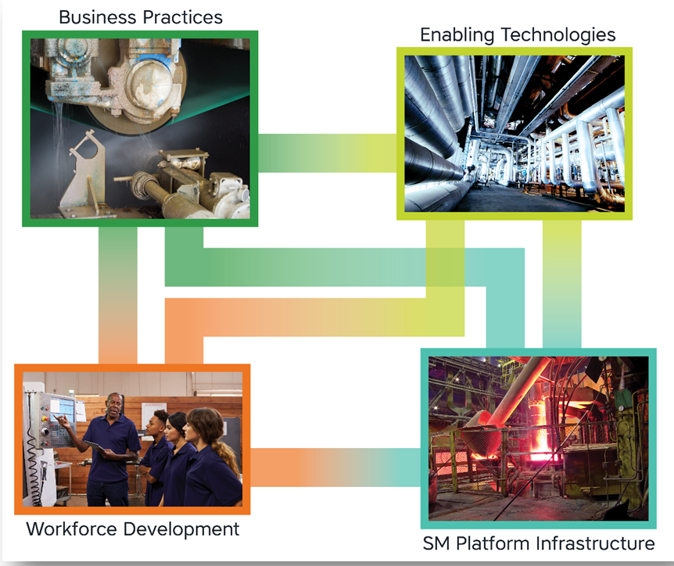
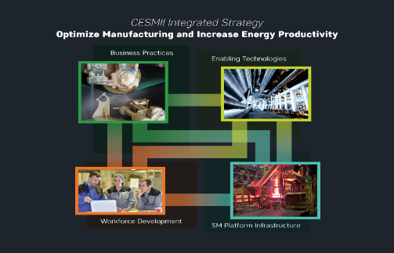
CESMII Current Portfolio
Close specific technology gaps, explore emerging technologies;
Create apps and information models specific to use case
Enabling
R&D Projects
Solve specific manufacturing problem & develop information models & apps
Innovation Projects
Education & Workforce Development Projects
Application Projects
Platform Capability Projects
Develop core platform capabilities & Tools
Demonstrate platform capabilities through use cases & Identify gaps
Develop content, train, certify

Slide 13
CESMII RFP-1 Program Portfolio: $16M
10 Projects have Launched
Projects Launched in mid-2019
1 | Data Modeling for Machine Learning and Data-Centric Analytics for Smart Aerospace Additive Manufacturing
2 | Smart Manufacturing Workforce Development Model
3 | Smart Connected Workers in Advanced Manufacturing
4 | Inferential Modeling for Driving Out Energy Waste
5 | Energy Management Systems for Subtractive and Additive Precision Manufacturing
6 | Factory 4.0 Educational Toolkit
7 | Production of zero-defect (ZD) slabs through the implementation of Smart Manufacturing technologies in steel continuous casting
8 | Smart Manufacturing of Cement
9 | Energy-Efficient Material Processing through Automated Process Monitoring and Controls
10 | Smart Manufacturing for Chemical Processing: Energy Efficient Operation of Air Separation Unit
Analytics
8
Information
1
Insights
4
Contextualization
Modeling
7
Data
Intelligence
3
10
Sensing
9
Control
5
Process
Workforce Development
Information Flow Enabled by SM PlatformTM
CESMII Focus Areas
2
6

Slide 14
CESMII RFP-2 Program Portfolio: $6M
Projects selected
1 | Improved Vacuum Arc Remelting (VAR) Processing
2 | Using Smart Manufacturing to Enable Energy-Efficient Manufacturing of Pharmaceutical Products
3 | Hybrid Modeling for Energy Efficient CNC Grinding
4 | Self-Powered Sensing and Data Science for Smart Manufacturing
5 | Smart Thermal Processing
6 | Bayesian Dropout Approximation of Process Outcomes as a Data Analysis Service
7 | Advanced Wireless Sensor PAT for Pharmaceutical Lyophilization
8 | Smart Manufacturing of Pulp and Paper
8 Projects
Analytics
8
6
1
2
3
Information
Insights
8
6
Contextualization
Modeling
3
1
2
Data
Intelligence
7
4
Sensing
8
5
Control
5
5
Process
Information Flow Enabled by SM PlatformTM
CESMII Focus Areas

Slide 15
CESMII RFPs
RFP2 Wave 2 – Education & Workforce Development: Proposal Evaluations in Progress
Areas of Interest…
Smart Manufacturing Education and Training
  Build pipeline of SM Engineering students
Smart Manufacturing Landscape – Software, Hardware, and Standards
  Frame SM for all
Smart Manufacturing Deployment and Practice
  Engage manufacturing industry domain experts at scale
  Engage and educate manufacturing executives
RFP2 Wave 3 – SM Innovation Platform Capabilities
RFP issued May 11 2020
Areas of Interest…
Connectivity & Data ingestion
Data contextualization
Secure data access, management, exchange
RFP2 Wave 4 – SM Innovation Projects
RFP issued May 11 2020
Areas of Interest…
Use cases addressing energy consumption and/or energy productivity
Use cases addressing precision, productivity and performance
Use cases addressing asset/process monitoring, management and predictive maintenance
Information models and software applications to create SM Profiles™ and populate SM Marketplace
$1.40M (50-50 Cost Share)
$2.0M (50-50 Cost Share)
$5.0M (50-50 Cost Share)

Slide 16
Examples of how projects contribute to AMO Mission
Project Title | Energy Productivity through Improved Efficiency by 25% (in 5 years) on Pathway to 50% (in 10 years) | Reduction of Validated Deployment Cost for Smart Manufacturing in Existing Processes by 50% Relative to Existing State of the Art | Validate Smart Manufacturing in First of Kind Applications. | Enable plug and play connectivity to ease integration and customization across industry sectors.
ArcelorMittal Production of Zero-defect (ZD) Slabs through the Implementation of Smart Manufacturing Technologies in Steel Continuous Casting | A tiny 0.2% savings in yield (from reduction of defects) is equivalent to an annual savings of $90M for the whole US steel industry | Information models for the caster equipment will be made available for conversion to SM Profiles in the future | Steel Industry: Predictive maintenance tools alone could save at least $2M per caster strand per year (there are hundreds of strands in the US) | Caster health monitoring software made available for CESMII's platform
Honeywell Data Modeling for Machine Learning and Data-Centric Analytics for Smart Aerospace Additive Manufacturing | 5% energy savings from Yield Improvement, reduced transportation and Energy savings relative to traditional casting and forging processes. | Information models for AM and post processing equipment for conversion to SM profiles in the future | Current AM metal processing yields are 90% at best. Successful development of sensors, monitoring and data analytics will help improve yield to 95% reducing energy consumption overall by 5%. | Image processing Ml algorithms, Machine learning toolkit with workflow made available

Slide 17
Expanding the AMO focus on understanding Key Knowledge Gaps
Game Theoretical Modeling
Agent Modeling
Pre-calculated Models
(look-up tables)
Engineering Models
Data driven models
(Ml, AI)
Physics-based Model
First Principles Models
Integrate the science-based models and data-driven models
All models are wrong and some are useful – we need verification, validation and uncertainty quantification
Stochastic and Bayesian Modeling
Network Science and Modeling
Notes:
Empirical equations, algorithms, curve-fits
Equations that depend on physical properties and usually satisfy basic scaling and conservation principles
The appropriate governing mathematical equations - conservation of mass, momentum, and energy are solved given any special assumptions and/or boundary conditions.

Slide 18

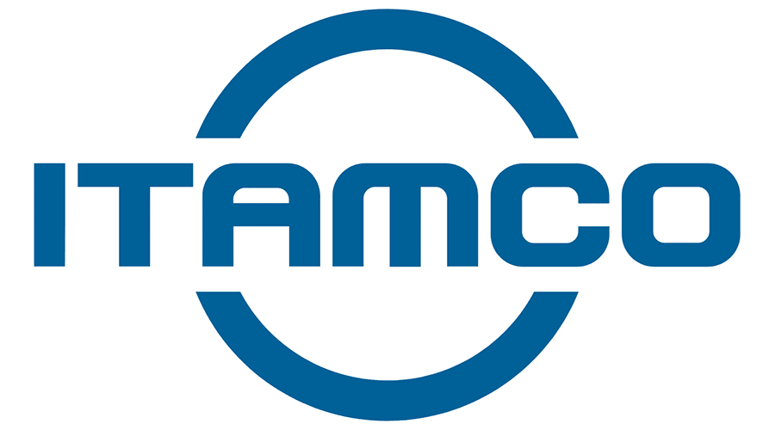









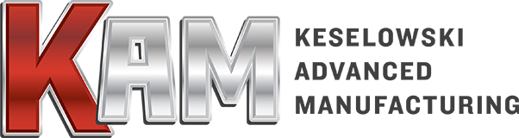





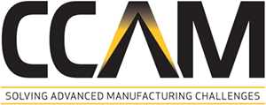






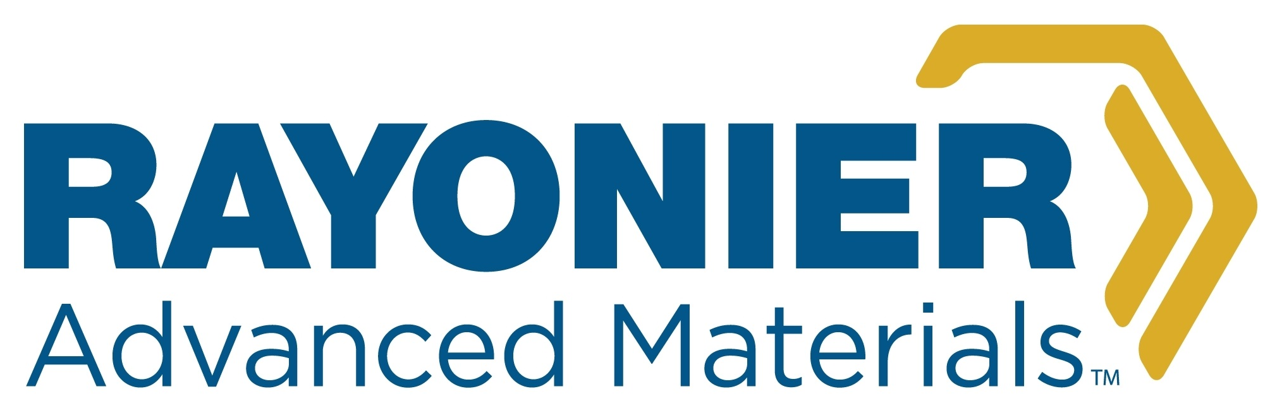


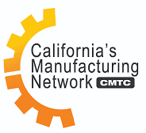







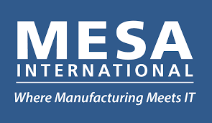




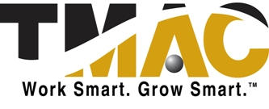




























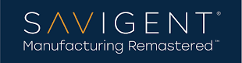




Technical Topic Collaborations

Slide 19








The DOE Team
Valri Lightner
Deputy Director
Advanced Manufacturing Office
Kristen McDaniel, PMP
Project Manager (Contractor)
Advanced Manufacturing Office
Steven Shooter Ph.D. PE
Fellow of Science and Technology Policy
Advanced Manufacturing Office
Mike McKittrick PhD
R&D Consortia Program Manager
Advanced Manufacturing Office
Bill Prymak
Lead Project Manager
Advanced Manufacturing Office
Sudarsan Rachuri PhD
CESMII Federal Program Manager
Advanced Manufacturing Office
Mahesh Mani Ph.D.
Senior Technical Advisor (Contractor)
Advanced Manufacturing Office
19

Slide 20
Supplemental slides

Slide 21
Smart Manufacturing Thrusts
Open Software and Communication Platforms
Standards and Protocols
Advanced Sensors
Real-Time Data Analytics and Control
Advanced High Fidelity Modeling
First-of-Kind Application Toolkits
Cyber security for manufacturing
Testbeds
Skills and workforce development

Slide 22
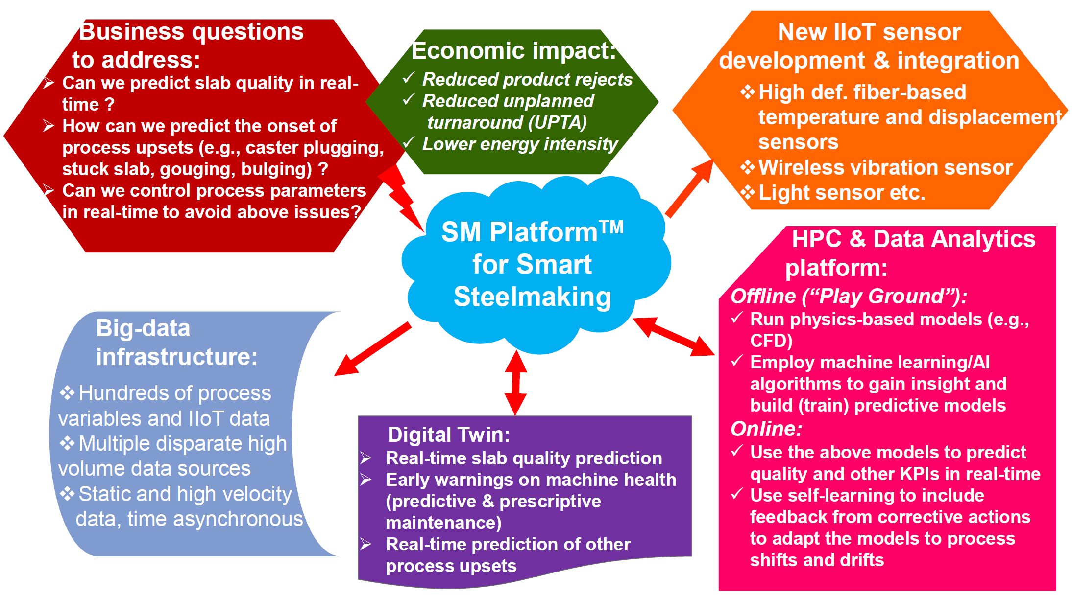




Production of Zero-defect (ZD) Slabs through the Implementation of Smart Manufacturing Technologies in Steel Continuous Casting
Project Lead: ArcelorMittal
PROBLEM STATEMENT
Absence of predictive maintenance and real-time quality prediction tools increases the overall energy intensity of the steelmaking process via increased unplanned turnarounds (UPTA) and product defects.
PROJECT GOAL
Improve steel slab quality and continuous caster productivity using Smart Manufacturing (SM) methodologies and technologies, thereby reducing overall energy intensity of the existing steelmaking and casting operations.
POTENTIAL IMPACT
A tiny 0.2% savings in yield (from reduction of defects) is equivalent to an annual savings of $90M for the whole US steel industry (plus a whopping 2.68 PJ of energy savings per year equivalent to about 22 million gallons of gas savings, enough to power ~ 70,000 typical American homes for a year)
Predictive maintenance tools alone could save at least $2M per caster strand per year (there are hundreds of strands in the US)
Transversal application of the developed technologies (available as SM Apps from the SM Marketplace) from this project would impact numerous other industries faced with similar problems and challenges

Slide 23
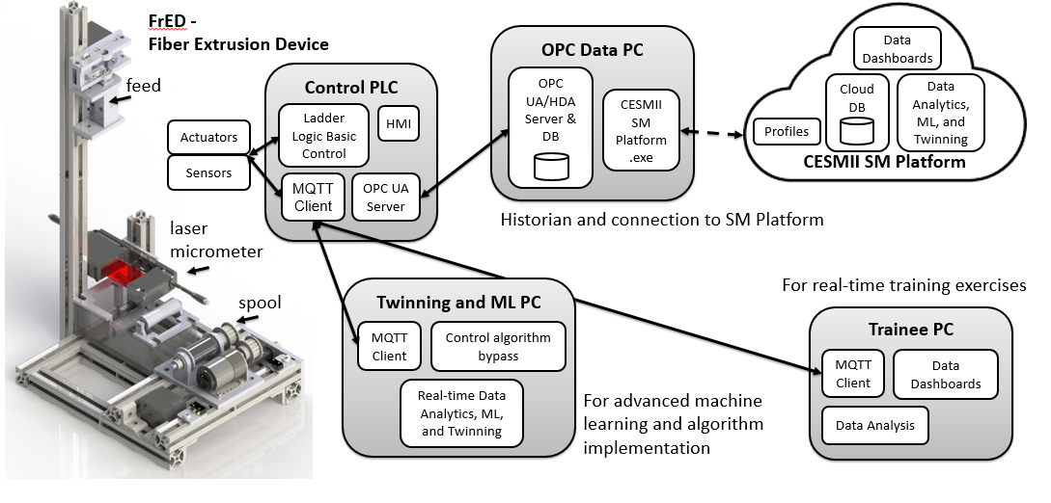


Factory 4.0 Educational Toolkit
Project Lead: Penn State
PROBLEM STATEMENT
Rapid pace of technology development has left educational systems scrambling to keep pace and adapt learning outcomes, resulting in inadequate preparedness and readiness of workforce at all levels
PROJECT GOAL
To develop an instrumented bench scale extrusion kit and platform that can be integrated into education modules (labs, projects, etc.)
POTENTIAL IMPACT
Immediate adoption of the tool kit in the state-wide programs.
Application to a broad range of engineering and other cross-discipline educational areas
Educational platform modules can be easily developed for K-12 students in rapid fashion CESMII member access to software with published code and algorithms.
Community driven extension to the software platform and educational modules for all levels of students.
Enable similar manufacturing facilities to evaluate and apply learning from this program into its operations

