Slide 1
Critical Materials
Helena Khazdozian, Technology Manager
Advanced Manufacturing Office
AMO Peer Review
June 2020 | Washington, DC
manufacturing.energy.gov

Slide 2
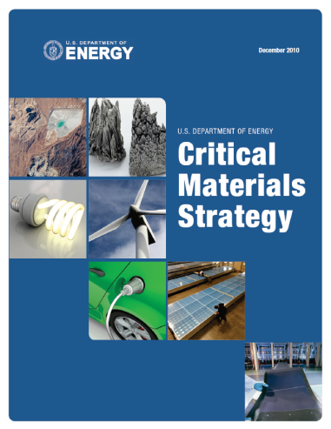
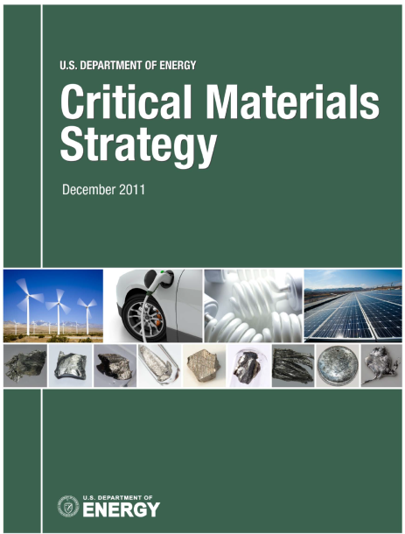
Technical Topic Background
White House Executive Order 13817, A Federal Strategy to Ensure Secure and Reliable Supplies of Critical Minerals, seeks to address strategic vulnerabilities in critical minerals supply chains
  Secretary of Interior, in coordination with executive branch agencies and offices, published list of critical minerals
  Secretary of Commerce, in coordination with executive branch agencies and offices, submitted a Federal Strategy
DOE conducts on-going assessments of material criticality across a range of energy technologies based on importance to energy and potential for supply risk to inform its R&D prioritization
DOE Critical Materials Priorities:
  Diversifying supply – including domestic production and processing
  Developing substitutes
  Driving recycling, reuse, and more efficient use
DOE coordinates strategic research priorities across the Department and identifies potential cross-cutting opportunities in both basic and applied science and technology

Slide 3
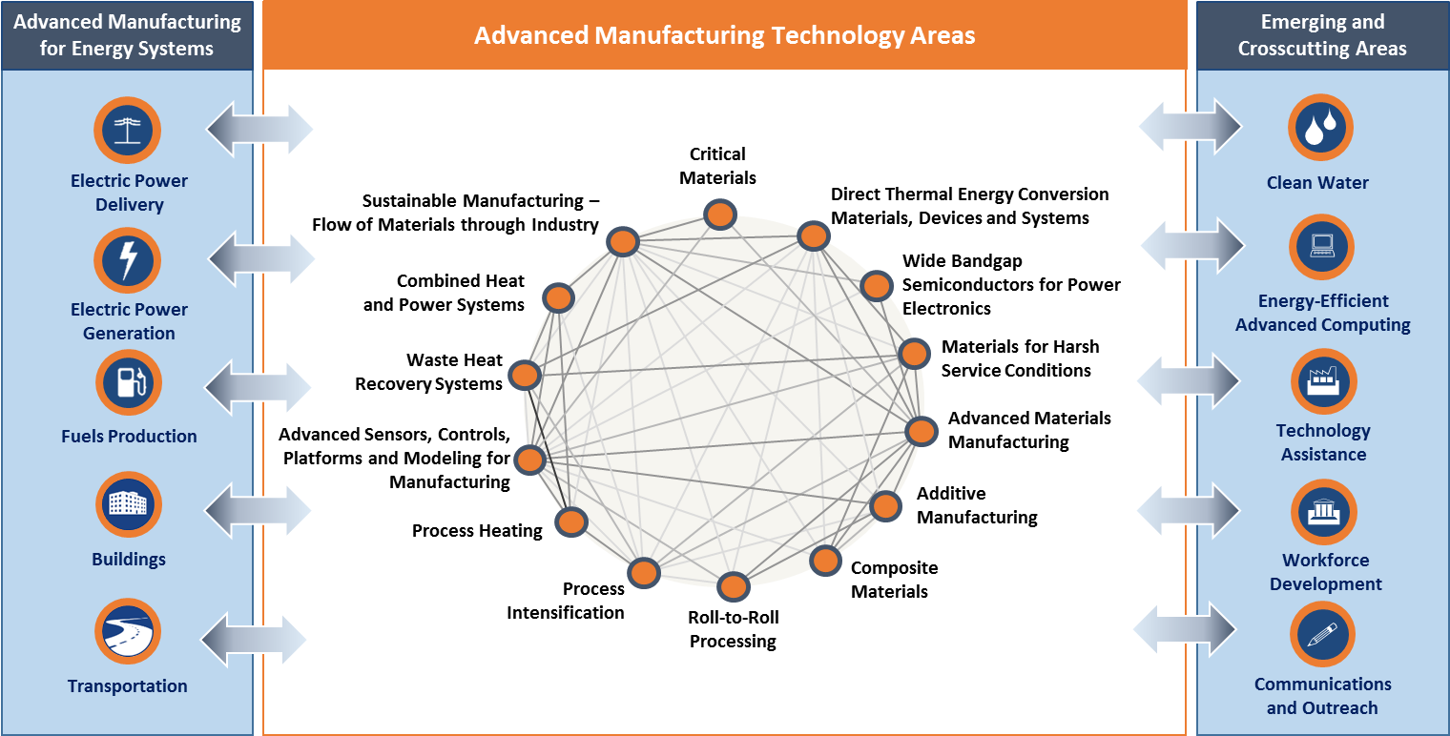
Technical Topic Background
Key critical material supply chains for AMO
  Rare earth elements for permanent magnets for electric machines
  Cobalt and lithium for electric vehicle batteries and grid storage
  Gallium for LEDs and power electronics

Slide 4
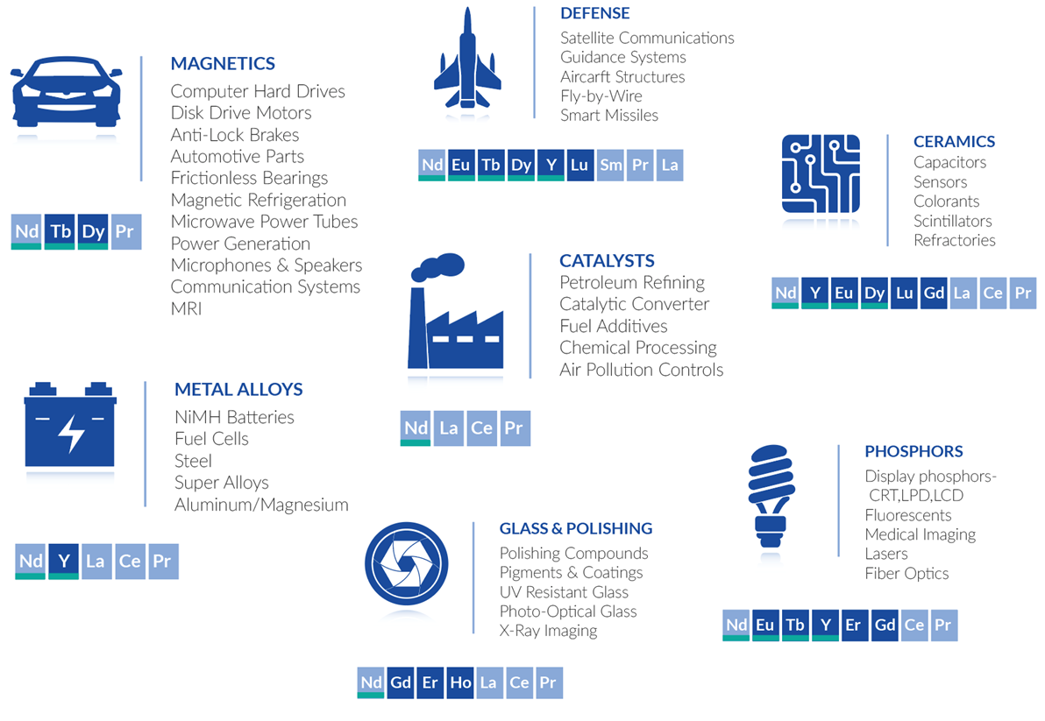
Rare Earth Element Applications

Slide 5
Technical Topic Challenges and Barriers
Critical Minerals Rare Earths Supply Chain Roundtable & Workshop held Oct. 31 – Nov. 1, 2019
Diversifying
Supply
Developing Substitutes
Reuse &
Recycling
Market volatility and uncertainty
Thin profit margins
Mining & Concentration
Separation
Conversion to Metals
Refining & Alloying
Fabrication
Part Manufacturing
Sub-Assembly Manufacturing
System Integration
Intellectual property
Technology validation and transfer
Permitting
Environmental stewardship
Rare earths balance problem
Manufacturers several steps removed from supply chain issues on both sides
Cross-cutting challenges: collection barriers for recycling; workforce development

Slide 6
Technical Topic Objectives and Targets
OBJECTIVE
Advance technology solutions that enable the increased and consistent availability of materials essential to energy applications by diversifying the supply, developing cost effective substitutes, and improving reuse and recycling of critical and near-critical materials.
TARGETS
Develop processing technologies for neodymium and other critical materials needed to meet U.S. energy requirements.
Develop a new phosphor that requires one-tenth critical rare earth elements compared to current fluorescent lamp phosphors
Develop substitute materials for rare earth permanent magnets that exhibit properties similar to current magnets, but contain one-tenth rare earth/critical materials compared to 2015 state-of-the-art materials
Recover and recycle materials from end-of-life (EOL) products and manufacturing waste to increase domestic availability of critical materials for energy technologies by 20%.

Slide 7

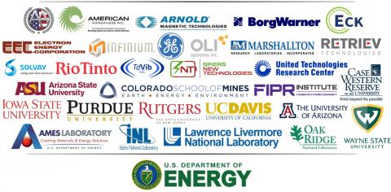
Led by Ames Laboratory
Started operations in 2013
DOE appropriated funds for CMI in FY12-20
Currently in Year 7 (Year 8 starts July 1)
Current appropriations will fund operations through June 2021
Diversifying Supply
Developing Substitutes
Driving Reuse & Recycling
Crosscutting Research
Expanded Sources
Energy Storage Systems
Enabling Science
Magnets with Reduced RE Content
Transformational Processing
Enabling & Optimizing Co-Production
Environmental Sustainability
New Uses for
Co-Products
Supply Chain & Economic Analysis
Electric Machines

Slide 8
CMI Capabilities: Aligned with Supply Chain Needs
Mining & Concentration
Extraction & Refining
Chemical & Metallurgical Processing
Refining & Alloying
Fabrication
Part Manufacturing
Sub-Assembly Manufacturing
System Integration
Recycling
DOE NATIONAL LABORATORIES
ORNL (separations, magnet material)
INL (integrated test bed)
INL (project road mapping)
LLNL (advanced materials & manufacturing)
Ames (materials discovery, recycling)
UNIVERSITIES
CSM (separation, alloying, recycling)
Economics & criticality assessments
UC Davis (material discovery)
Rutgers (thermodynamics)
Purdue University (project road mapping, techno-economic analysis)
CORPORATIONS
American Manganese
Retriev
Mercury Marine
Rio Tinto
United Technologies
All American Lithium
Infinium
Spiers New Technologies
Marshallton
Solvay
Eck Industries
BorgWarner
OLI
Electron Energy Corporation
Arnold Magnetics
Td VIC LLC

Slide 9
Technical Topic Current Portfolio
Critical Materials Institute (CMI), $25M per year as directed by Congress
Energy Storage Cross-Cut
  FY19 selections – battery cathode materials
  Strategic Analysis: Battery recycling case studies
  LEEP innovator, NUMix Materials: metal recovery from end-of-life batteries
  Lithium-ion Battery Recycling Prize
SBIR/STTR and Technology Commercialization Fund projects to advance technologies beyond the lab, including two CMI patented technologies
$30M planned for FY20 Funding Opportunity Announcement
  Field validation and demonstration
  Next-generation technologies
  $5M Congressional direction for lithium R&D Center
Critical Materials in AMO
CMI
Analysis
LEEP
Battery Prize
SBIR,
TCF
R&D Projects
Diversifying
Supply
Developing Substitutes
Reuse &
Recycling
Notes:
Electronic component material analysis; supply chain issues inclusive of critical materials but also broader than critical materials.

Slide 10
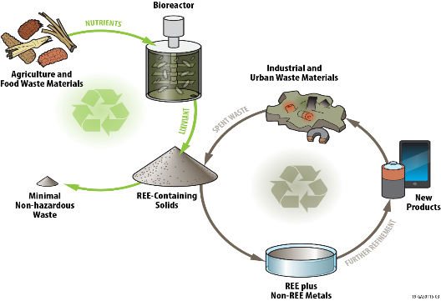
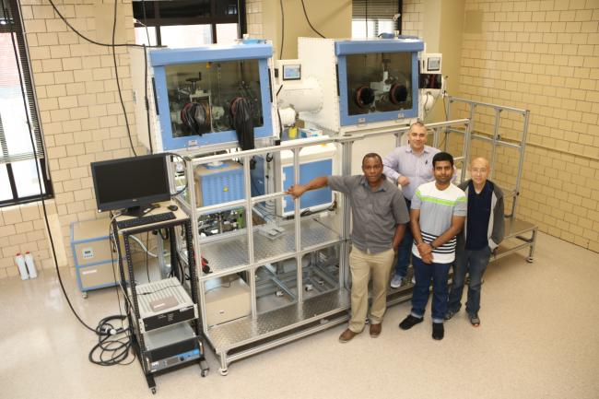
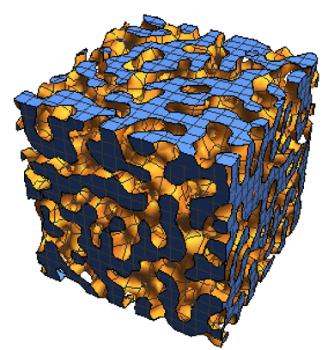
Technical Topic Accomplishments/Successes
Diversifying Supply: Transformational Processing
Demonstrated improved separation of adjacent lanthanides for industrial process (solvent extraction)
Has the potential to reduce chemical and physical footprint and reduce CAPEX
Mining & Concentration
Extraction
Separation
Recycling & Reuse: Biomaterials
Leverages agricultural wastes as microbrial substrate
Recovers effectively from diverse resources using parameters (e.g. pH) that allow for industry adoption
Conversion to Metals
Refining & Alloying
Recycling
Developing Substitutes: Magnet Maturation
Controlled Atmospheric Materials Processing System
Maturation of magnet materials and fabrication routes to demonstrate manufacturability
Fabrication
Part Manufacturing
Sub-Assembly Manufacturing
Crosscutting R&D: Machine Learning (ML) Tools
Developed deep learning toolkit for predicting 3D microstructure evolution
ML simulations can lower computational costs, reducing from 7 hours to 15 seconds!
System Integration

Slide 11
CMI Current Project Portfolio

Slide 12
Technical Topic Accomplishments/Successes
CMI has completed or made significant process towards meeting MYPP targets
 | MYPP Target | Fiscal Year | Current AMO Activity* | Current Status (2018)
 |  |  |  | 2015 Baseline | Progress to Date
1.1 | Develop processing technologies for neodymium and other critical materials needed to meet U.S. energy requirements. | 2023 | CMI | No Nd is currently produced in the U.S. | 9 patent applications 1 patent issued 5 licensed technologies
1.2 | Develop a new phosphor that requires one-tenth critical rare earth elements compared to current fluorescent lamp phosphors. | 2020 | CMI | Phosphors consume 250 REE tonnes/year, including europium, terbium, yttrium, and lanthanum | 1 patent application submitted 2 patents issued 1 licensed technology
1.3 | Develop substitute materials for rare earth permanent magnets that exhibit properties similar to current magnets, but contain one-tenth rare earth/critical materials compared to 2015 state-of-the-art materials. | 2023 | CMI, R&D Project | Typical REE magnets contain~25% Nd (by mass) with a typical energy product range of 25-50 MGOe | 2 patent applications submitted 1 patent issued 4 licensed technologies
1.4 | Recover and recycle materials from end-of-life (EOL) products and manufacturing waste to increase domestic availability of critical materials for energy technologies by 20%. | 2023 | CMI | <1% of EOL REE are recycled | 8 patent applications submitted 2 patents issued 6 licensed technologies

Slide 13
Technical Topic Collaborations
DOE has taken a leadership role in critical materials across the Federal landscape
AMO has had a sustained leadership role within DOE and across the US Government
  AMO co-chairs an interagency body to lead implementation of the Federal Strategy with USGS and White House Office of Science & Technology Policy
    AMO co-leads with DOD on implementation of innovation R&D
DOE Coordination
  AMO co-chairs a working group to coordinate R&D across DOE, which reports to DOE senior leadership
  Funding Opportunity Announcements have been coordinated with DOE program offices: Office of Fossil Energy, Basic Energy Sciences – Office of Science, ARPA-E
  AMO co-chairs working groups for international R&D coordination and collaboration
EERE Coordination
  Lithium-ion Battery Recycling Prize (led by Vehicle Technologies Office)
  Battery critical materials with Geothermal Technologies Office and Vehicles Technologies Office
  Aluminum-cerium coordination within AMO and with the Vehicle Technologies Office

Slide 14
AMO Technical Topic Team
CMI
Analysis
LEEP
Battery Prize
SBIR,
TCF
R&D Projects
Brian Valentine
Tina Kaarsburg
Joe Cresko
Mike McKittrick
Diana Bauer
Helena Khazdozian
Bob Gemmer
Joe Cresko
THANK YOU!

