Slide 1
High Performance Computing for Manufacturing
HPC4Mfg
Bob Gemmer, Technology Manager
Advanced Manufacturing Office
AMO Peer Review
June 2020 | Washington, DC
manufacturing.energy.gov

Slide 2
Background
The National Laboratory Complex has some of the fastest computers in the world!
  Capabilities developed over the years for:
    Nuclear weapons development
    Fundamental science investigations
  But what about applied research and development?
High Performance Computing for Manufacturing Initiated in 2015
  Goals:
    Use the National Laboratory HPC capabilities to
      Help industry meet the objectives and mission of AMO
      Facilitate innovation by short-circuiting traditional trial and error experimentation
    Encourage the adoption of computational tools by American industry

Slide 3
Role of HPC4Mfg in the AMO MYPP
HPC

Slide 4
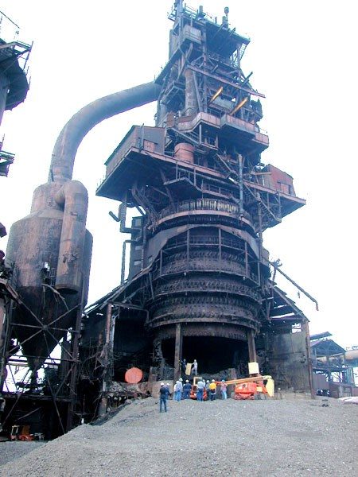
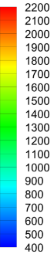
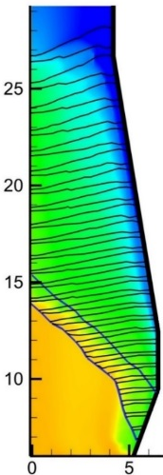
Challenges and a Solution
Industry is lagging in adoption of High Performance Computing
  Industry has difficulty estimating the return on investment of computational capabilities and therefore is reluctant to invest in HPC computers
  Industry often does not have the talent needed for use with new computer architecture
  Industry often does not have the technical talent when going into new areas
HPC4Mfg Program issues solicitations to address industry needs
  Show what is possible with HPC through demonstration projects
    We match laboratory researchers with industry
  Encourage the adoption of HPC through follow-on projects
    Project duration: one to two years
  Build the HPC Manufacturing community
    Technical Colloquium webinars
    Student intern programs
    Industry Day
Gas Temp (K)
Gas Temp (K)

Slide 5
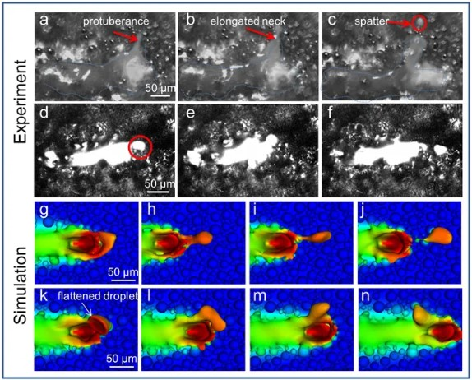
Program Approach
The solicitation topics directly align with AMO goals
  Broad impact on energy efficiency and/or productivity:
  Use HPC to overcome a key technical challenge needed to save energy
    Process optimization
    Advanced product design
    Predicting performance and failure rates
Results of this program can help companies justify computational expenditures
  Companies have trouble estimating ROI on difficult computational efforts
  Traditional experimental methods are more easily understood but problems remain
    Experiments are expensive and limit innovation
    Much of the “low hanging fruit” is already taken and next-generation innovations are not as obvious
    Challenge to step far out of a familiar box
  This program helps “buy down” risk of computational effort

Slide 6
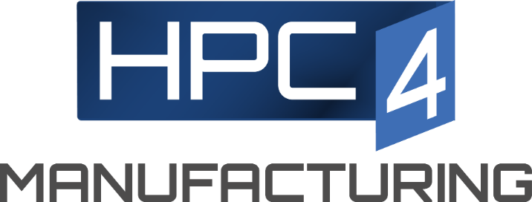
The HPC4Mfg Program is in steady state
March – September 2015
Launch program with seedling projects
Inaugural solicitation
Steady state
LLNL established the program
$1.5M: 5 seedling projects
Industry outreach
September 2015–March 2016
LBNL, ORNL join as partner labs
$3M solicitation: 10 demonstration projects to 8 companies
March 2016 on
Recent Budget | Recipient | DOE Funding
FY 2016 | LLNL | $5,200,000
FY2017 | LLNL | $5,200,000
FY2018 | LLNL | $5,200,000
FY2018 | LLNL | $5,200,000
FY202020 | LLNL | $3,200,000
 | ORNL | $1,000,000
 | NREL | $1,000,000
Solicitation twice a year
Demonstration/Capability projects
Summer internships
Workshops, Industry Engagement Day
Added participating laboratories: ANL, NREL, NETL, SNL, LANL, PNNL, Ames

Slide 7
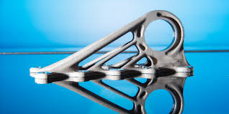
Change for FY 2020 - Three Solicitations
Round 9
  Fall ‘19 solicitation co-listed with HPC4Materials
  37 concept papers; 16 full proposals, 9 projects funded
Round 10
  Special Solicitation for US Manufacturing Institutes and AMO Consortia
  14 concept papers
Round 11
  Spring ‘20 solicitation
  Released May 5, 2020

Slide 8
SMSVC/Stelco + LLNL: Simulations to Explore New Blast Furnace Operating Conditions and Reduce Coke Usage
Project Description:
Reduce the rate of coke consumption in Stelco blast furnaces. Increase natural gas rate to replace the coke.
Experimental techniques to find optimal set points on a production blast furnace is too financially risky.
Replace experiments with models to find the set points for the new operating conditions.
Gas Temp (K)
Approach:
Run hundreds of computer simulations varying the natural gas injection rate, injection temperature, and amount of coke.
Examine simulation results to find stable operating conditions at higher natural gas injection rates.
Impact:
Simulations found furnace conditions that save 25 kg/thm of coke while maintaining stable operating temperatures.
This is expected to save 1.4 trillion BTU/yr of energy in a blast furnace producing 6500 thm/day.
Stelco is now engaging with their engineers to design natural gas heater for one of their blast furnace.
Notes:
Thm: ton hot metal
Approach:
Trading natural gas for coke is a well-known approach to reduce the coke required in a blast furnace, however, this has the side effect of changing the temperature profile in the furnace. This limits the amount of coke that can be replaced with natural gas without leading to unstable furnace operation.
Figure:
Each dot on the plot represents the amount of coke consumed per ton of metal produced for a set of furnace operating conditions. For each NG injection rate the operating conditions were selected from dozens of simulations by varying all the other knobs and finding the most stable operating temperatures.
Impact
Stelco’s blast furnace of interest produces 6500 thm/day.
This will save 25*6500*365 = 60 million kg of coal coke per year.
Coal has an energy content of 24 MJ/kg.
Expected energy savings is 1400 TJ/yr for one blast furnace.

Slide 9
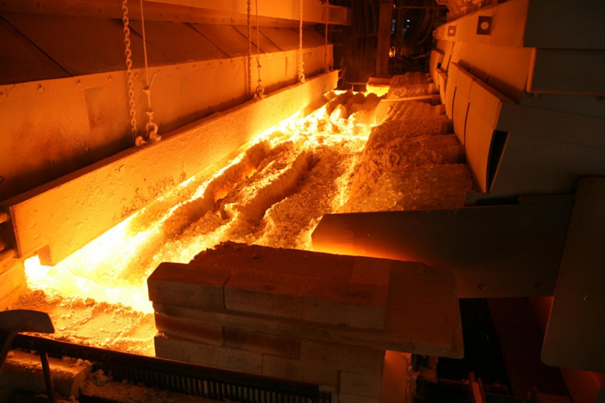
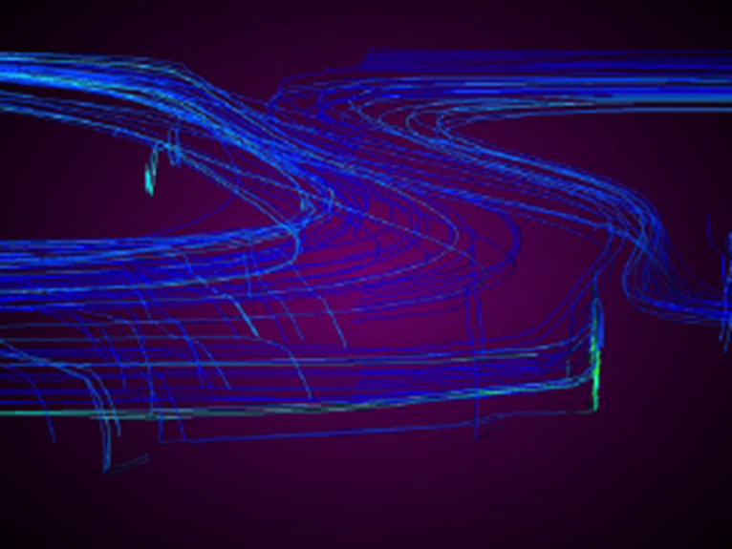
Vitro Flat Glass + LLNL: Advanced Machine Learning for Glass Furnace Model Enhancement
Project Description:
Flat glass for consumer products such as windows and doors are produced in large glass furnaces.
When furnace set-points drift, week-long computational approaches are used to calculate new furnace settings resulting in significant down-time, waste and energy costs.
Machine learning can emulate scientific modeling and incorporated into real-time process control systems
Approach
Machine Learning (ML) approaches were used to emulate the traditional models of a glass furnace in a new ML model.
The ML model can be run in real-time on a small computer rather than a week on a large computer.
Furnace sensor data was added to the ML model to increase the accuracy of the model.
Impact
The company is actively using this model to explore new furnace set-points.
Performing multiple experiments to find set points would be too financially risky in a production environment.
Similar models, if deployed across the glass industry, could reduce overall costs and energy usage by 3.5 trillion BTUs per year.
Notes:
Model cracking in fiber composites; build a tooling around material curing and fibers;; have a model for fibers that is heuristic based around cylinders; looking at directionality of fibers as they are laid out; will look at different models, boeing will build and compare experiement with simulation – seemed like a trial balloon for efforts toward a general software starting with a specific problem; have a good handle on what is and is not computational feasible; model is confidently laid out
Strengths – existing and feasible models and codes, made a good case for lightweight materials for energy savings; decreasing the manufacturing cost by having fewer failed parts
If they didn’t do this project would they still use composites to build airplanes – yes they would - so not all the savings in use of composites can be attributed to this project; so what is the incremental benefit that can be attributed to this project
Suresh dinged it because it is more like a academic proposal – a fishing expedition; no mention of materials they are going to focus on, how they will evaluate it’s good or bad; not specific enough
Surpised that Boeing can’t put any cash into this project – a very ambitious project because it’s not specific enough
Need HPC for this, because there are so many interfaces, but they didn’t articulate this very well
Had a good person from PNNL on the team
There is commerical code for this sort of modeling but Boeing didn’t mention it – DARPA funded an ICME program for composites - Scielo code
Can give them detailed feedback – encourage them to reconsider applying if they address the problems

Slide 10
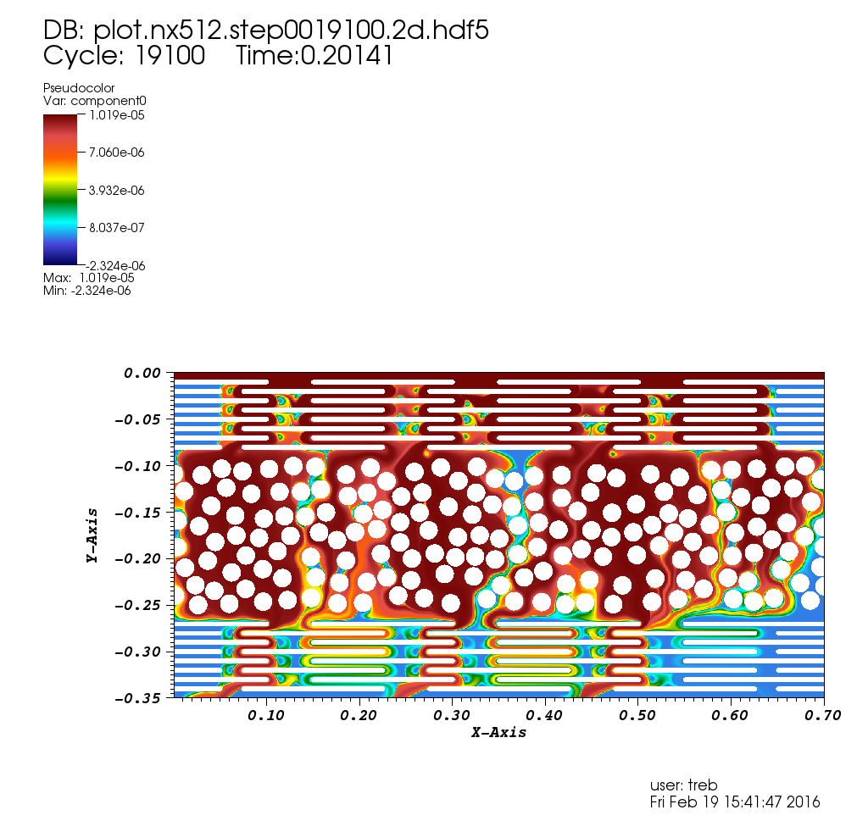
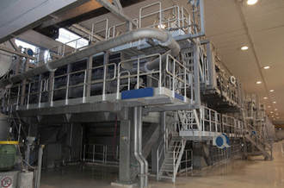
Agenda 2020 + LBNL + LLNL: A Model for Flow and Mechanical Deformation of the Porous Paper Web
Project Description:
Maximizing water removal can significantly reduce the energy-intensive drying process in paper-making.
A 10% improvement in solid content of the paper web entering dryer section will lead to 20% drying energy saving, or 80 trillion BTU/yr.
.
Pore-scale modeling of flow in realistic geometries obtained from felt image data is used to inform better parametrization of porosity and permeability for continuum-scale computations.
Approach:
Use HPC at LBNL & LLNL to develop an integrated, multi-physics modeling framework as a critical first step to understanding and reducing re-wet at the press section.
Examine simulation results to find the optimal conditions and geometries to reduce re-wetting, and thus the need for less drying, in paper making.
Impact:
Demonstrated complex flow simulation in a synthetic pore scale representation of image data.
Results show simulations are critical to understanding the permeability of the felt in the paper making process.
A consortium member of Agenda 2020 is now employing these results in their paper production line.
Notes:
Thm: ton hot metal
Approach:
Trading natural gas for coke is a well-known approach to reduce the coke required in a blast furnace, however, this has the side effect of changing the temperature profile in the furnace. This limits the amount of coke that can be replaced with natural gas without leading to unstable furnace operation.
Figure:
Each dot on the plot represents the amount of coke consumed per ton of metal produced for a set of furnace operating conditions. For each NG injection rate the operating conditions were selected from dozens of simulations by varying all the other knobs and finding the most stable operating temperatures.
Impact
Stelco’s blast furnace of interest produces 6500 thm/day.
This will save 25*6500*365 = 60 million kg of coal coke per year.
Coal has an energy content of 24 MJ/kg.
Expected energy savings is 1400 TJ/yr for one blast furnace.

Slide 11
Seurat Technologies + LLNL: Accelerate Development of Fast Metal Additively Manufacture Technology
Project Description:
Significantly reducing the time required to print an additively manufactured metal part will decrease production costs and increase technology adoption.
Using wide area imaging rather than narrow laser beams to melt metal reduces process time.
Reduce the defect generation rate in this new technology.
Approach:
Use computer simulations to identify process changes to reduced defects and improve density.
Use advanced multiphysics techniques to model the melting of the metals by the incident radiation.
Impact:
Simulation work led to a change the powder size which led to significantly reduced defects and improved density.
Additively manufactured parts are often half the weight of traditional parts.
Substantial fuel savings will be realized by aerospace and automotive transportation lightweighting
Notes:
Startup Seurat plans to introduce advanced, industrial metal additive manufacturing.
Evaluate Business Need
The company’s lasers are considered large for the industry, to melt relatively large areas (postage stamp sized) of metal powder simultaneously for additively manufacturing parts in a powder bed fusion process.
Seurat’s goal is to speed their metal additive manufacturing process and achieve high metal density. Metal that is printed must be 99.99% as dense as traditionally-manufactured metal. Mechanical properties suffer at 99.5% density.
Improve Process
Our scope was to determine the mechanisms of defect (pore) formation during the pulsed, laser melting of metal powders to achieve higher densities.
Simulations of the initial process revealed pits and areas that wouldn’t completely melt.
With HPC resources, we simulated situations in which density would increase. Results indicated the direction to take to improve the process.
Ultimately, changing powder size, yielded improved density with ideal layers and complete melting.
We used high speed imaging of the process to see that the physics in the simulation matched the experiment.
Refine and Launch
The startup could now experiment more efficiently and effectively to fine tune its business offering.
Helping this startup succeed ultimately reduces energy use across the metal manufacturing industry because 1) Seurat’s lasers are inherently more efficient than typical lasers, and 2) metal additive manufacturing uses less energy than traditional manufacturing, which typically calls for material re-melting

Slide 12
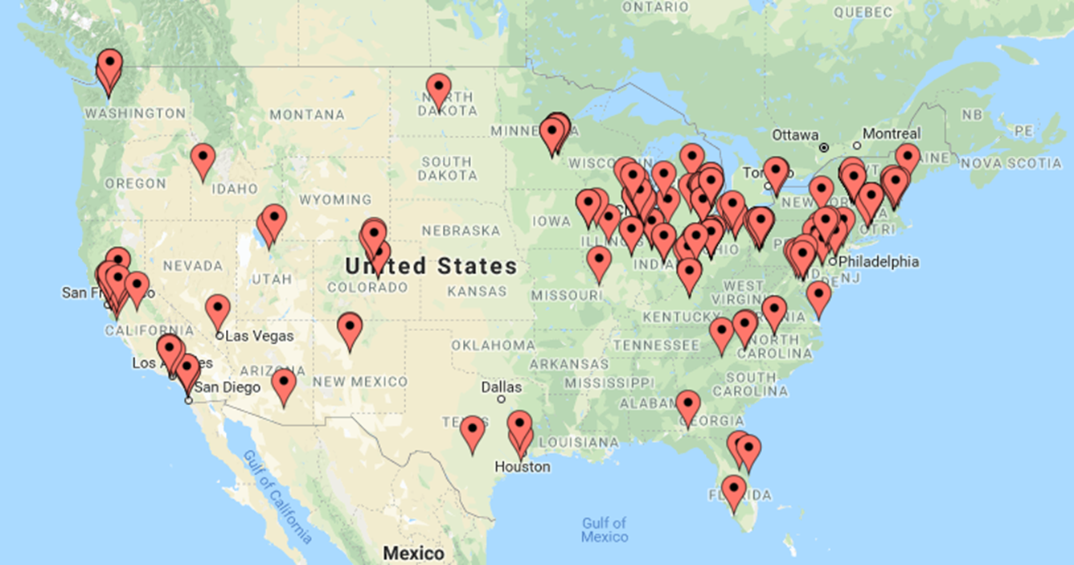
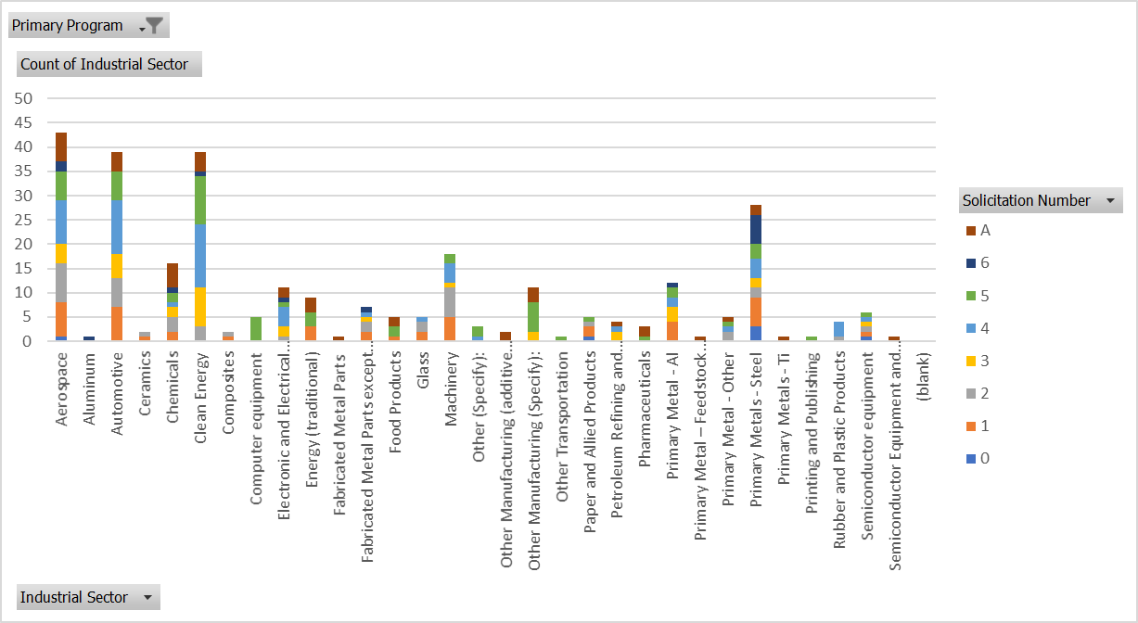
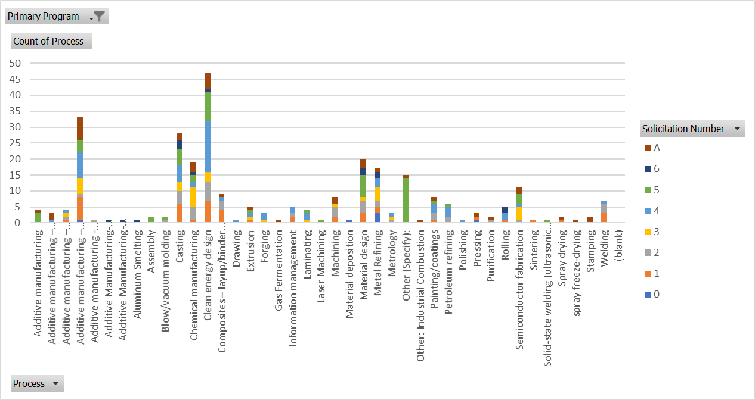
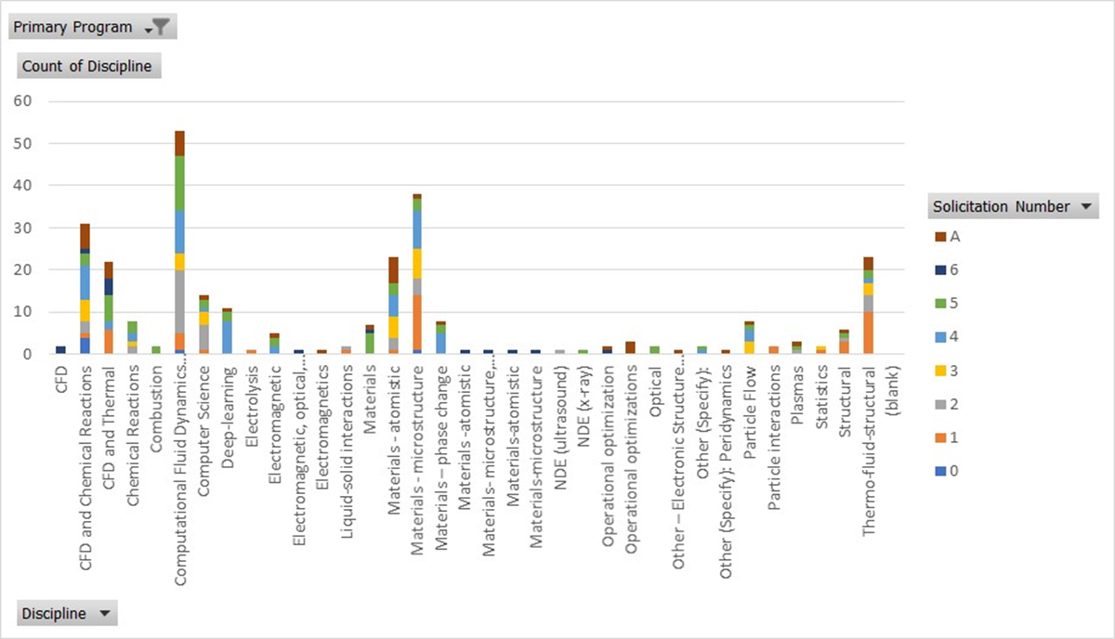
Concept paper participation has been diverse
Industries
Aerospace
Automotive
Clean Energy
Machinery
Steel
Processes
Additive Manufacturing
Casting
Chemicals
Metal Refining
Semi-conductor Fabrication
Disciplines
CFD
Atomistic Materials
Microstructure Materials
Thermo-fluid-structural

Slide 13
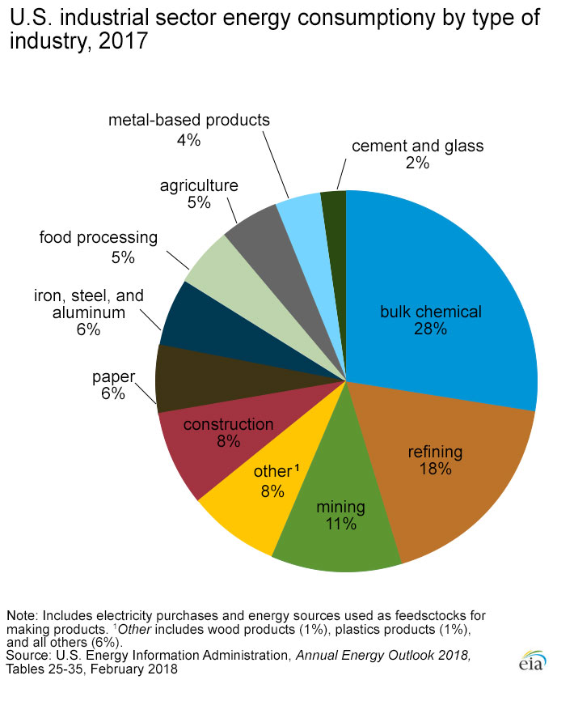
Large energy consuming industries

Slide 14

Technical Topic Collaborations
High Performance Computing for Energy Innovation
  HPC4Mobility
    EERE’s Vehicles Technology Office
  HPC4Materials
    Office of Fossil Energy

Slide 15
AMO HPC4MFG Team
Bob Gemmer
Jeremy Leong
Isaac Chan
A detailed presentation on the HPC Program is available on the Peer Review website
THANK YOU!

