Slide 1
Advanced Manufacturing at the US Department of Energy
2019 DOE IP Counsel Meeting
Valri Lightner, Advanced Manufacturing Office
manufacturing.energy.gov
September 10, 2019 | Washington, DC

Slide 2
Advanced Manufacturing -- Opportunity
Technology Innovation through Applied Research and Development in Advanced Manufacturing and Energy is a Foundation for Economic Growth and Jobs in the US
24 QBTU (25% of National Total) – Manufacturing
2/3 Manufacturing Energy is in Intensive Sectors
$2T Manufacturing GDP
12.4M Manufacturing Direct Employment Jobs
0.8 / 1.0 – Indirect / Direct Jobs - All Manufacturing
2.2 / 1.0 – Indirect / Direct Jobs - Advanced Sub-Sectors

Slide 3
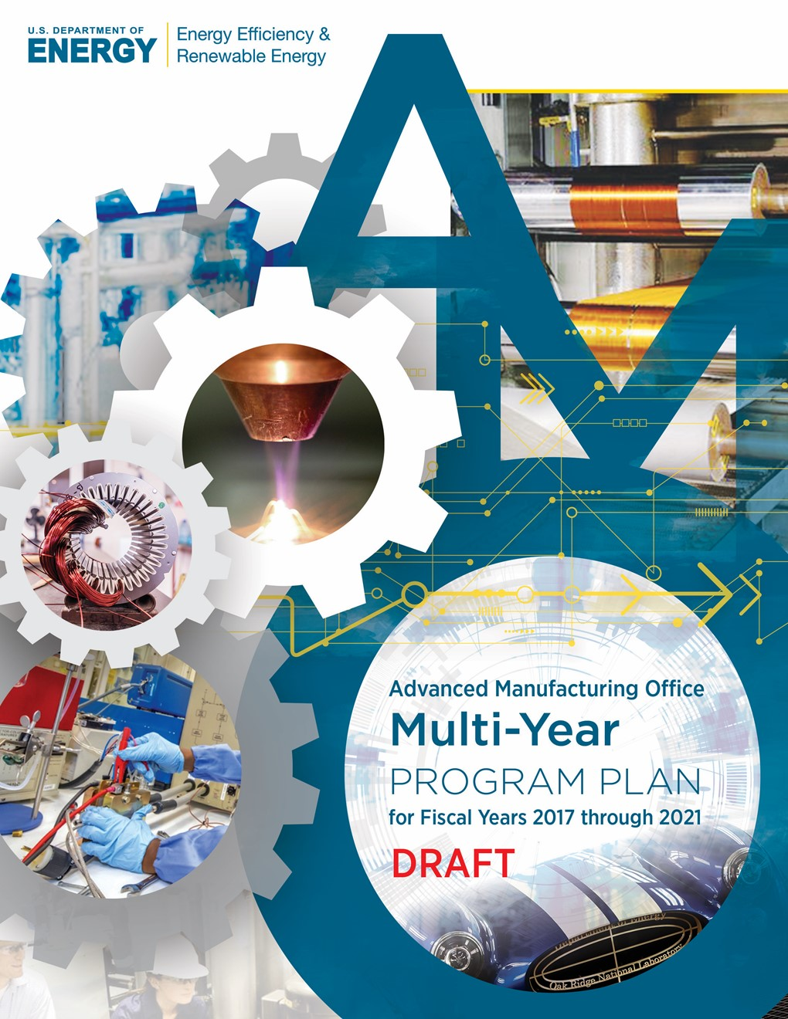
AMO Vision and Mission
VISION: U.S. global leadership in sustainable and efficient manufacturing for a growing and competitive economy.
MISSION: Catalyze research, development and adoption of energy-related advanced manufacturing technologies and practices to drive U.S. economic competitiveness and energy productivity.
MULTI-YEAR PROGRAM PLAN:
Describes the Office mission, vision, and goals
Identifies the technology, outreach, and crosscutting activities the Office plans to focus on over the next five years.
3

Slide 4
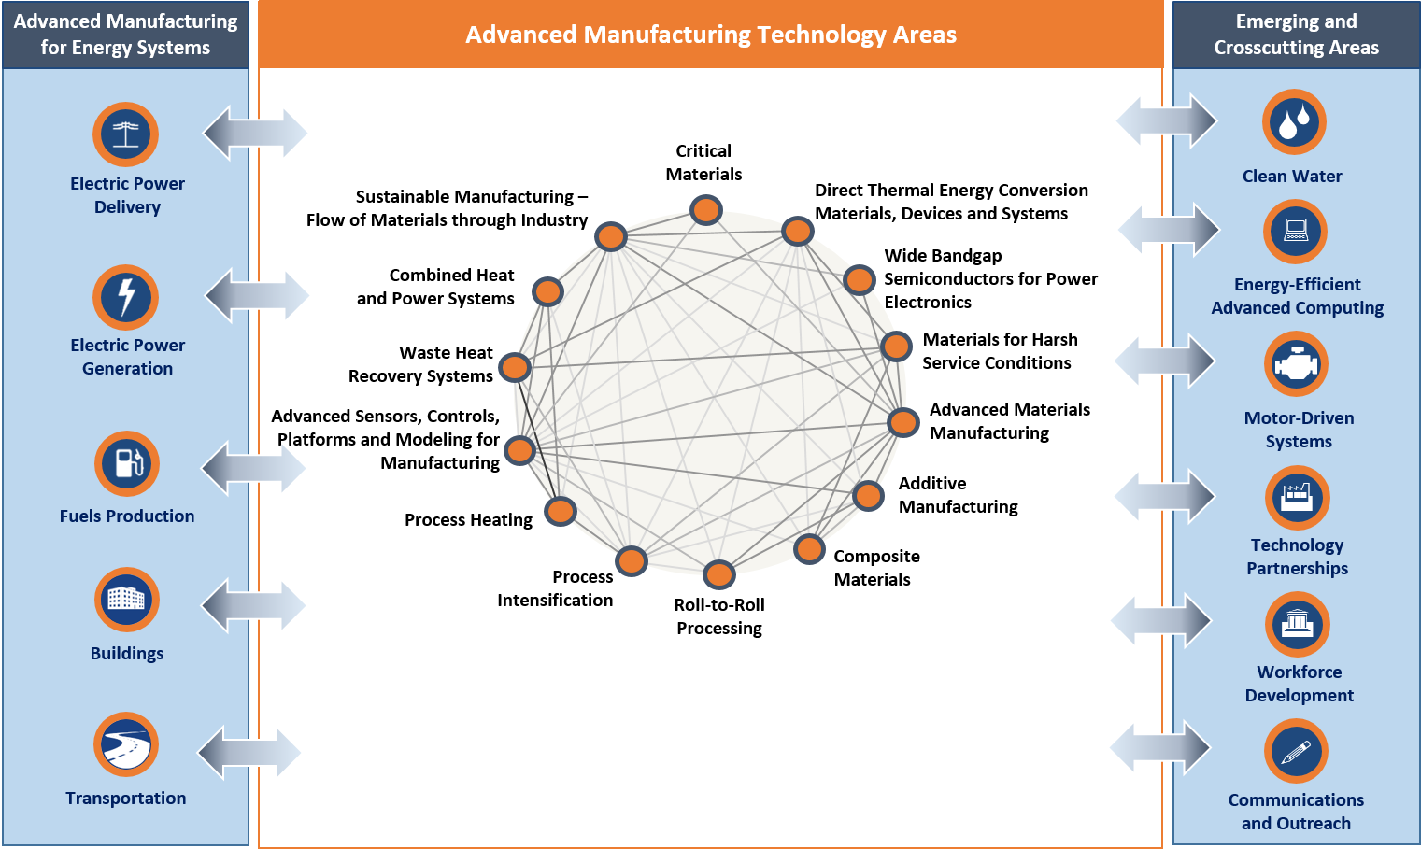
AMO Multi-Year Program Plan (MYPP) Framework
4

Slide 5
AMO Success Indicators
Validate selected advanced manufacturing technologies and deploy practices that increase the rate of energy intensity improvement from business as usual (~1 % per year) to 2.5% per year.
Advance materials and manufacturing technologies with the potential to reduce lifecycle energy by 50% by 2025 compared to the 2015 state-of-the-art.
Establish partnerships resulting in 30,000 U.S. manufacturing facilities implementing AMO-recognized energy management products, practices and measures by 2025.
Double supported technical education and training activities in advanced manufacturing made available for private entities, universities, community colleges, and high schools by 2025.

Slide 6
AMO: Three complementary strategies
R&D Projects: Bridging the innovation gap
Research and Development Projects to support innovative manufacturing processes and next-generation materials
R&D Consortia: Public-Private consortia model
R&D Consortia offer affordable access to physical and virtual tools, and expertise, to foster innovation and adoption of promising technologies
Technical Assistance: Direct engagement with Industry
Driving a culture of continuous improvement and wide scale adoption of proven technologies, such as CHP, to reduce energy use in the manufacturing sector

Slide 7
Current/Upcoming FOAs
Desalination Hub
Status: Announcement expected in Fall 2019.
To establish an Energy Innovation Hub focused on desalination technologies to accelerate transformational advances that reduce the energy and cost requirements of providing clean and safe water.
Cybersecurity in Energy Efficient Manufacturing
Status: FOA released on March 26, 2019; full applications due August 20.
AMO’s sixth Manufacturing Institute.
To establish a Clean Energy Manufacturing Institute focused on understanding the evolving cybersecurity threats to greater energy efficiency in manufacturing industries, developing new cybersecurity technologies and methods, and sharing information and knowledge to the broader community of U.S. manufacturers.
Multi-Topic FOA
Status: FOA released May 7,2019 ; full applications due September 5, 2019.
Focus on developing next-generation manufacturing material, information, and process technologies that improve energy efficiency in energy intensive and energy dependent processes, and facilitate the transition of emerging cost-competitive energy technologies to domestic production.
FOA covers 9 technical subtopic areas including support of congressionally directed technology development, such as: advanced drying technologies, design of materials and devices for harsh service conditions, process development of nanocrystalline metal alloys, and development of manufacturing processes to lower battery energy storage costs.
AMO anticipates funding between 20 and 50 projects with a total funding amount of nearly $89M (including $5M from VTO).

Slide 8
R&D Projects Highlights
High Performance Computing for Manufacturing
Unites the world-class computing resources and expertise of Department of Energy national laboratories with U.S. manufacturers to deliver solutions that could revolutionize manufacturing.
Competitively selected projects apply modeling, simulation, and data analysis to industrial processes and products to lower production costs and shorten the time to market.
Currently in its 5th year, with two project solicitations per year, the program receives approximately $5M to 6M annually.¹
Over 30 projects of the nearly 67 projects funded to date are completed.
Lab-Embedded Entrepreneurship Program
AMO supports the Cyclotron Rd (LBNL), Innovation Crossroads (ORNL), and Chain Reactions (ANL) programs that embed budding entrepreneurs with energy technology prototypes at national labs for a two-year post-doctoral fellowship to develop their startups and technologies.
Program is designed to leverage the strengths and capabilities within each regional innovation ecosystem and provide innovators with access to state-of-the-art facilities and technical expertise within the National Lab network.
Currently in its 5th year, with one solicitation per year, the program currently receives approximately $8M annually. Next solicitation for cohorts is tentatively scheduled to be released in Fall 2019.
Flexible Combined Heat and Power Systems R&D
AMO selected 7 projects worth $9.3M in Fall 2018 to support research and development of technologies that enable small-to-midsize manufacturers to use combined heat and power (CHP) systems to provide services to the electric grid. Successful development of these technologies will allow:
Manufacturers to receive revenue from grid services providing attractive return on CHP investment.
Grid operators to receive cost-effective access to dispatchable generating capacity and frequency regulation.

Slide 9
R&D Consortia Highlights
Manufacturing Demonstration Facility
Open-door facility at Oak Ridge that helps industry adopt new additive manufacturing technologies to lower production cost, and create new products.¹
Critical Materials Institute
Energy Innovation Hub focused on technologies that improve processing and separations, develop substitutes and improving recycling of energy technology materials that are subject to supply disruptions.²
Currently in second 5-year phase (up to $125M per 5 year phase, pending appropriations).
Manufacturing Institutes
Manufacturing Institute Model
create an innovation ecosystem that accelerates technology development and facilitates the transfer of innovative advanced manufacturing technology to U.S industry;
provide shared research facilities to small manufacturers;
develop advanced manufacturing workforce skills; and
catalyze ($70 million federal investment) initial collaboration and then after 5 years transition to a privately-sustained model.
5 existing Institutes – PowerAmerica (wide band gap materials), IACMI (carbon fiber composites), CESMII (smart manufacturing), RAPID (chemical process intensification), REMADE (recycling and remanufacturing).
PowerAmerica (DOE’s first Institute) is transitioning to a privately-funded model.
FOA applications for Cybersecurity in Energy Efficient Manufacturing Institute are due August 20, 2019.
1. https://web.ornl.gov/sci/manufacturing/mdf/
2. https://cmi.ameslab.gov/

Slide 10
Technical Assistance Highlights
Better Plants
Voluntary program recognizes industrial partners for setting and achieving long-term energy efficiency goals (e.g. 25% energy intensity reduction over 10 years), enables information-sharing of energy-saving solutions, and facilitates field validation and adoption of energy-saving technologies.
Technical account managers help companies develop energy management plans, identify energy-saving opportunities, and track energy performance metrics.
221 Partners with over 3200 facilities have recorded $6.7B in cumulative energy savings since 2009.
Industrial Assessment Centers (IACs)
Currently a network of 28 university-based centers, led by professors and staffed by engineering students.
Program trains the next generation of energy engineers to assist small and medium sized manufacturers improve energy efficiency, productivity and competitiveness.
Teams perform in-person energy efficiency, productivity improvement, waste and water use reduction, and cybersecurity vulnerability assessments for small and medium-sized manufacturers.
Three (3) additional extension centers are expected to be operational by the end of the fiscal year to support manufacturers in relatively underserved regions.
Combined Heat and Power (CHP)
Promotes and assists in transforming the market for CHP, waste heat to power, microgrids, and district energy (DE)*, while also supporting CHP as a solution for critical infrastructure resiliency planning at the state, local, and utility levels. Twenty profiles detail accomplishments in using CHP/DE in resilience planning.
Free online decision tool supports CHP cost/benefit analysis, optimization of potential CHP systems, and general education and awareness.
* CHP and district energy are overlapping technical areas, as CHP systems can be key elements of a district energy system.

Slide 11
Thank You
For additional information:
energy.gov/eere/amo/advanced-manufacturing-office

