Slide 1
2017 Wind Technologies Market Report: Summary
Ryan Wiser & Mark Bolinger, Lawrence Berkeley National Laboratory
August 2018

Slide 2
2017 Wind Technologies Market Report
Purpose, Scope, and Data:
  Publicly available annual report summarizing key trends in the U.S. wind power market, with a focus on 2017
  Scope focuses on land-based wind turbines over 100 kW
  Separate DOE-funded reports on distributed and offshore wind
  Data sources include EIA, FERC, SEC, AWEA, etc. (see full report)
Report Authors:
  Primary authors: Ryan Wiser and Mark Bolinger, Berkeley Lab
  Contributions from others at Berkeley Lab, Exeter Associates, National Renewable Energy Laboratory
Funded by: U.S. DOE Wind Energy Technologies Office
Available at: http://energy.gov/windreport

Slide 3
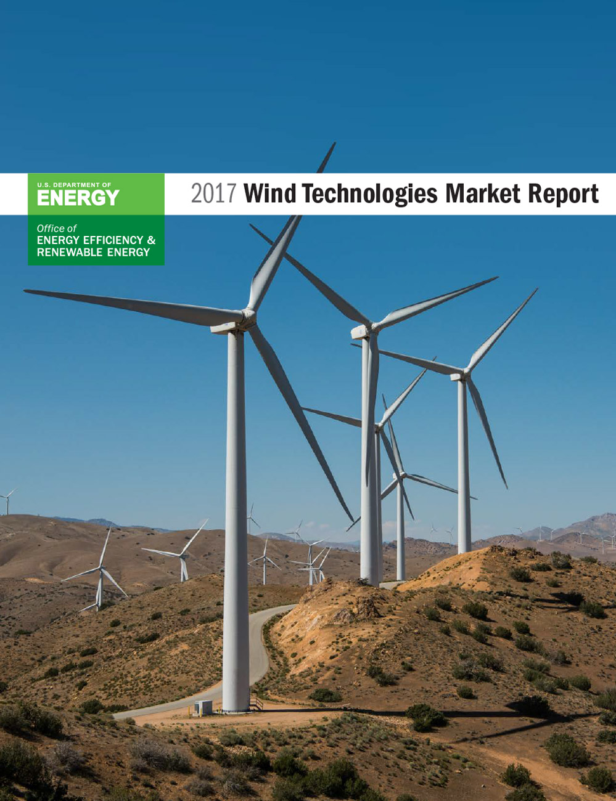
Report Contents
Installation trends
Industry trends
Technology trends
Performance trends
Cost trends
Wind power price trends
Policy & market drivers
Future outlook

Slide 4
Key Findings
Wind capacity additions continued at a rapid pace in 2017, with significant additional new builds anticipated over next three years in part due to PTC
Wind has been a significant source of new electric generation capacity additions in the U.S. in recent years
Supply chain is diverse and multifaceted, with strong domestic content for nacelle assembly, towers, and blades
Turbine scaling is significantly boosting wind project performance, while the installed cost of wind projects has declined
Wind power sales prices are at all-time lows, enabling economic competitiveness (with the PTC) despite low natural gas prices
Growth beyond current PTC cycle remains uncertain: could be blunted by declining federal tax support, expectations for low natural gas prices and solar costs, and modest electricity demand growth
Notes:
4

Slide 5
Installation Trends

Slide 6
Wind Power Additions Continued at a Rapid Pace in 2017, with 7,017 MW of New Capacity, Bringing the Total to 88,973 MW
$11 billion invested in wind power project additions in 2017
Over 80% of new 2017 capacity located in the Interior region
Partial repowering trend: 2,131 MW of existing plants retrofitted w/ longer blades

Slide 7
Wind Power Represented 25% of Electric-Generating Capacity Additions in 2017, Behind Solar and Natural Gas
Over the last decade, wind has comprised 30% of capacity additions nationwide, and a much higher proportion in some regions

Slide 8
Globally, the U.S. Placed 2nd in Annual Wind Power Capacity Additions in 2017, and in Cumulative Wind Power Capacity
U.S. also remains a distant second to China in cumulative capacity
Global wind additions in 2017 were below the 54,600 MW added in 2016 and the record level of 63,000 MW added in 2015

Slide 9
The United States is Lagging Other Countries in Wind as a Percentage of Electricity Consumption
Note: Figure only includes the countries with the most installed wind power capacity at the end of 2017

Slide 10
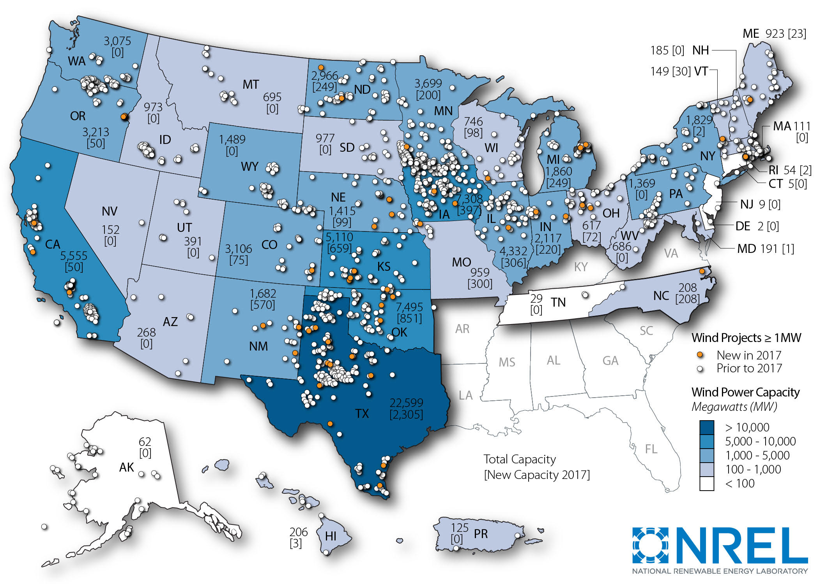
The Geographic Spread of Wind Power Projects Across the United States Is Broad, with the Exception of the Southeast
Note: Numbers within states represent cumulative installed wind capacity and, in brackets, annual additions in 2017
Notes:
10

Slide 11
Texas Installed the Most Wind Power Capacity in 2017; 14 States Exceed 10% Wind Energy, 4 States Exceed 30%
2017 Wind Penetration by ISO: SPP: 23.2%; ERCOT: 17.4%; MISO: 7.7%; CAISO: 6.0%; NYISO: 2.7%; PJM: 2.7%; ISO-NE: 2.6%
Notes:
11

Slide 12
A Record Level of Wind Power Capacity Entered Transmission Interconnection Queues in 2017; Solar and Storage Also Growing
Note: Not all of this capacity will be built
AWEA reports 33 GW of capacity under construction or in advanced development at end of 1Q2018

Slide 13
Larger Amounts of Wind Power Capacity Planned for Southwest Power Pool, Midwest, Texas, and Mountain Regions
Note: Not all of this capacity will be built

Slide 14
Industry Trends

Slide 15
Vestas, GE and Siemens-Gamesa Captured 88% of the U.S. Market in 2017
Globally, Vestas, Siemens Gamesa, Goldwind and GE were the top suppliers of wind turbines for land-based applications
Chinese suppliers occupied 4 of the top 10 spots in the global ranking, based primarily on sales within their domestic market

Slide 16
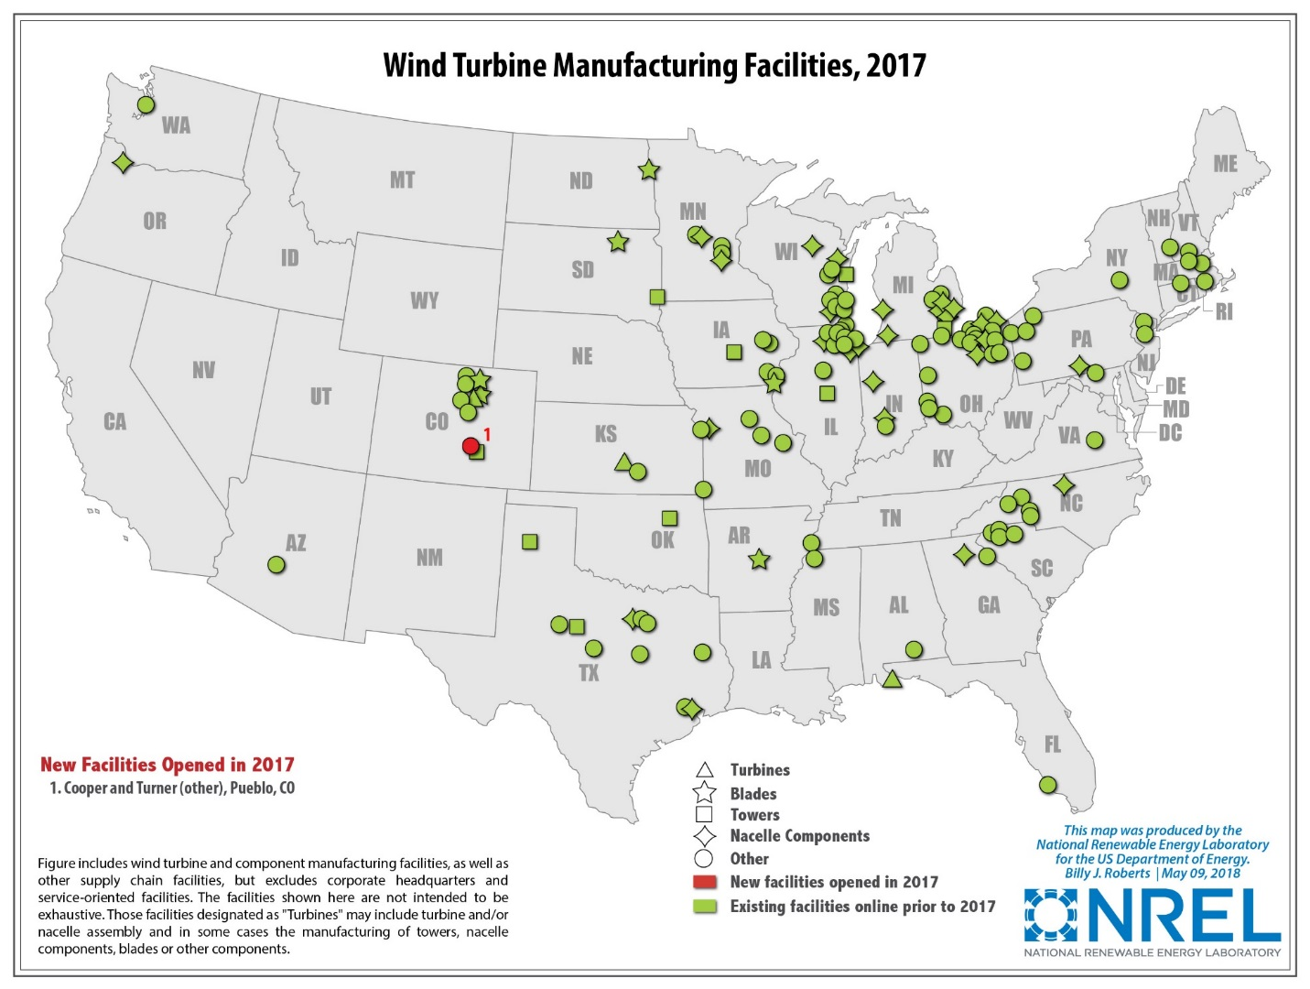
The Domestic Supply Chain for Wind Equipment is Diverse
Some manufacturers increased the size of their U.S. workforce in 2017 and/or expanded existing facilities, but expectations for significant long-term supply-chain expansion has become less optimistic
Continued near-term expected growth, but strong competitive pressures and expected reduced demand as PTC is phased out
At least three domestic manufacturing facility closures in 2017; one opening
Many manufacturers remain; three largest OEMs serving U.S. market all have at least one U.S. facility
Wind-related jobs reached a new all-time high, at 105,500
Note: map not intended to be exhaustive

Slide 17
Domestic Manufacturing Capability for Nacelle Assembly, Towers, & Blades Reasonably Well Balanced Against Historical Demand

Slide 18
Turbine OEM Profitability Has Generally Been Strong in Recent Years, Compared to Near Breakeven from 2011 through 2013

Slide 19
Imports of Wind Equipment into the United States Are Sizable; Exports Remained Low in 2017
Notes: Figure only includes tracked trade categories; misses other wind-related imports; see full report for the assumptions used to generate this figure
U.S. is net importer of wind equipment
Exports of wind-powered generating sets = $60 million in 2017
No ability to track other wind-specific exports, but total ‘tower and lattice mast’ exports equaled $39 million
Notes:
19

Slide 20
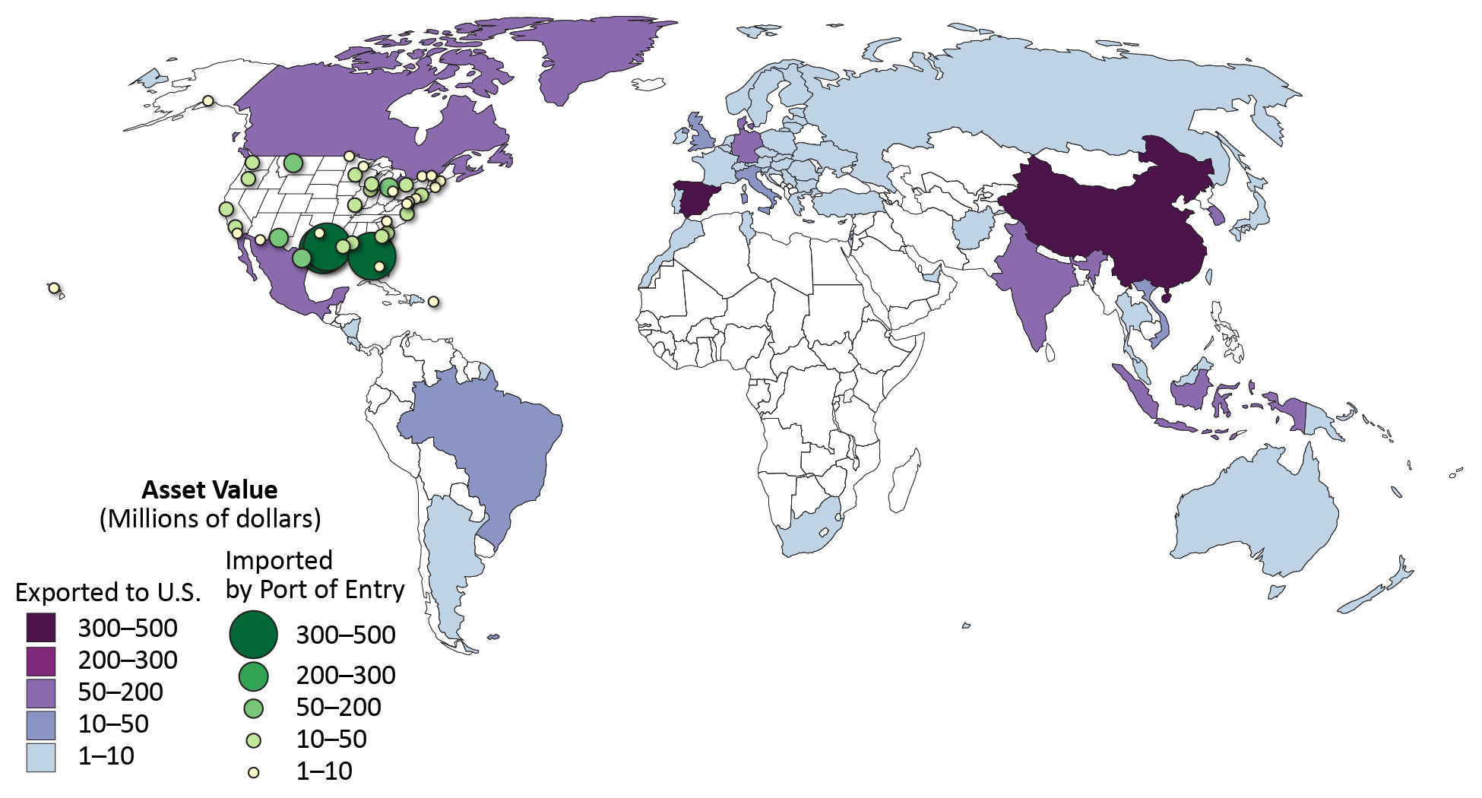
Tracked Wind Equipment Imports in 2017: 50% from Asia, 36% from Europe, 14% from the Americas
Note: Tracked wind-specific equipment includes: wind-powered generating sets, towers, hubs and blades, wind generators and parts

Slide 21
Source Markets for Imports Have Varied Over Time, and By Type of Wind Equipment
Majority of imports of wind-powered generating sets historically from home countries of OEMs, dominated by Europe
Decline in imports of towers from Asia over time, in part due to tariff measures
Majority of imports of blades & hubs from China
Globally diverse sourcing strategy for generators & parts, but with drop from China & growth from Mexico
Notes:
21

Slide 22
Domestic Manufacturing Content is Strong for Nacelle Assembly, Towers, and Blades, but not Equipment Internal to the Nacelle
Domestic Content for 2017 Turbine Installations in the United States:
Towers | Blades & Hubs | Nacelle Assembly
70–90% | 50–70% | > 85%
Imports occur in untracked trade categories, including many nacelle internals; nacelle internals generally have domestic content of < 20%
Notes:
22

Slide 23
The Project Finance Environment Remained Strong in 2017
Sponsors raised $6 billion of tax equity and $2.5 billion of debt in 2017
Tax reform legislation contained a number of provisions with implications for wind finance, but general consensus that the overall impact will be benign

Slide 24
Independent Power Producers Own the Majority of Wind Assets Built in 2017
Utility ownership should increase in the coming years as many utilities have recently announced plans to build and own new wind assets.

Slide 25
Long-Term Sales to Utilities Remained Most Common Off-Take, but Direct Retail Sales and Merchant Were Significant
24% of added wind capacity in 2017 are from direct retail sales; 40% of total wind capacity contracted through PPAs in 2017 involve non-utility buyers
Notes:
25

Slide 26
Technology Trends

Slide 27
Turbine Capacity, Rotor Diameter, and Hub Height Have All Increased Significantly Over the Long Term, and in 2017
Notes:
27

Slide 28
Growth in Rotor Diameter and Nameplate Capacity Have Outpaced Growth in Hub Height over the Last Two Decades
Nameplate Capacity
Rotor Diameter
Hub Height
Notes:
28

Slide 29
Turbines Originally Designed for Lower Wind Speed Sites Have Rapidly Gained Market Share
IEC Class
Specific Power
Specific Power by
Selected IEC Class
Specific power: turbine nameplate capacity divided by swept rotor area; lower specific power leads to higher capacity factors, as shown later
IEC Class 1/2/3 represent turbines designed originally for high, medium, and low wind speed, respectively
Notes:
29

Slide 30
Wind Turbines Were Deployed in Somewhat Lower Wind-Speed Sites in 2017 in Comparison to the Previous Three Years
Notes:
30

Slide 31
Low Specific Power Turbines Are Deployed in Low & High Wind Speeds; Taller Towers Predominate in Great Lakes & Northeast
By Region
By Wind Resource Quality
Notes:
31

Slide 32
Wind Power Projects Planned for the Near Future Are Poised to Continue the Trend of Ever-Taller Turbines
Notes:
32

Slide 33
A Large Number of Projects Continued to Employ Multiple Turbine Configurations from a Single Turbine Supplier
Note: Turbine configuration = unique combination of hub height, rotor diameter, and/or capacities
Notes:
33

Slide 34
Turbines that Were Partially Repowered in 2017 Now Have Significantly Larger Rotors and Lower Specific Power
Average specific power declined from 335 W/m² to 252 W/m² for the 2,131 MW of turbines partially repowered in 2017
Notes:
34

Slide 35
Performance Trends

Slide 36
Sample-Wide Capacity Factors Have Gradually Increased, but
Are Impacted by Curtailment & Inter-Year Resource Variability
Notes:
36

Slide 37
Wind Curtailment Varies by Region; Was Highest in MISO in 2017, but Highest-Ever in ERCOT in 2009
In areas where curtailment has been particularly problematic in the past—principally in Texas—steps taken to address the issue have born fruit

Slide 38
Capacity Factors Have Increased Significantly Over Time, by Online Date (i.e., Commercial Online Date, COD)

Slide 39
Trends Explained by Competing Influences of Lower Specific Power, Higher Hub Heights, Varying Quality Wind Resource Sites
Notes:
39

Slide 40
Controlling for Wind Resource Quality and Specific Power Demonstrates Impact of Turbine Evolution
Turbine design changes are driving capacity factors higher for projects located in given wind resource regimes
Notes:
revisions
40

Slide 41
Controlling for Wind Resource Quality and Commercial Operation Date Also Illustrates Impact of Turbine Evolution
Notes:
revisions
41

Slide 42
Change in Performance as Projects Age Also Impacts Overall Trends; Performance Degradation Shown After Year Nine
Notes:
revisions
42

Slide 43
Regional Variations in Capacity Factors Reflect the Strength of the Wind Resource and Adoption of New Turbine Technology
Note: Limited sample size in some regions

Slide 44
Cost Trends

Slide 45
Wind Turbine Prices Remained Well Below the Levels Seen a Decade Ago
Recent turbine orders in the range of $800-950/kW

Slide 46
Lower Turbine Prices Have Driven Reductions in Reported Installed Project Costs
2017 projects had an average cost of $1,610/kW, down $795/kW since 2009-2010
Limited sample of under-construction projects suggest somewhat lower costs in 2018

Slide 47
Economies of Scale Are Apparent, Especially when Moving from Small- to Medium-Sized Projects
Project Size
Turbine Size
Note: Includes 2016 and 2017 projects

Slide 48
Regional Differences in Average Wind Power Project Costs Are Apparent, but Sample Size Is Limited
Note: Includes 2016 and 2017 projects

Slide 49
Most Projects—and All of the Low-Cost Projects—Are Located in the Interior; Other Regions Have Higher Costs
Note: Includes 2016 and 2017 projects

Slide 50
O&M Costs Vary By Project Age and Commercial Operations Date
Note: Sample is limited; few projects in sample have complete records of O&M costs from 2000-17; O&M costs reported here DO NOT include all operating costs
Capacity-weighted average 2000-2017 O&M costs for projects built in the 1980s equal $70/kW-year, dropping to $58/kW-year for projects built in the 1990s, to $28/kW-year for projects built in the 2000s and since 2010

Slide 51
O&M Costs Are Lower for More-Recent Projects, and Increase with Age for the Older Projects
Note: Sample size is limited
O&M reported in figure does not include all operating costs: statements from one public company with a large U.S. wind portfolio reports total operating costs in 2017 for projects built in the 2000s of ~$53/kW-year

Slide 52
Wind Power Price Trends

Slide 53
Sample of Wind Power Sales Prices
Berkeley Lab collects data on historical wind power sales prices, and long-term PPA prices
PPA sample includes 435 contracts totaling 40,360 MW from projects built from 1998 to 2017, or planned for installation in 2018 or beyond
Prices reflect the bundled price of electricity and RECs as sold by the project owner under a PPA
  Dataset excludes merchant plants, projects that sell renewable energy certificates (RECs) separately, and direct retail sales
  Prices reflect receipt of state and federal incentives (e.g., the PTC or Treasury grant), as well as various local policy and market influences; as a result, prices do not reflect wind energy generation costs

Slide 54
Wind PPA Prices Remain Very Low, and Are Competitive with the Levelized Fuel Cost of a Gas Plant
Notes:
54

Slide 55
A Smoother Look at the Time Trend Shows a Steep Decline in Pricing Since 2009; Prices Below $20/MWh in Interior Region
Notes:
55

Slide 56
The Relative Competitiveness of Wind Power Has Been Affected by Declines in the Wholesale Market Value of Wind Energy
Wholesale market value considers hourly local wholesale energy price and regional hourly wind output profile; additional capacity value ~$3/MWh available in some regions
Price comparisons shown are far from perfect—see full report for caveats

Slide 57
The Wholesale Energy Market Value of Wind Energy in 2017 Varied by Region: Lowest in SPP, Highest in CAISO
Price comparisons shown are far from perfect—see full report for caveats

Slide 58
Recent Wind Prices Are Competitive with the Expected Future Cost of Burning Fuel in Natural Gas Plants
Price comparisons shown are far from perfect—see full report for caveats
Notes:
58

Slide 59
Renewable Energy Certificate (REC) Prices in Key RPS Markets Fell Significantly in 2017, Reflecting Growing Supplies
REC prices vary by: market type (compliance vs. voluntary); geographic region; specific design of state RPS policies

Slide 60
The Levelized Cost of Wind Energy Is at an All-Time Low
Estimates reflect variations in installed cost, capacity factors, operational costs, and cost of financing; include accelerated depreciation but exclude PTC

Slide 61
Policy and Market Drivers

Slide 62
The Federal Production Tax Credit (PTC) Remains One of the Core Motivators for Wind Power Deployment
5-year extension of PTC in 2015, plus guidance allowing 4 years for project completion after the start of construction
PTC phase-out, with progressive reduction in the value of the credit for projects starting construction after 2016
PTC phases out in 20%-per-year increments for projects starting construction in 2017 (80% PTC value), 2018 (60%), 2019 (40%)

Slide 63
State Policies Help Direct the Location and Amount of Wind Development, but Wind Growth is Outpacing State Targets
29 states and D.C. have mandatory RPS programs, which can support ~4.5 GW/yr of renewable energy additions on average through 2030 (less for wind specifically)

Slide 64
System Operators Are Implementing Methods to Accommodate Increased Penetrations of Wind
Integrating wind energy into power systems is manageable, but not free of additional costs
Transmission Barriers Remain
Notes: Because methods vary and a consistent set of operational impacts has not been included in each study, results from the different analyses of integration costs are not fully comparable.

Slide 65
Future Outlook

Slide 66
Sizable Wind Additions Anticipated for 2018–2020 Given Federal Tax Incentives; Downturn and Uncertainty Beyond 2020
Wind additions through 2020 consistent with deployment trajectory analyzed in DOE’s Wind Vision report; not so after 2020
Notes:
66

Slide 67
Future Outlook, Beyond Current PTC Cycle, is Uncertain
Current Low Prices for Wind, Future Technological Advancement, and Direct Retail Sales May Support Higher Growth in Future, but Headwinds Include:
Phase-out of federal tax incentives
Continued low natural gas and wholesale electricity prices
Potential decline in market value as wind penetration increases
Modest electricity demand growth
Limited near-term demand from state RPS policies
Limited transmission infrastructure in some areas
Growing competition from solar in some regions
Notes:
67

Slide 68
Conclusions
Wind capacity additions continued at a rapid pace in 2017, with significant additional new builds anticipated over next three years in part due to PTC
Wind has been a significant source of new electric generation capacity additions in the U.S. in recent years
Supply chain is diverse and multifaceted, with strong domestic content for nacelle assembly, towers, and blades
Turbine scaling is significantly boosting wind project performance, while the installed cost of wind projects has declined
Wind power sales prices are at all-time lows, enabling economic competitiveness (with the PTC) despite low natural gas prices
Growth beyond current PTC cycle remains uncertain: could be blunted by declining federal tax support, expectations for low natural gas prices and solar costs, and modest electricity demand growth
Notes:
68

Slide 69
For More Information
See full report for additional findings, a discussion of the sources of data used, etc.:
  windreport.lbl.gov
To contact the primary authors:
  Ryan Wiser, Lawrence Berkeley National Laboratory
  510-486-5474, RHWiser@lbl.gov
  Mark Bolinger, Lawrence Berkeley National Laboratory
  603-795-4937, MABolinger@lbl.gov
Berkeley Lab’s contributions to this report were funded by the Wind Energy Technologies Office, Office of Energy Efficiency and Renewable Energy of the U.S. Department of Energy under Contract No. DE-AC02-05CH11231. The authors are solely responsible for any omissions or errors contained herein.

