Slide 1
Snehal Desai
Global Business Director

Slide 2
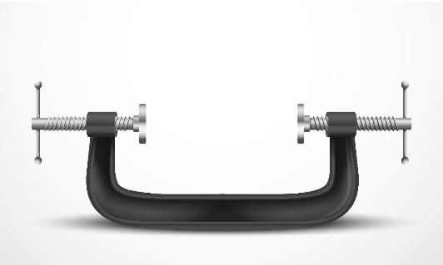
Water Pressure
Increasingly challenging feedwater
More stringent discharge requirements
Seawater
Municipal WWTP
Brackish water
Recovered wastewater
Receiving body
Notes:
At the point of source, you’re facing increasing cost of water and increasingly challenging feedwater, especially when you think of reusing wastewater.
At discharge, more stringent requirements – whether to the municipal wastewater treatment plant or any other receiving body – are going to dictate that you do something on that end anyway.
So if we focus on improving water efficiency, or getting more from every drop, it’s going to have a direct impact on your cost picture and bottom line.

Slide 3
MLD: Reduce Recovery Costs of Last 30% of Water by 60%
Primary Wastewater Reuse
Minimal Liquid
Discharge (MLD)
ZLD
$12-13/1000 gal
ZLD without MLD
$4-6.6/1000 gal
Cost of Water Recovery ($/m3)
ZLD with MLD
Water Recovery (%)
0
70
95
100
Bond, R.G. and Veerapaneni, S. Journal AWWA, 2008, 100 (9), 76-89.
Notes:
Shooting for Zero Liquid Discharge is an important goal that we will get to in the future.
For now, the math for recovering the last 5% to get to ZLD is a multiplier jump in cost.
Leveraging Dow Water & Process Solutions’ experience and solutions, we introduced the concept of Minimal Liquid Discharge to the market in early 2015.
MLD has the potential to get water recovery from the average primary wastewater reuse rate of 70% all the way up to 95% with minimal cost impact.
This is a mindset changing approach to looking at water reuse.

Slide 4
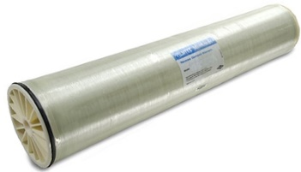
IoT Ecosystem
Dow Water &
Process Solutions
Dow Database
Dow SDMS – data routing internal and external
Dow Data Transformation
Dow Data Analytics
DW&PS Modelling Software - Wave
DW&PS Expertise R&D/TS&D – Answer Center
Secure IoT Platform
Hardware + Software
IoT Gateway
Security Internet Access
User Interface
Performance Data
Data stream to be captured
Customer Partnerships
Industrial
Consumer
Directed Customer Actions
End User Engagement
Innovation Targets
Drive Innovation Adoption
Potential to Provide value added services
DW&PS SMART Element (or Smart HDW System)
External sensor development opportunity
Vessel sensors, element sensors, system sensors

Slide 5
Thank you

