Slide 1
Advanced Manufacturing Office Overview and Clean Water R&D
2017 Clean Water Technology Workshop
Cleveland, OH
Mark Johnson
Director
Advanced Manufacturing Office
www.manufacturing.energy.gov
August 23th, 2017

Slide 2
Energy and Manufacturing Innovation Today
  Energy independence
  Stable, diverse energy supply
Security
Advanced Manufacturing and Energy Innovation
  Competitiveness by energy productivity
  Domestic jobs
  Clean Air
  Clean Water
Environment
Economy
Technology Innovation through Early-Stage Research and Development
In Manufacturing and Energy is a Foundation for Economic Growth & Jobs
Notes:
2
If Energy is at the nexus of economy, security, and the environment, then Clean Energy is at the nexus of solutions to these challenges.
2

Slide 3
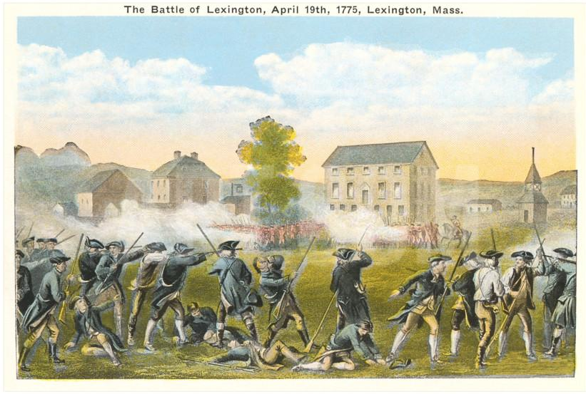
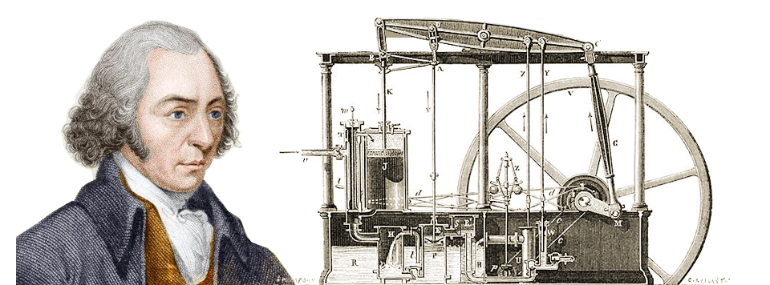
A little history: The Start of a pair of Revolutions
Lexington & Concord
1775
Watt, Boulton & Co.
1775
(intelligence: steam regulation
for external combustion engines)

Slide 4
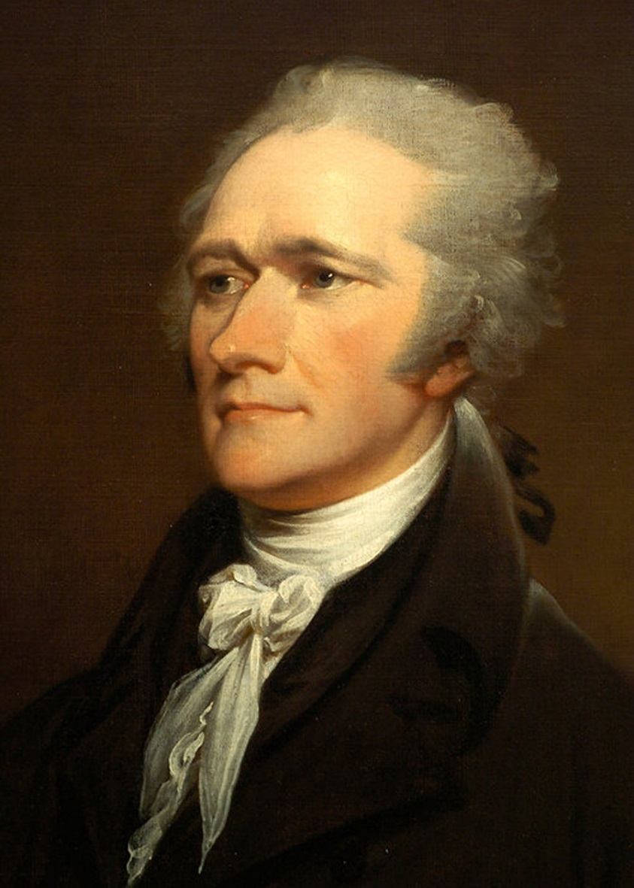
US Manufacturing Strategy for First Industrial Revolution
“… the encouragement of manufactures is the interest of all parts of the Union.”
“Not only the wealth; but the independence and security of a country, appear to be materially connected with the prosperity of manufactures.“
“… it is the interest of a community with a view to eventual and permanent economy, to encourage the growth of manufactures.”
- Alexander Hamilton
US Treasury Secretary (1789-1795)
Reports to Congress
First Report on the Public Credit - 1790
Second Report on Public Credit - 1791
Report on the Subject of Manufactures - 1791

Slide 5
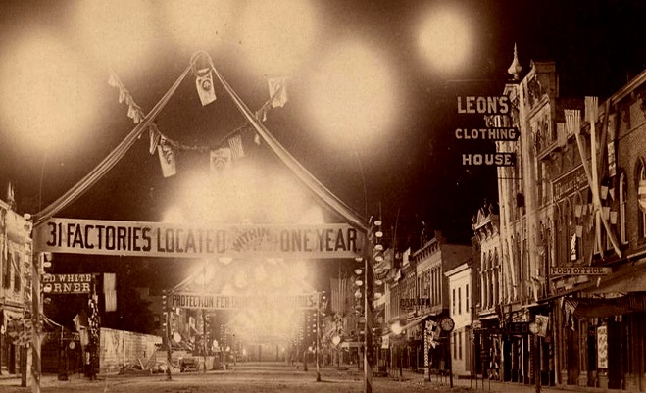
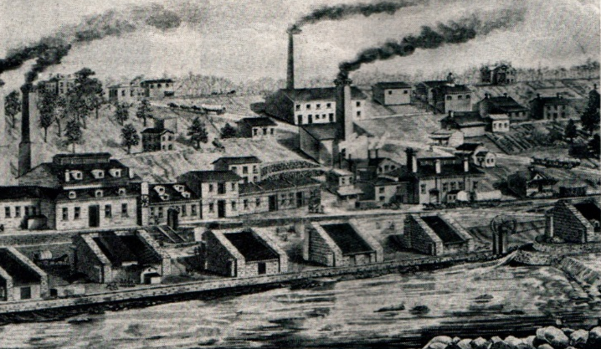
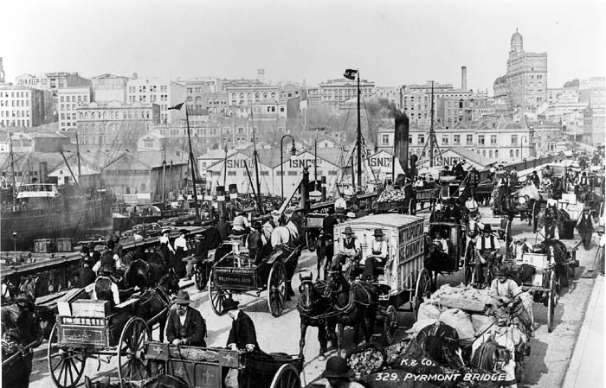

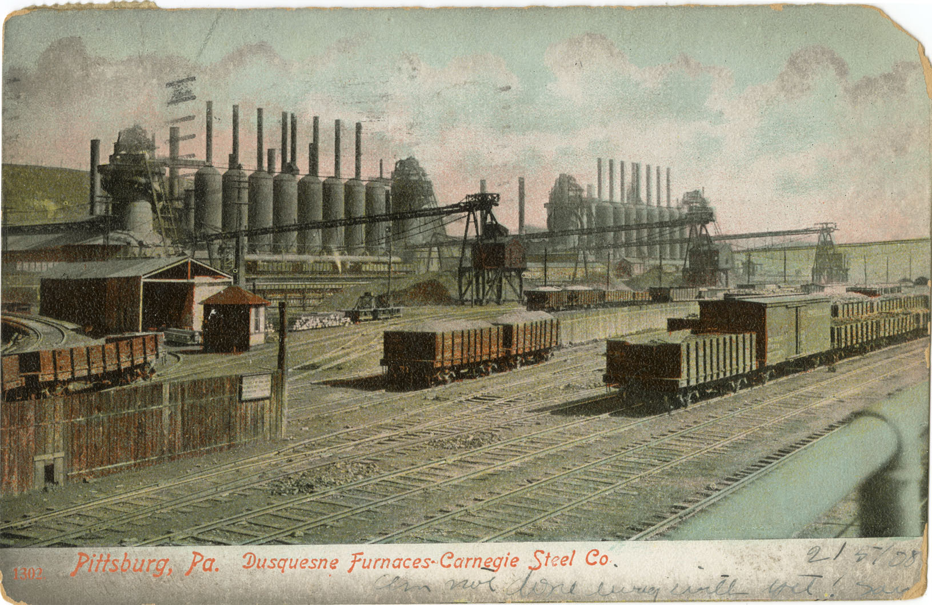
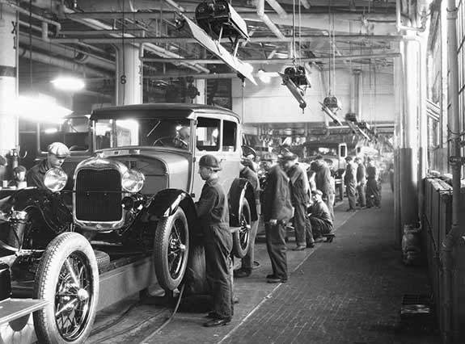
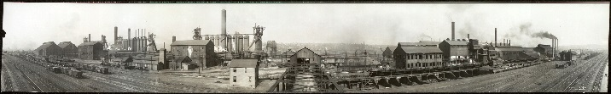
Second Industrial Revolution
Process Scaling
Energy & Materials
Standardization &
Assembly Line
Electrification

Slide 6
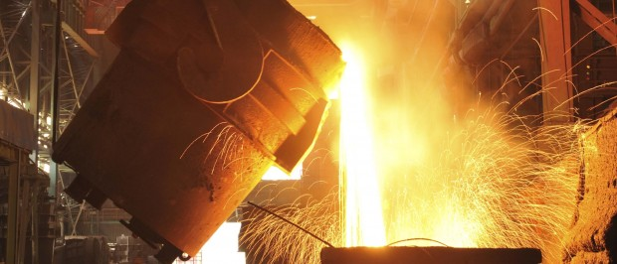

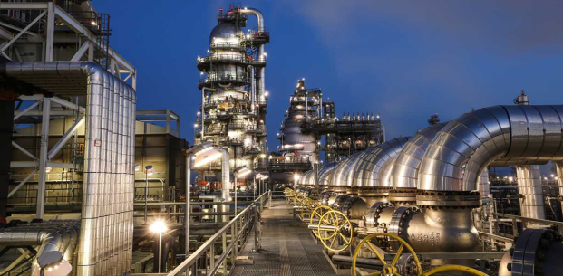
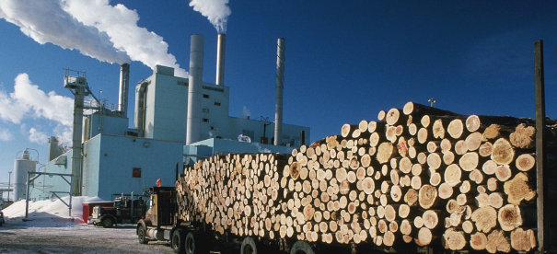
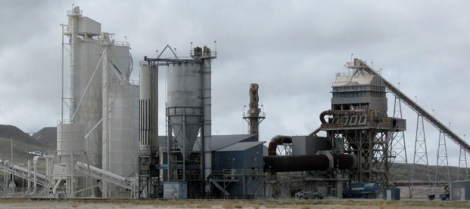
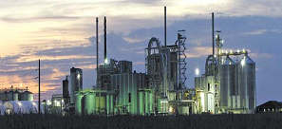
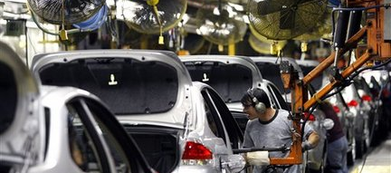
Energy Intensive Industries -Today
Primary Metals
1608 TBTU
Petroleum Refining
  6137 TBTU
Chemicals
4995 TBTU
Wood Pulp & Paper
2109 TBTU
Glass & Cement
716 TBTU
Food Processing
1162 TBTU
Other Manufacturing
~1600 TBTU

Slide 7
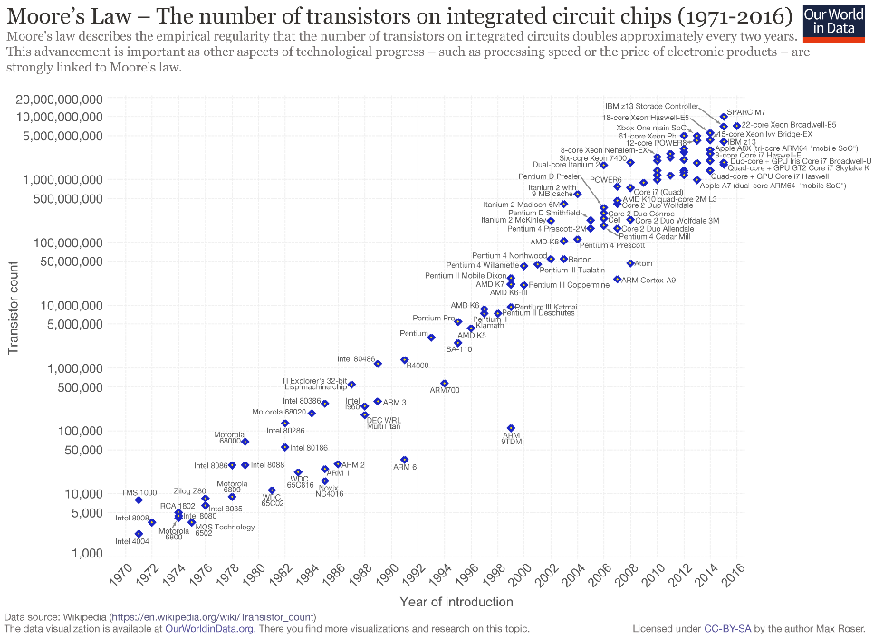

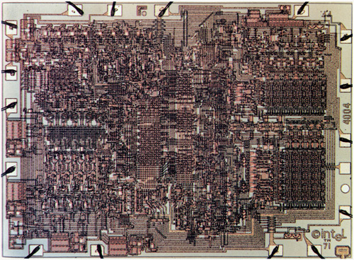
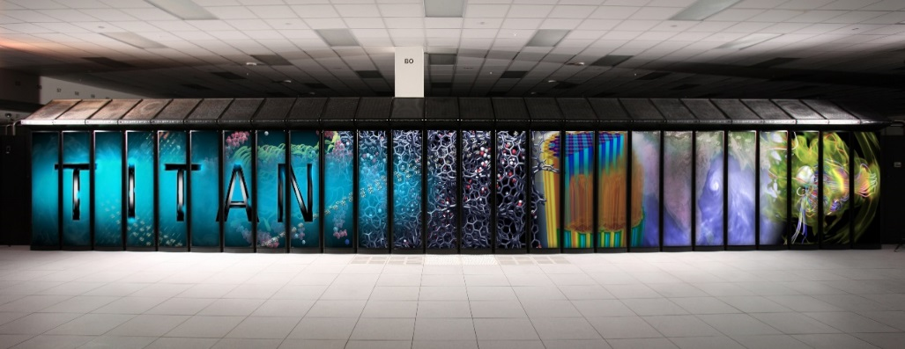
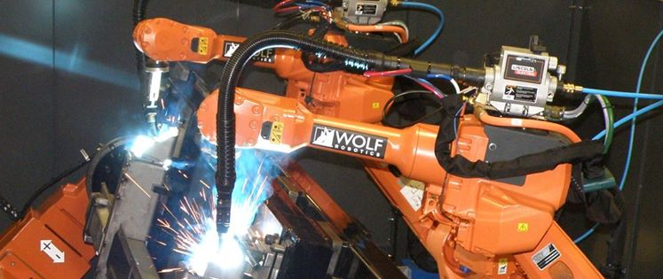
Third Industrial Revolution - Today
Microprocessor
Integrated
Centralized
Scaled-out
Intensified
Generalized
How will Manufacturing, Economy and Security of the Nation depend on Information, Computation, Actuation and Communication Technologies in the 21st Century?

Slide 8
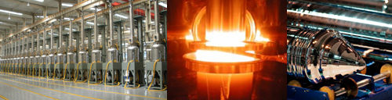
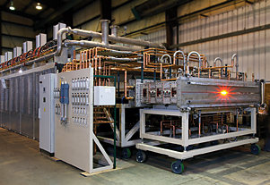
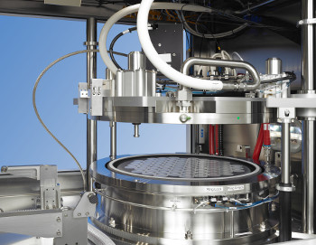
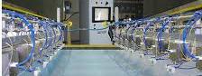
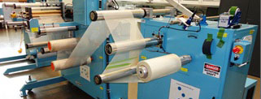
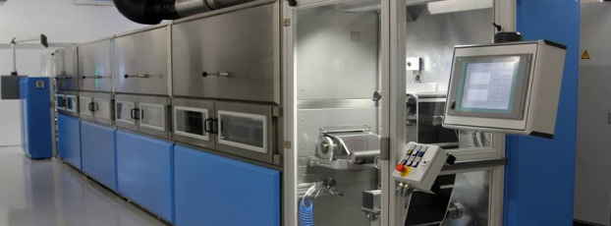
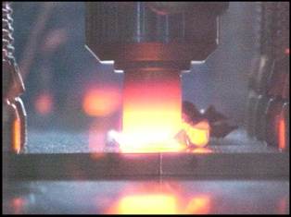
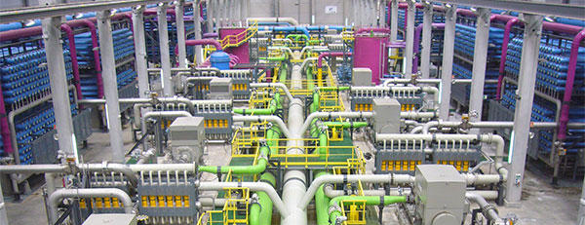
Processes for Clean Energy Materials & Technologies
Energy Dependence: Energy Cost Considered in Competitive Manufacturing
Solar PV Cell
Carbon Fibers
Light Emitting Diodes
Electro-Chromic Coatings
Membranes
EV Batteries
Multi-Material Joining
Water Desalination

Slide 9
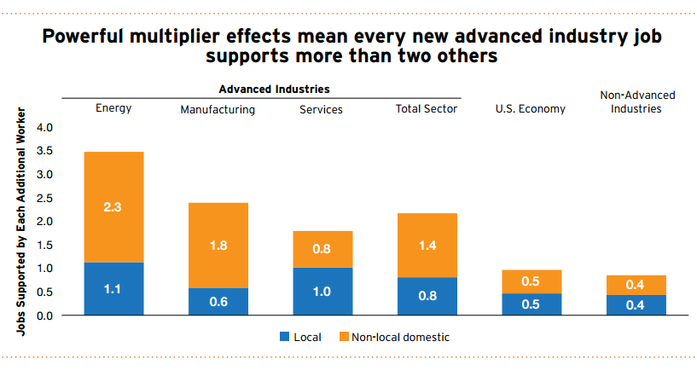
Innovation, Talent and Jobs

Slide 10
Energy Use in the US Economy

Slide 11
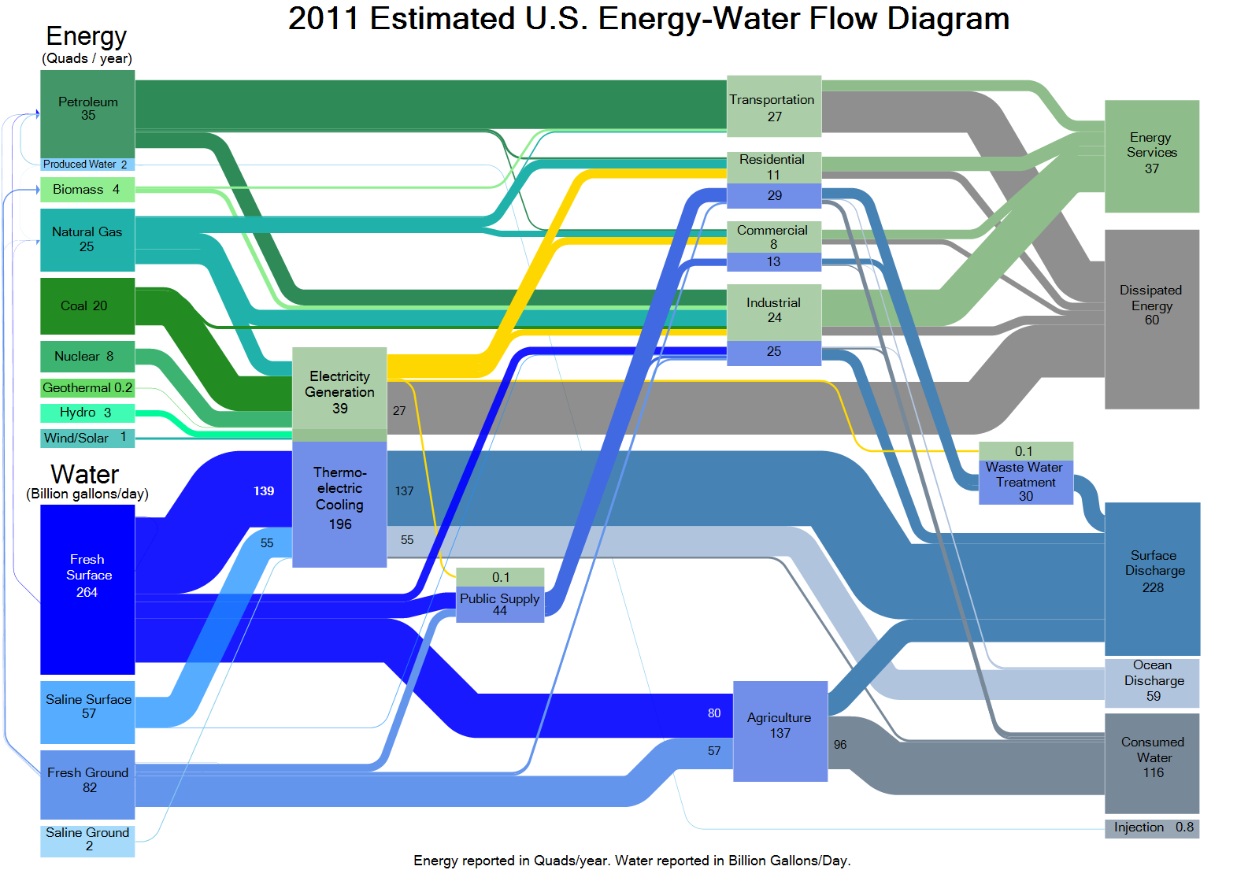
Clean water challenges are Energy challenges

Slide 12
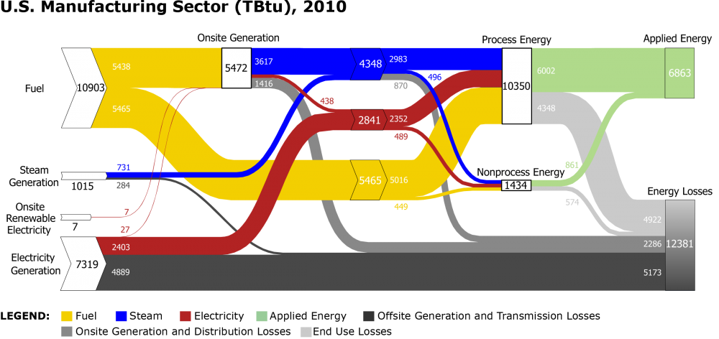
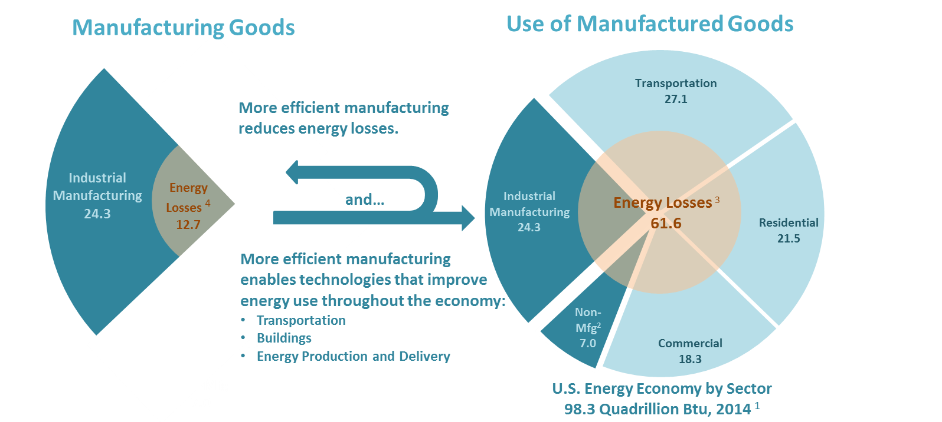
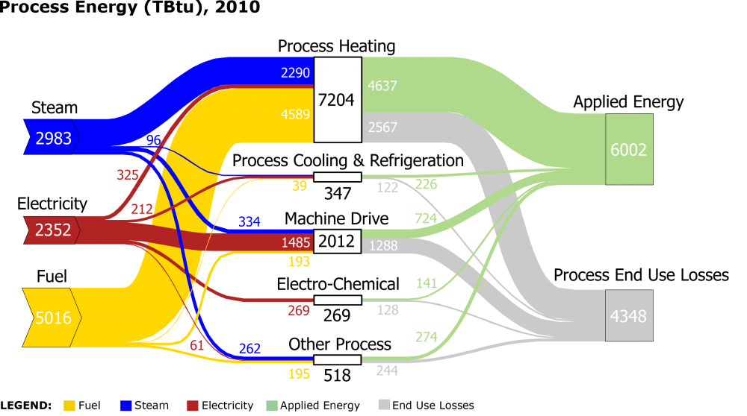
Advanced Manufacturing -- Opportunity
Technology Innovation through Early Stage R&D in Advanced Manufacturing and Energy is a Foundation for Economic Growth and Jobs in the US
$2T Manufacturing GDP
12.4M Manufacturing Direct Employment Jobs
0.8 / 1.0 – Indirect / Direct Jobs - All Manufacturing
2.2 / 1.0 – Indirect / Direct Jobs - Advanced Sub-Sectors
24 QBTU (25% of National Total) – Manufacturing
2/3 Manufacturing Energy is in Intensive Sectors
QTR, 2015

Slide 13
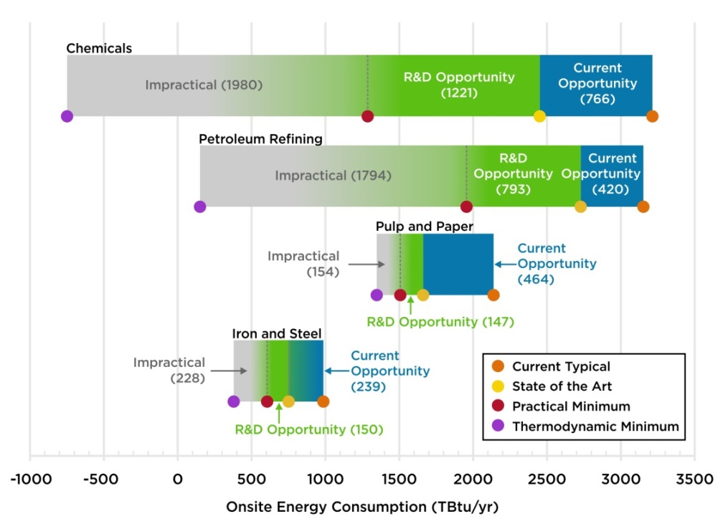
Manufacturing Bandwidth Studies: Energy Savings Potential
Current opportunities represent energy savings that could be achieved by deploying the most energy-efficient commercial technologies available worldwide. R&D opportunities represent potential savings that could be attained through successful deployment of applied R&D technologies under development worldwide
AMO: September 2015

Slide 14
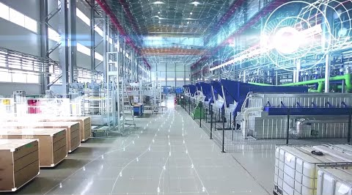
Advanced Manufacturing Office Framework
Focus on Early Stage Applied Research and Development
Technology Areas with Knowledge Gaps
Applicable to Manufacturing and Energy
Merit-based R&D at National Laboratories, Universities,
Companies (for profit and not for profit) and Consortia
Partner with Private Sector to Identify Technical Knowledge
Gaps and Transfer Learning for Subsequent Adoption

Slide 15
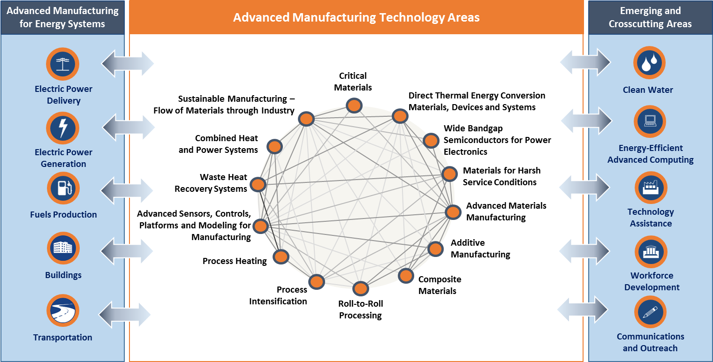
AMO Technical Focus Areas (2017 MYPP / DRAFT)

Slide 16
Impact Areas of Cross-Cutting Efficiency Technology
R&D for Energy Intensive Industry Sectors
 |  | Chemicals & Bio-chemicals | Petroleum Refining | Primary Metals | Forest & Food Products | Clean Water
SMART Manufacturing
Process Intensification
CHP & Grid Integration
Sustainable Manufacturing

Slide 17


Early Stage R&D and Manufacturing Technology
Deploy
Demo
Develop
Technology Readiness
Research
Manufacturing Scale

Slide 18
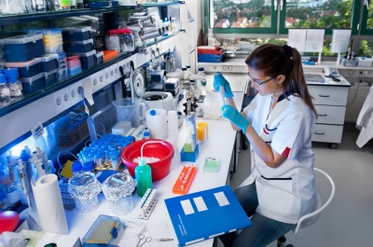
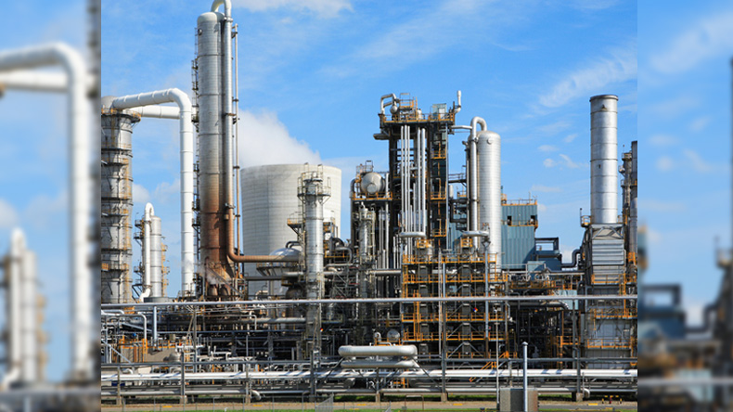
Early Stage R&D and Manufacturing Technology
Deploy
Demo
Develop
Technology Readiness
New Knowledge
Enabling Subsequent Deployment
Research
Manufacturing Scale

Slide 19
AMO: Three complimentary modalities
Technical Partnerships with Industry
Partnerships and tools to accelerate adoption of early-stage research and development by private sector with potential impact of improved energy efficiency and productivity for U.S. firms and manufacturing facilities.
R&D Consortia: Public-Private Partnerships
National lab and university-based consortia focused on early stage research and development to create new knowledge about underlying scientific challenges in key manufacturing technical areas.
R&D Projects: Creation of New Technical Knowledge
Merit-based early-stage research and development projects into manufacturing relevant materials, information and process technologies

Slide 20
Overview of DOE Advanced Manufacturing Office
Technology Assistance Partnerships
Research and Development Projects
Research and Development Consortia
Clean Water

Slide 21
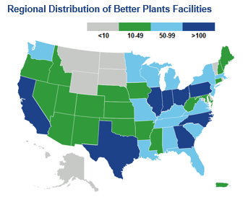
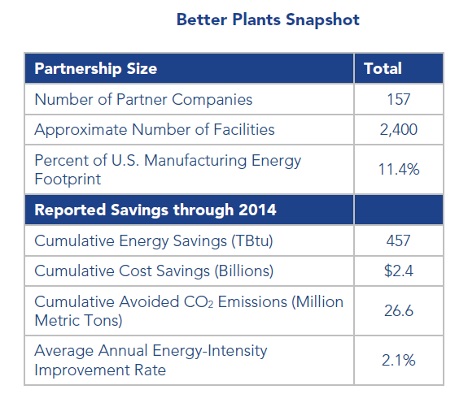
Technical Assistance: Better Plants Program
Key component of Better Buildings Initiative to improve energy efficiency of commercial and industrial buildings by 20% by 2020.
Voluntary pledge by manufacturers and industrial-scale energy users to reduce energy intensity
DOE provides technical assistance to meet goals and firms report progress
To date, Better Plants Partners have reported $2.4 billion in cumulative energy costs (more than 0.45 Quads of energy)

Slide 22
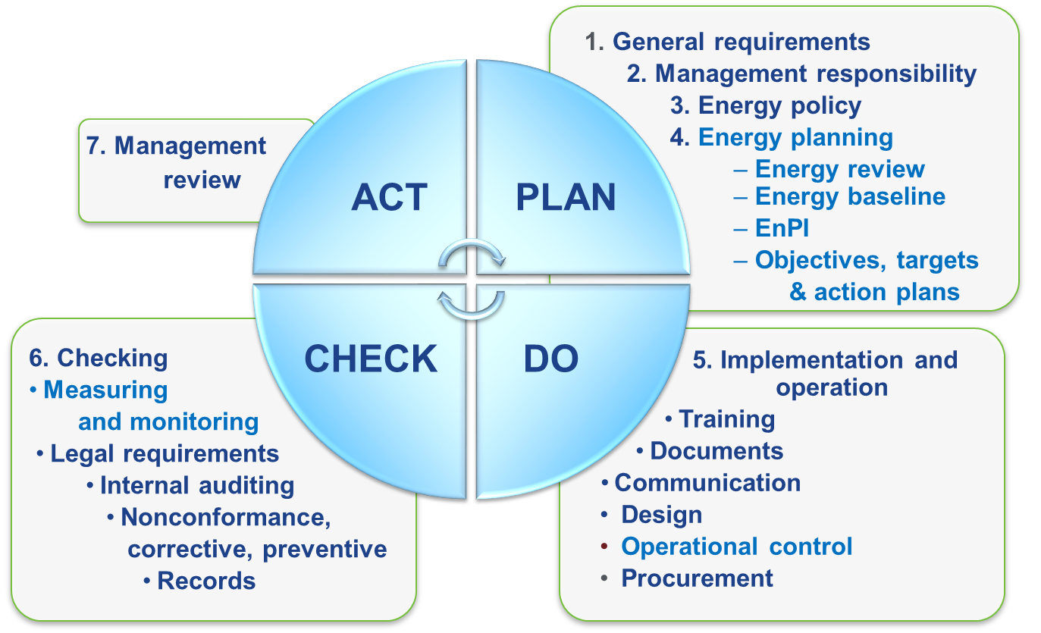
ISO 50001–Energy Management Systems (EnMS)
International standard that draws from best practices around the world. Developed with input from 56 countries, many countries now adopting it as a national standard.
ISO 50001 specifies requirements for establishing, implementing, maintaining and improving an EnMS.
It does not prescribe specific energy performance improvement criteria.
Light blue text represents new data-driven sections in
ISO 50001 that are not in ISO 9001 & ISO 14001

Slide 23
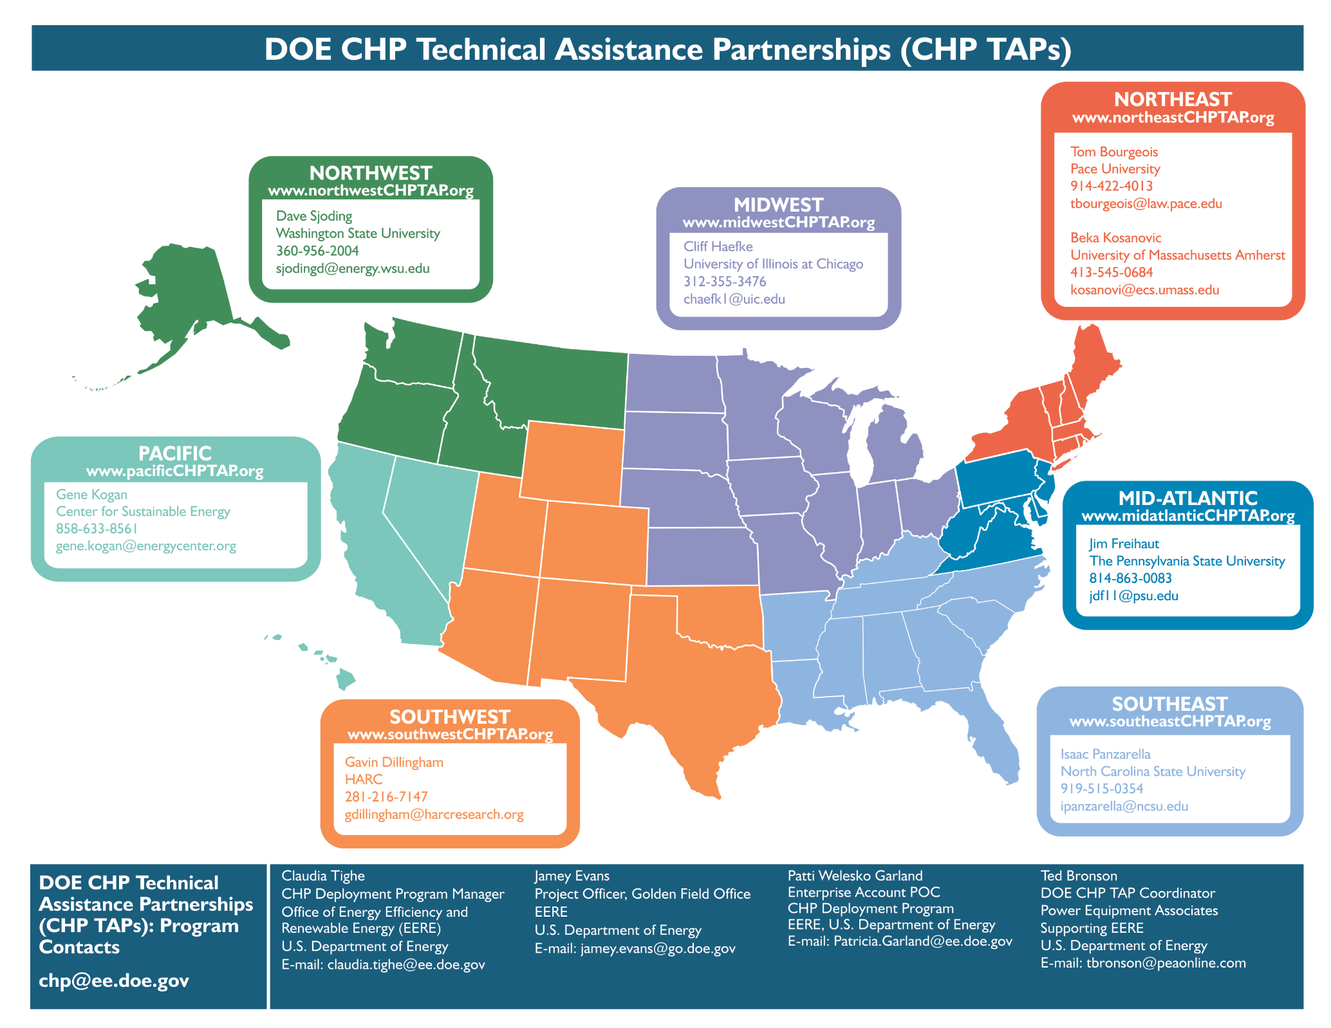
Combined Heat and Power, Technical Assistance Partnerships (CHP-TAPs)
23

Slide 24
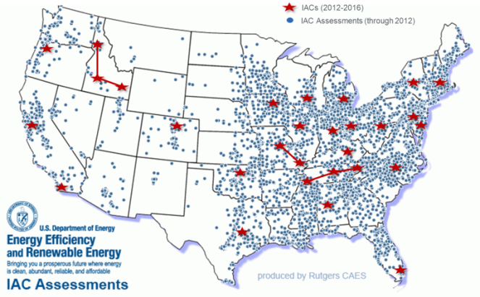
Technical Assistance: Industrial Assessment Centers
Energy Assessments & Student Training
University-based Industrial Assessment Centers
Support for small/medium sized manufacturing
Energy.gov/IAC

Slide 25
Overview of DOE Advanced Manufacturing Office
Technology Assistance Partnerships
Research and Development Projects
Research and Development Consortia
Clean Water

Slide 26
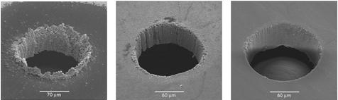
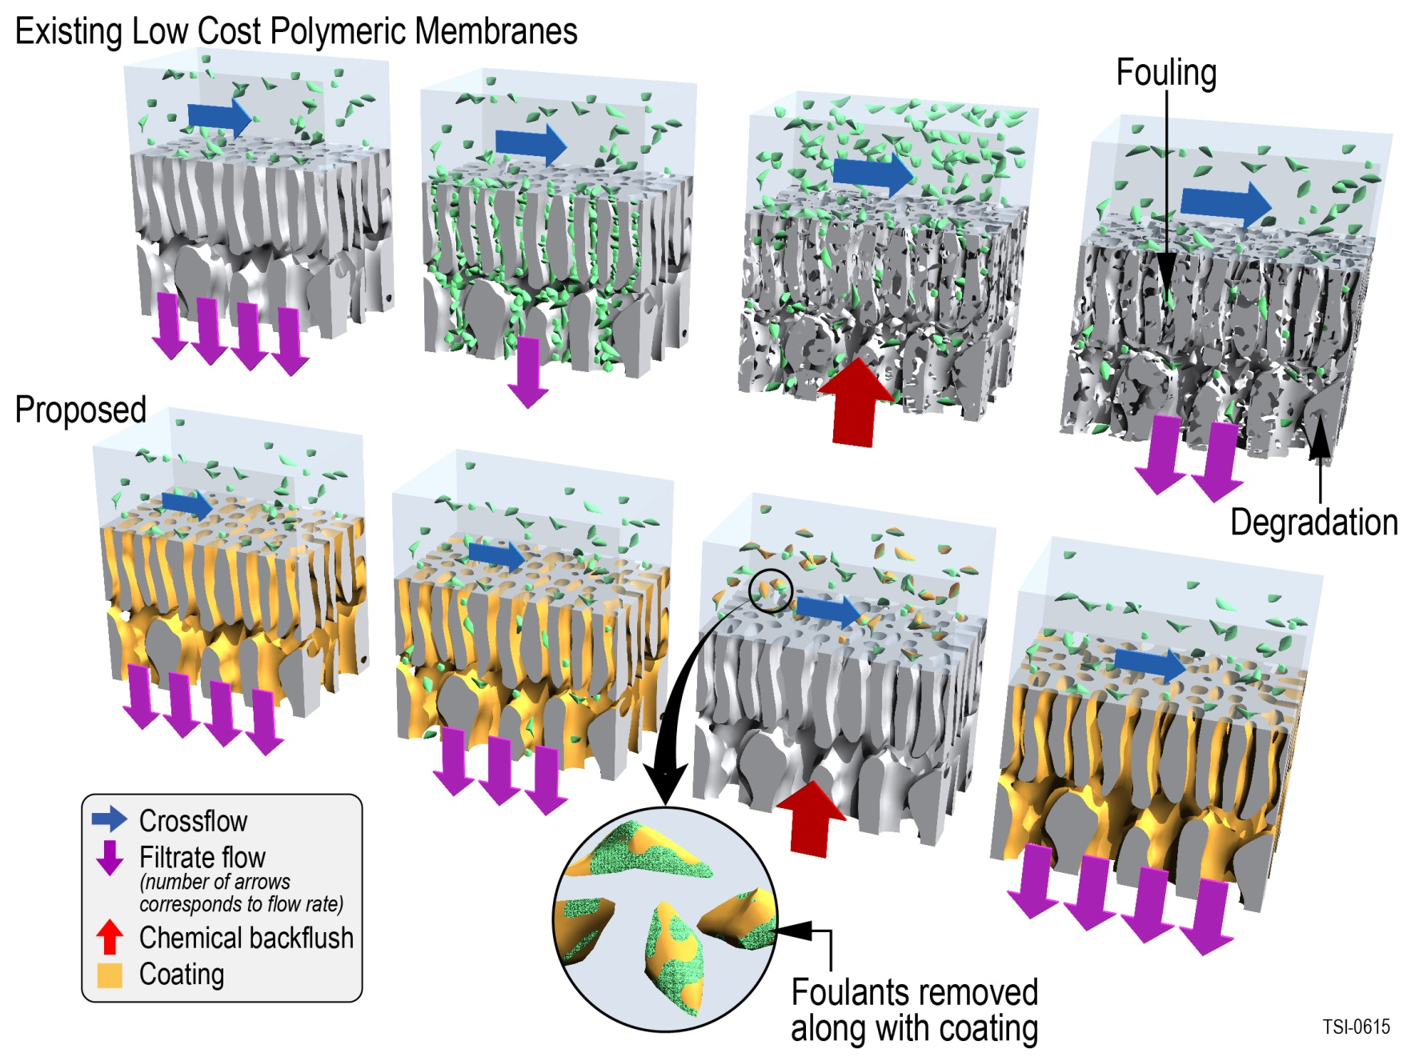
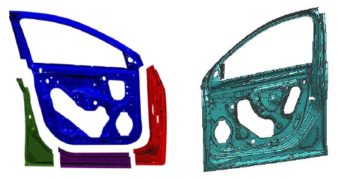
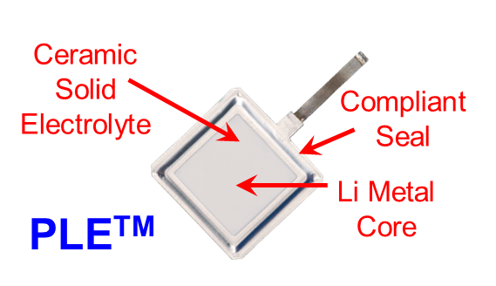
R&D Projects: Manufacturing Processes
Ultrafast, femtosecond pulse lasers (right) will eliminate machining defects in fuel injectors.
Image courtesy of Raydiance.
Protective coating materials for high-performance membranes, for pulp and paper industry.
Image courtesy of Teledyne
Energy-efficient large thin-walled magnesium die casting, for 60% lighter car doors.
Graphic image provided by General Motors.
A water-stable protected lithium electrode.
Courtesy of PolyPlus

Slide 27
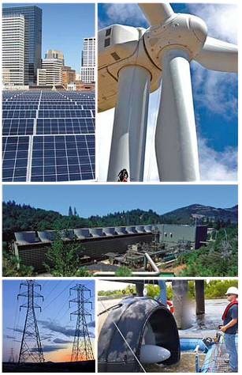
R&D: Next Generation Electric Machines (NGEM)
Focus on developing energy efficient, high power density, integrated medium voltage drive systems.
Current efforts:
Manufacturing of high performance thermal and electrical conductors
Manufacturing of low-loss silicon steel
High temperature superconducting wire manufacturing
Manufacturing of other enabling technologies to increase performance.
Potential to save 1.6% of total U.S. electricity consumption each year

Slide 28
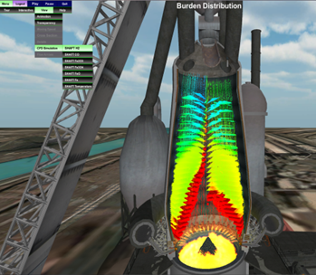

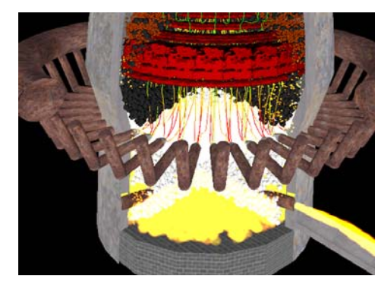
High Performance Computing for Manufacturing
Apply modeling and simulation capabilities to manufacturing challenges
A computer simulation of the virtual blast furnace. Image courtesy of Purdue University – Calumet.
Industry defined challenges
Partner with National Labs to Address R&D Using HPC
Streamlined partnering process

Slide 29

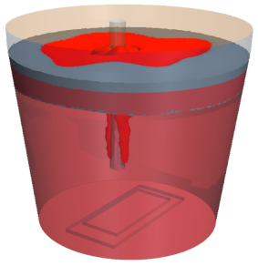



HPC has been used to design better processes in a variety of industries
Paper Towel Manufacturing
Reducing Coke Usage in Steel
Goal: Use HPC to evaluate different microfiber configurations to optimize drying time while maintaining user experience
Goal: Use models of complex reacting flows HPC to optimize blast furnace processes to reduce carbon loads and coke usage; savings up to $80M/yr if successful
Results to date: New mesh tool reduces product design cycle by 2X cycle; additional cores by another 8X; largest non benchmark run of Paradyn code at LLNL
Results to date: 1000X improvement in computational speed of parametric studies to examine factors such as CO2 enrichment, wind rate. Scaling code up to 2000 cores
Team: Proctor and Gamble with LLNL
Team: Purdue Calumet with LLNL
Notes:
Predictive capabilities helps to assure engineers of the quality of each individually-made part
Goal of microstructure modeling is to capture mesoscale structure involving a large number of dendrites as well as microstructural features within each dendrite including solute segregation, primary and secondary dendrite arm spacing
High Performance Computing is essential to capture the multi-scale morphology of the solidification microstructure of the Nickel base alloy 718 during Additive Manufacturing
Multi-component alloys can be modeled incorporating kinetic and thermodynamic databases using the Caliphad approach
Evolution of columnar dendrites in a Ti-V alloy due to imposed temperature gradient shows the dendrite morphology as well as the distribution of V in the inter dendritic space. Simulations used 512 processes in a Cray XC30 cluster
The thermodynamic module for a model Ni-Fe-Nb alloy that has the same solidification range as alloy 718 has been developed
Prediction of three-dimensional dendrite morphology using the Ni-Fe-Nb alloy is ongoing

Slide 30


Applied R&D for Materials Genome Initiative (MGI)
Coordinated resource network with a suite of capabilities for advanced materials R&D
Predictive Simulation Across Scales
Process Scalability
Synthesis & Characterization
Reliability Validation
End Use Performance
Real-time Characterization
Rapid Screening
Process Control
MGI - Framework
Data Management & Informatics
Materials Design & Synthesis
Functional Design
Process Scale-Up & Qualification
New Material Innovations for Clean Energy 2X Faster and 2X Cheaper

Slide 31





Lab Embedded Accelerator Model:
Post-Doc innovators “spin in” to national labs for R&D
Post-Doc Innovation Accelerator at National Laboratories
VC
Corp. M&A
Licensing
Recruit the world’s best energy technology innovators
Leverage experts and facilities at a world-class R&D institute
Deploy people, IP, and technology
31

Slide 32
Overview of DOE Advanced Manufacturing Office
Technology Assistance Patrnerships
Research and Development Projects
Research and Development Consortia
Clean Water

Slide 33

R&D Facilities & Consortia
Address market disaggregation challenge to the industrial commons
How could we get innovation into manufacturing today?
- RD&D Consortia
- Workforce Development and Education
- Public-private Partnership to Scale
Then
Now
OEM
Tier 1
Tier 2
Tier 2
Tier 1
Tier 2
Tier 3
Tier 3
Tier 3
Ford River Rouge Complex, 1920s
Photo: Library of Congress, Prints & Photographs Division, Detroit Publishing Company Collection, det 4a25915.
Notes:
Ford River Rouge Complex: http://www.nps.gov/nr/travel/detroit/d38.htm
“By 1927, when Ford shifted its final assembly line from Highland Park to the Rouge, the complex included virtually every element needed to produce a car: blast furnaces, an open hearth mill, a steel rolling mill, a glass plant, a huge power plant and, of course, an assembly line.”
Address Market Barriers by providing:
Proving ground – to demonstrate the costs and efficiency gains of new technologies
Affordable access – to capital-intensive technologies and capabilities
Focus – to a sector, or set of sectors, around common technical challenges
Accelerated partnership development and supplier relationships
Workforce training location for advanced manufacturing
Positively Impact U.S. competitiveness:
Increased domestic manufacturing capabilities and expertise
Increased manufacturing collaboration between small, medium and large businesses, and university and government
Positive feedback loop – between production and research/design accelerates both
Accelerated adoption – of energy efficient technologies and manufacturing processes in existing U.S. manufacturing

Slide 34
Economic Development Organizations
Consortia Model
State & Local Governments
Industry
Each Consortia has:
Clear technology focus
TRL level suited to specific technology challenge
Shared user facilities
Ability to address critical challenges
A balanced portfolio
of projects
Large Manufacturing Companies
Academia
Consortia
Lab Facilities
Institutes
Hubs
EFRCs
Federal Government
Government
Universities & National Labs
Small & Medium Enterprises
Community Colleges
Start-ups
Place-based innovation that builds regional advanced manufacturing ecosystem
Development of advanced manufacturing workforce in key technology areas
Accelerated RD&D and commercialization of new technology products in the U.S.
Notes:
MII design was based upon
lessons learned from the pilot institute, America Makes
inputs from regional workshops
MIIs address Market Barriers by providing:
Proving ground – to demonstrate the costs and efficiency gains of new technologies
Affordable access – to capital-intensive technologies and capabilities
Focus – to a sector, or set of sectors, around common technical challenges
Accelerated partnership development and supplier relationships
Workforce training location for advanced manufacturing
MIIs positively impact U.S. competitiveness by:
Increased domestic manufacturing capabilities and expertise
Increased manufacturing collaboration between small, medium and large businesses, and university and government
Positive feedback loop – between production and research/design accelerates both
Accelerated adoption – of energy efficient technologies and manufacturing processes in existing U.S. manufacturing
a public RFI.

Slide 35
Manufacturing Technology Maturation
Industry
Partnerships
End-Use Adoption
Deployment
TRL 6/7: System Testing in Production Relevant Environment
MRL 6/7: System Components made in Pilot Environment
Demonstration
TRL 5/6: Hardware-in-Loop System Testing in Laboratory
MRL 5/6: Investigate Pilot Environment to Make Systems
TRL 4/5: System Technology Tested in Laboratory
MRL 4/5: Investigate Pilot Environment to Make Components
Development
Applied
Research
TRL 3/4: Enabling Technology Tested in Laboratory
MRL 3/4: Enabling Components Made in Laboratory
Technology Needs and Requirements
Technology Capabilities and Opportunities
Basic
Research
TRL 1-3:
MRL 1-3:
Foundational
Science
Lab
Facilities

Slide 36












  Eliminate materials criticality as an impediment to the commercialization of clean energy technologies for today and tomorrow.
Selected Goals
Materials supply chains assured for clean energy manufacturing in the US
Commercialize at least one technology in each of its three technical focus areas
Develop updated criticality assessments to ensure relevance of CMI research and identify potential critical materials for clean energy
Initial Support
$120M for R&D June 2013-June 2018

Slide 37












14 Manufacturing Innovation Institutes launched to date
LIFT
Light/Modern Metals
Detroit, MI
REMADE
Sustainable MFG
Rochester, NY
AIM Photonics
Photonics
Rochester, NY
Process Intensification
New York, NY
37
NextFlex
Flex. Electronics
San Jose, CA
DMDII
Digital Mfg.
Chicago, IL
America Makes
Additive Mfg.
Youngstown, OH
AFFOA
Adv. Textiles
Boston, MA
CESMII
Smart Mfg
Los Angeles, CA
IACMI
Adv. Composites
Knoxville, TN
Power America
Power Electronics
Raleigh, NC
Over $800 million federal funding catalyzed over $1.2 billion
from consortia
Institutes have attracted hundreds of companies and universities as active partners from across the country
NIMBLE
BioPharma MFG
Wilmington, DE
ARMI
Adv.Tissue Manufacturing
Manchester, NH
ARM
Advanced Robotics
Pittsburgh, PA
Notes:
Federal Govt responded by launching 7 institutes, with 3 more on the way.
America Makes: Aug 16, 2012; DOD. 3D printing/additive manufacturing, including design, materials, technology, workforce. ($30 Fed+40 non-Fed)
Digital Manuf and Design Innov: Feb 25, 2014; DOD. Integrated digital design and manuf, with goal to create product and manuf process definitions simultaneously. ($70+250)
Lightweight innov for tomorrow: Feb 25, 2014; DOD. New lightweight metal manuf processes, incl. Al, Mg, Ti, high-strength steel alloys. Workforce devel. ($70+78)
Power America: Jan 15, 2015; DOE. Large-scale production of wide bandgap semiconductors (SiC, GaN) for smaller, faster, and more efficient electronics than Si. ($70+70)
Institute of Adv Composites: Jan 19, 2015; DOE. Cheaper, faster, more efficient manuf and recycling processes for composites. ($70+180)
Flex hybrid electronics: Aug 28, 2015, DOD. Design, manufacturing, integration of electronics and sensors, and assembly and test automation through technology platform demonstrations of complex flexible hybrid electronics on non-traditional conformal, bendable, stretchable, and foldable substrates. ($75+96)
Integrated photonics: Jul 23, 2015, DOD. Integrated design tools for efficient simulation and design of integrated photonic circuits, domestic photonic device fabrication foundry access, automated packaging, assembly/test, workforce devel. ($110+500)
Revolutionary fibers and textiles: Apr 22 2015 proposers day, DOD. Technical textiles, exceptionally strong and lightweight, flame resistant, antimicrobial compression bandage, etc. ($75+?)
Smart manuf: Sep 16 2015 FOA live, DOE. Advanced sensing, instrumentation, monitoring, control, and process optimization using both advanced hardware and software platforms, as well as real-time and predictive modeling and simulation technologies, for industrial automation; in particular, real-time in-situ monitoring for HTHP processes. ($70+?)
DMDII vs. Smart: key benefit = faster time to market vs. energy efficiency and conservation; cost savings by greater accuracy vs. optimized energy use; cyber security emphasis = systems vs. devices

Slide 38




DOE Manufacturing USA Institute #1: PowerAmerica (Raleigh, NC)
PowerAmerica: Develop advanced manufacturing processes that will enable large-scale production of wide bandgap semiconductors.

Slide 39

Highlights: X-Fab Texas launches SiC Merchant Foundry
X-Fab Texas
Using existing Si fab line, launched first available “merchant” SiC line
Will dramatically reduce cost of SiC wafers for global power electronics market
Supports 400 jobs in Lubbock, TX and will produce first device fall 2016
Read More at: https://www.whitehouse.gov/blog/2016/04/04/depth-look-how-manufacturing-hubs-helped-business-innovate

Slide 40

DOE Institute #2 – Carbon Fiber Composites (Oak Ridge, TN)
Institute for Advanced Composite Material Manufacturing (IACMI): Develop and demonstrate technologies to produce carbon fiber composites at 50% the cost and 75% less energy.
Launched in January 2015
$70 million Federal support matched by $180 million non-Federal
94 Total members including 72 industry members, 14 universities, and 2 national labs
46 Small and medium-sized industry partners

Slide 41



Institute for Advanced Composite Materials Innovation (IACMI)
Established regional centers of excellence across a number of fiber composite applications

Slide 42

DOE NNMI Institute #3 – Smart Manufacturing (Los Angeles, CA)
Advanced sensors and controls for real-time process management
Focus on Real-Time
For Energy Management
Institute Goals
>50% improvement in energy productivity
>50% reduction in installation cost of Smart Manufacturing hardware and software
15% Improvement in Energy Efficiency at systems level
Increase productivity and competitiveness across all manufacturing sectors

Slide 43









DOE NNMI Institute #4 – RAPID (New York, NY)
Objective: Develop a set of technologies that bring significant reduction in equipment size, process complexity, cost or risk reduction that will result in…
Test Bed Challenges
- 2x Improved energy efficiency - 20% Improved energy productivity
- 50% Decreased deployment cost

Slide 44



REMADE: Reducing EMbodied-energy And Decreasing Emissions
DOE NNMI Institute #5 – REMADE (Rochester, NY)
Key Technical Goals:
  Reduce energy and emissions through reduction of primary material use
  Achieve secondary (e.g. scrap, reused, recycled) feedstock “better than cost and energy parity” for key materials, and
  Widespread application of new platform technologies across energy intensive industries and at key stages in the manufacturing process
  Technology Focus Areas
Lead: Sustainable Manufacturing Innovation Alliance (SMIA)
$70M public investment, $70M match
26 universities,
44 companies,
7 national labs,
26 industry trade associations and foundations

Slide 45









Manufacturing Demonstration Facility:
National Lab Consortia
Supercomputing Capabilities
Spallation Neutron Source
Additive Manufacturing
Research in partnerships at MDF can provide validation and feedback to further research in AM technologies utilizing various materials from metals to polymers to composites.
Arcam electron beam processing AM equipment
POM laser processing AM equipment

Slide 46

Collaborative R&D Project: AMO partnership with Wind
Bringing Manufacturing Innovation to the Renewable Energy Space
Enable innovative blade designs
Achieve lower overall costs and higher efficiencies
Collaboration with Oak Ridge, Sandia, and TPI Composites
Potential copper metal casting projects

Slide 47











INDUSTRIAL ASSESSMENT CENTERS

Slide 48
Overview of DOE Advanced Manufacturing Office
Technology Assistance Programs
Research and Development Projects
Research and Development Consortia
Clean Water

Slide 49


Nature’s Timely Reminder!
California drought is cited as the worst recorded in 1200 years*
California recently passed Italy and the Russian Federation to become the world’s 8th-largest economy.
* "How unusual is the 2012–2014 California drought?," Geophysical Research Letters, Daniel Griffin and Kevin J. Anchukaitis, December 2014.

Slide 50


Slide 51

What is ‘Pipe Parity’ for Clean Water
Deliver Water with equivalent Economic & Energy cost
  Price: Approximate $0.50 / m3 (tonne)
    Ranges from $0.10 to $1.00 nationally
  Energy: Approximate: 1kWh / m3 (tonne)
    0.65 kWh (corresponding to 235m elevation change)
  Environment: Approximate: 1lb / m3 (tonne)
    Based on 0.69kg CO2/kWh
  Quality: 500 ppm TDS
  Complimentary Cases: Desalination, Produced Water, Grey Water, etc.

Slide 52

Framework Cost for Desalination in Clean Water
Goal = $0.50/m3
What are the technology R&D pathways that get us there?

Slide 53
Some Possible Areas for Opportunity
Operating Costs: Chemical additives (anti-bacterial, longer lasting membranes), Disposal / Post-processing of saline brines
Capital Costs: Low-cost heat exchangers for thermal processes, Cost Effective membranes, Balance of Plant Equipment, Small Modular System Footprint
Energy: Improve pressure energy recovery, utilize low-cost thermal energy
System Integration: Intelligent design of water networks to minimize connection costs, Real-time Control and Sensor Systems
Soft Costs: Workforce, Supply Chain, Expertise and Environmental Considerations

Slide 54

Where are the possible gaps?
Other
Biology

Slide 55
Needed outcomes from workshop
What technology advancements needed to hit cost target?
What ancillary and associated technology advancements (membranes, pumps/valves, etc.) are needed to make desalination pipe-parity competitive?
Identify the most effective R&D needs for DOE in advancing these technologies.
Discuss pathways to accelerate R&D of promising clean-water approaches at lower energetic, economic, and environmental costs relative to existing technologies

Slide 56
Thank You

