Slide 1
Step 4: Project Implementation

Slide 2
Small Group Exercise
Review with a partner what you learned yesterday
Partner 1 explains to Partner 2: Step 2
Tribal Role Options
Intro to Financing: Tax Incentives and Up-Front Capital
Partners and Procurement
Permitting, and Interconnection and Transmission
Partner 2 explains to Partner 1: Step 3
Recap: Tax-Equity and Federal Tax Incentives
Project Financing Structures
Direct Ownership
Third-Party Financed PPA
Tax Equity Partnerships: Partnership Flip, Sale Leaseback, Inverted Lease

Slide 3
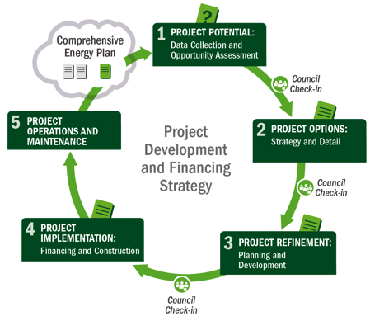
4
Implementation
5 Operations & Maintenance
1
Potential
2
Options
3
Refinement
4
Implementation
Notes:
Slide 3 - PAUSE
We are now turning to the 4th step in the process, the implementation phase.

Slide 4
Step 4: Project Implementation - Tasks
Purpose: Contract for, realize physical construction of project
Tasks:
Finalize project agreements
Finalize vendor contracting process
Finalize preconstruction tasks
Realize construction and equipment installation
Realize interconnection
Realize project commissioning leading to commercial operations
Output: Completed project (commercial operation)
Notes:
Slide 4
In this step, which can be among the longer of the steps, you finalize all the partnerships and technology agreements, complete the interconnection with the utility, and get all the financing in order and executed so you can build the project.
When the project implementation is done, which is often done by the developer, the renewable power project is commissioned and operation begins.

Slide 5
Step 4: Project Implementation - Checks
Check:
Ensure permitting is complete
Ensure on-site activities will not interfere with construction and vice versa
Communicate and plan with the vendor/contractor
Interconnection:
Sometimes contracted and completed by system owner in cooperation with utility
Sometimes involves host
Often coordinated by contractor/system owner
Construction/commissioning: diligence of each party as appropriate to its assumption of risk as:
PPA energy seller (or purchaser) – least diligence for tribal entity – economic due diligence needed
Energy system seller (or purchaser/owner) – technical diligence and capability for tribal entity
Notes:
Slide 5
It is a best practice to have completed or have strong assurances that permitting activities will be successful and completed in a timely manner before contracting with a vendor for installation of a commercial scale renewable energy system.
Delays in project implementation can be expensive, so it is important to have all aspects of site and permitting ready before actually putting the vendor or contractor to work. Most experienced and reputable renewable energy system vendors are familiar with the types of issues that can arise, however, and will help the site ensure that it’s prepared by providing instruction by phone conversations, site inspection visits, checklists, etc.
Interconnection to the utility is a key task under step 4: implementation. The way the project works with the utility will be dictated by state and utility rules and regulations. The system operator is always involved and sometimes the host is too. It is important to follow rules that apply to any particular project, to make sure the appropriate party takes the appropriate role.
Under each ownership model, both the Tribe and the vendor/contractor can play different roles and thus take on different risks.
PPA seller – the tribal entity is at lower risk, because most risk is taken on by the engineering, or EPC firm.
If the Tribe is the energy system owner – it is important to play a more involved role in project construction and commissioning.
The tribe should consider its goals carefully and negotiate (if possible) the terms of all contracts carefully, especially operating and performance warranties.

Slide 6
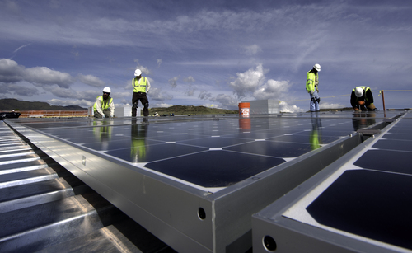
Step 4: Project Implementation– Outputs
Completed and operating project
New ownership organization completed (if needed)
Commercial Operating Date (COD) Success
Project generating electricity
Project developed within budget
Photo by Dennis Schroeder, NREL 21512
Notes:
Slide 6
After you have completed step 4 – CONGRATULATIONS you have a working renewable energy project that is generating clean electricity and making a difference! Give yourself a pat on the back! Hopefully, your project was developed on time and on budget.

Slide 7
Commercial-Scale Project Risks – Post Step 4
 | Risks | Risk Assessment Post Step 4
Development | Poor or no renewable energy resource assessment Not identifying all possible costs Unrealistic estimation of all costs Community push-back and competing land use | Low; site picked Low; detailed model Low; detailed model None; addressed
Site | Site access and right of way Not in my backyard (NIMBY)/build absolutely nothing anywhere (BANANA) Transmission constraints/siting new transmission | None; site secure None; opposition addressed None; addressed
Permitting | Tribe-adopted codes and permitting requirements Utility interconnection requirements Interconnection may require new transmission, possible NEPA | Low; complete Low; complete None; complete
Finance | Capital availability Incentive availability risk Credit-worthy purchaser of generated energy | None; finalized None; finalized None; finalized
Construction/Completion | EPC difficulties Cost overruns Schedule | None; contracted None; construction complete
Operating | Output shortfall from expected Technology O&M Maintaining transmission access and possible curtailment | Assumed low, mitigable, or allocatable
Sources: Adapted from Holland & Hart, RE Project Development & Finance & Infocast, Advanced RE Project Finance & Analysis
NOTE: Underlining signifies that the risk assessment outcome changes during the step at hand.
Notes:
Slide 7
As you can see in the risks evaluation. Each of these steps have been completed and the project is operational. There are some remaining operational and performance risks that will be handled by the long term operator of the equipment.
-

Slide 8
Big Group Exercise
Play Jeopardy! Win cash (bars) prize!

