Slide 1
Energy.gov Content Management System (CMS) Training
Presented by DOE CMS Support
Notes:
On the side: Tab Set 0,
Welcome to the Energy.gov Content Management System (CMS) Training
Specific to WebEx: expand shared screen to fullscreen from controls on right
MANDATORY: “This WebEx call is being recorded and may be posted on DOE's website or used internally. If you do not wish to have your voice recorded, please do not speak during the call or disconnect now. If you do not wish to have your image recorded, please turn off your camera or participate only by phone. If you speak during the call or use a video connection, you are presumed to consent to recording and to the use of your voice or image.”
I am Ryon Grau. System Admin for the CMS.
You are here today because you have been selected to maintain content on your organization’s public website using the Energy.gov Drupal content management system (CMS) platform.
We have a lot to cover today. Please feel free to ask questions or ask me to clarify things, speed up or repeat. If we start running short on time I may ask that we wait until the end for Q&A
Let’s review our agenda.

Slide 2
Agenda
CMS Basics
The Energy.gov CMS
Logging and your User Account
Adding New Content and Content Types
Editing Content and Paragraph Types
Files and Media
The Publication Workflow
Notes:
try not to overwhelm ‘em with options/ info. While bombarding them with options and info.

Slide 3
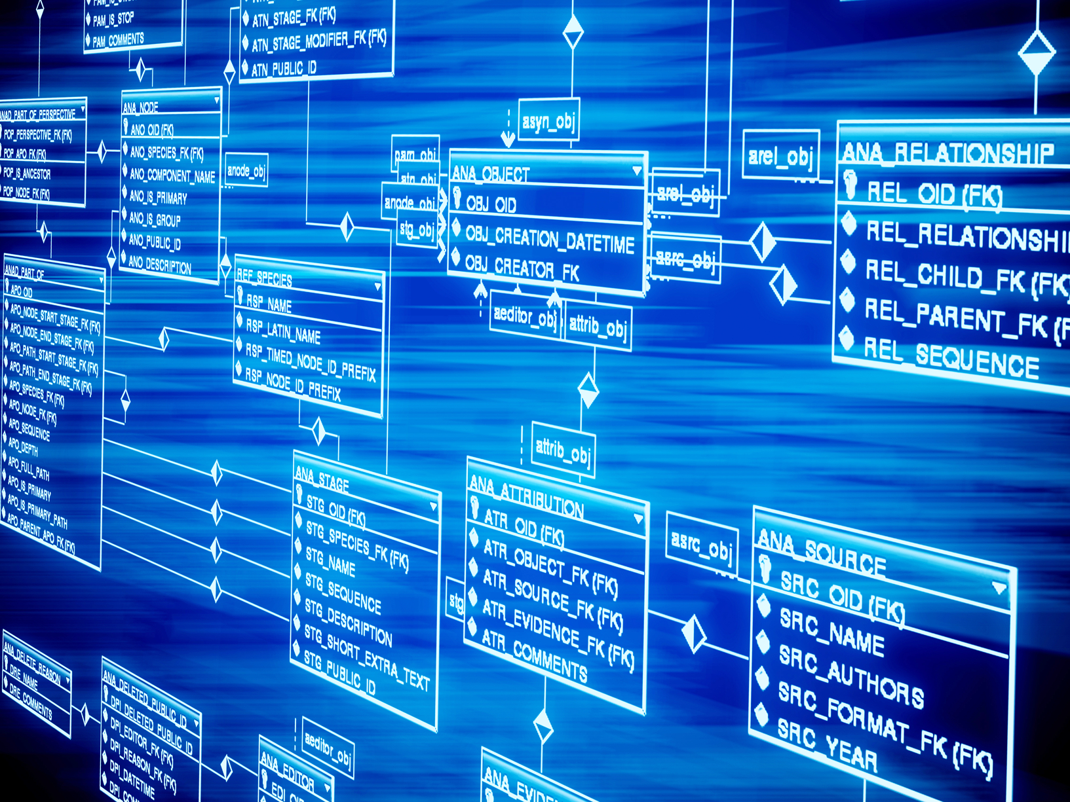
CMS Basics
The content management system is a gigantic database
Notes:
?? Get level of experience
Big ol Database
All changes are recorded, so be good.
Unique IDs for everything
Nodes
Files
Users
Unique IDs are important
96 “Side 1”
40 nodes “About Us”
31 “Contact Us”
22 “Events”
32 “1.jpg”
That’s why we’ll always ask for title/ link AND ID

Slide 4
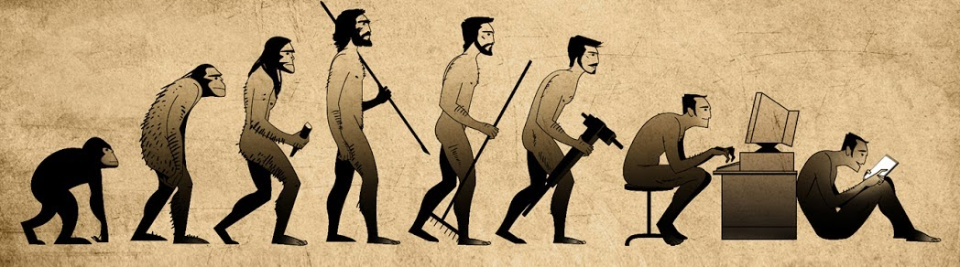
Site Evolution
We have completed the Design Refresh, and we are moving toward Drupal 8
Notes:
Design Refresh July 2017 > Now > AWS > D8.. When?
This is a Drupal Platform- there are many like it, but this is ours.
Built to accommodate all the needs of all the offices
Responsive to user need
Responsive Design
Constantly updating and improving features
look for release notifications DL-energygovusers
Customized with modules
Customized with custom code
Coming from Design Refresh
Where we introduced Paragraphs, a new way to edit and maintain content.
Moving towards Drupal 8
Content migration & deprecation/ Evergreen
PA is looking to trim it down- keep it modern and relevant
This is public facing- NOT a system of record
Production (PROD) vs Stage/ Development (Dev)
We are on Demo, so don’t be shy to try things out

Slide 5


Login and User Account
first time login and beyond
Notes:
CMS.doe.gov vs energy.gov
https://www.energy.gov/[something]
https://cms.doe.gov/[something]
Private vs public facing energy >> cms for /user
Must be on network, or VPN. Virtual Desktop? may God have mercy on yer soul
URLs with the following format are subdomains that are not managed within the Energy.gov Drupal platform:
https://[something].energy.gov
https://[something].doe.gov/
User name is your full and complete DOE email address
When the account is created, you will receive an automated system message with a first-time, one-time log in link.
You need to do that right away when you receive the system message. The link is time sensitive and if you do not log in, follow the prompts and the password policy to change your password, you will be blocked by the CMS as a security precaution.
Again, I will follow up in an email “this afternoon” to include the PRODUCTION instance URL, which you should bookmark and that you will use to log in after you complete your first time log in and password change.
DEMO: https://energy.gov/user >> redirecting to CMS.DOE.GOV/user & describe
DEMO: GO LOG IN for realsies: https://demo.cms.doe.gov/user testeditor-Publisher
Federal system. Be good, don’t goof. DB remembers all.
Be secure, don’t share access
We don’t have PWs, reset it yerself https://demo.cms.doe.gov/user/password
Don’t get yourself locked out: 3x
Only 1 password change in 24 hours
Highlight User ID
Review Group ID
Office Roles
Our implementation of Drupal uses a module called Groups.
When your account is created, you are assigned to the group or groups where you are to maintain your content.
Your account is what we call Group Aware.
>> /Edit user: demo Password Change

Slide 6
Inside Energy.gov– Overview
Home
Help
Office Content
Media Browser
Notes:
When anything is saved to a database, it is given some kind of unique identifier.
OPEN TABSET 6: Inside Energy.gov
Home
Help – cms-support.doe.gov
User
Logout
Environmental indicator
Office Content: Offices
Click> homepage
Hover Office Links >
Other hidden admin functions here
Block: Unnecessary at this point
Click through to Test Group content
Office’s Content View
Explain the view
Demo the filtering
Point out the .csv (spreadsheet) download
Actions = BAD. Don’t use edit link!
Review Node ID – explain there are 3 ways to find the node id:
With a node open for edit, look in the URL
You can use filters within the Office Content View to find a node and identify the node ID
You can use View Page Source from the browser- but ew
Review Media Browser
Switch to list view
File name
File type
User ID
File size (in bytes) Mention limit 60Mb)
Group ID - can view all files in media browser, but request ownership if not able to edit.
Filters Apply
Actions = BAD. Don’t use edit link!
Edit an individual Media File
Demo editing- be careful of changing Groups Audience!
Demo usage, follow through

Slide 7
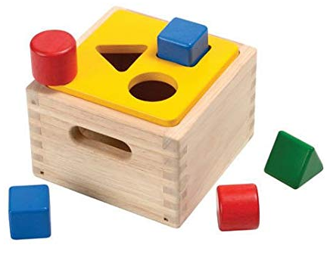
Adding Content & Content Types
Each Content Type has a specific purpose
Notes:
DEMO: Add Content
It’s not just web pages you’ll be making- you’ll be making many KINDS of web pages. It’s important to use the right tool for the right job.
In Drupal, each item of content is called a node (AND NOT A PAGE), and each node belongs to a single content type, which defines various default settings for nodes of that type.
Some are static webpages, which are indeed Page Nodes. ☺

Slide 8
Content Types - Overview
Our Focus
  Article
  Download
  External Resource
  Listing
  Page
Homepage
Contributor
Event
Photo Gallery
Pivot Table
Video
Timeline
Notes:
DEMO: OPEN TABSET 12: Content Types – Overview
Go over the use case of each Content Type
Focus ON;
Use an Article for news, press releases, or a blog post,. Articles are timely content that include a date. Articles can be dynamically listed.
Use Download pages are where you make a document file available for download. In general, documents are timely content; therefore, the download page includes a date association. Download pages can be dynamically listed. You can list a collection of documents by applying a pre-determined taxonomy term to each download page node targeted for a collection.
Use External Resources to link to another website. External Resource nodes are required to reference a link to another website within an entity reference field.
Use a Listing node to automatically curate content using filters. Content filtered into Listings can be displayed on other nodes in Dynamic Listing Paragraphs. The Listing will populate the Listing (Dynamic) paragraphs.
Listings usually display Timely items, but can be set for alphabetical
Includes types: Articles, Downloads, Videos, External Resources, Maps, Photogalleries.
A basic Page containing relatively static content. A page does not expose a date. A page is often linked to the navigation structure.
Another time: (will get permissions to make later)
The Calendar content type dynamically lists events and displays them in either a Month (calendar grid) or Upcoming (list) view. Calendar nodes can be referenced within the Calendar paragraph, which can list up to 10 events and provides a link to the referenced Calendar node.
Use a Contributor to reference phone and email information for a contact or post biographical information for contributor or leader. Contact DOECMS-Support in order to verify Person Name for use as an Article Contributor. NEVER CHANGE THAT NAME.
Use the Event content type to create individual events. Events are dynamically listed on a Calendar node. Each event must include a Start Date/Time and an End Date/Time. Calendar nodes can be referenced within the Calendar paragraph, which can list up to 10 events and provides a link to the referenced Calendar node.
This is the homepage for your group or Office. Has special fields for those featured Items.
Use an Interactive node to display content which responds to the user's actions by presenting real-time, hyper-relevant results. Interactive content type nodes can be referenced within the Interactive paragraph to display within the Body field of other nodes. Because of the security concerns with custom code, the permission to create this is restricted, but you an reverence the interactive content in a Map Paragraph.
Use Photo Galleries to create an interactive slideshow of images. Photogalleries display on other nodes when referenced in a Photogallery Paragraph.
Pivot Table node with Facets and Search using Datatables.
Use a Timeline to create a chronological list of interactive image and text content.
Use a Topic landing page, for promoting content related to a given site topic.
Use a Video to display a video and all the relevant and Accessibility compliant content.

Slide 9
Content Types - Review
POP
QUIZ
  Page
  Article
  Download Page
  External Resource
  Listing
Homepage
Contributor
Event
Photo Gallery
Pivot Table
Video
Timeline
Notes:
Who can tell me which content type to use to add a news item?
Who can tell me which content type to use when I need to upload a document file like a PDF?
Who can tell me which content type to use for basic, static content?
Who can tell me which content type to use when I need to reference a webpage not managed within our content management system?
Who can tell me which content type to use when I want to dynamically list a collection of similar content? For example, a list of Blog articles?

Slide 10
Editing Content Basics
Providing enhanced editing power to content maintainers
Notes:
Demo: Pull up Static Listing node : Listing (Static) w/ All Content Types, All List Styles
The basic Fields on all (most) types:
Title
Changing title= changing URL, ‘so always link to NID
Short Title
Summary
(Alt-D8) Thumbnail
Date
MENTION: Navigation: gotta go through us

Slide 11
Editing Content: Taxonomy and Listings

Slide 12
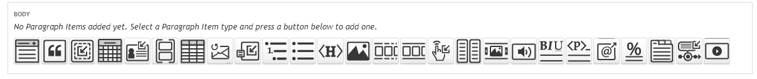
Paragraphs
Providing enhanced editing power to content maintainers
Notes:
These are all the different paragraph types
There are a lot of options. Like with content types, y’gotta choose the

Slide 13
Paragraph Types - Overview
Accordion
Blockquote
Calendar
Container
Datatable
Formatted List
Interactive
Photogallery
Podcast
Social Media
Statistic
Subscription
Tab
Timeline
Video
Our Focus
  Featured Item Paragraph
  Heading Paragraph
  Image Paragraph
  Listing Paragraph (Static & Dynamic)
  Multi-column Paragraph
  Rich Text & Rich Text (Full)
Notes:
Focus:
Featured Item Paragraph The Featured Item Paragraph is features or displays a Entity Reference Link to another node. Unique layouts Homepage content type nodes. Primary groups use a 3-Up layout that displays one large feature on the left and two smaller features stacked on the right. Nested groups use a 4-Up layout that displays one large background image with the most prominent feature as large text in the upper-left corner and the option for up to three text link features across the bottom third of the background image.
Heading Paragraph Insert headings at will on a node and select the desired level (that is⎯Section Heading, Subsection Heading, Subsection Subheading). Optionally, apply links to headings.
Image Paragraph The Image Paragraph allows addition of an image with associated layout styles, a caption, title, and an attribution to a node. The Image Paragraph is also available within the Accordion, Container, Multi-Column, and Tab Paragraph Types.
Listing (Dynamic)Use this paragraph to reference dynamic listings built using the Listing content type.
Listing (Static)Reference nodes to manually curate a list of links.
Multi-column Provides a two-column layout option.
Rich Text Provides the ability to enter prose or formatted text within an editor.
Rich Text (Full) Enter prose or formatted text within an editor. The Rich Text (Full) paragraph also allows entry of html tables.
Save for Another day Click to start scroll
Accordion Paragraph Make expandable/hidable content that can contain text and images. When clicked, the Accordion shows its content.
Blockquote Paragraph Display quoted text from an external reference.
Calendar Use the Calendar paragraph to reference a Calendar content type node and choose to display up to 10 events in a vertical list. The Paragraph provides a link to the Calendar node so all events can be viewed.
Contact Reference Paragraph Use the Contact Reference paragraph to reference one or more Contact content type node(s). Only the Contact content type nodes may be referenced within the Contact Reference paragraph type.
Container Paragraph The Container Paragraph provides the ability to group together Accordion, Heading, Image, and Rich Text paragraph types.
Data Table Paragraph The Data Table Paragraph allows the CMS editor to maintain data in an MS Excel spreadsheet. The spreadsheet data can be saved as a .csv (comma separated values) file, and uploaded to the CMS to display in table format.
Formatted List (Simple) Paragraph This paragraph type offers a quick way to include numbered and bulleted lists. Content entry is limited to simple text lists.
Interactive Use the Interactive paragraph to reference Map content type nodes.
Photo Gallery The Photo Gallery Paragraph contains a required entity reference field that autocompletes as a single photo gallery node is referenced.
Podcast The Podcast Paragraph contains a required entity reference field that autocompletes as a single podcast item node is referenced.
Social Media The Social Media Paragraph allows content editors the ability to embed posts from the following social media outlets: Facebook, Instagram, and Twitter.
Statistic Paragraph The Statistic Paragraph allows for the entry and callout display of a number or statistic.
Subscription Add GovDelivery or Mailchimp email subscriptions to content.
Tab Create grouped tabs to make swappable, related content. When clicked on, the tab should show its content.
Timeline The Timeline Paragraph contains a required entity reference field that autocompletes as a single timeline node is referenced.
Video Embed Videos from YouTube, Facebook, and Twitter with associated styles, a caption, and attribution on a node.

Slide 14
Paragraph Types - Review
POP
QUIZ
Accordion
Blockquote
Calendar
Container
Datatable
Formatted List
Interactive
Photogallery
Podcast
Social Media
Statistic
Subscription
Tab
Timeline
Video
  Featured Item Paragraph
  Heading Paragraph
  Image Paragraph
  Listing Paragraph (Static)
  Listing Paragraph (Dynamic)
  Multi-column Paragraph
  Rich Text
  Rich Text (Full)
Notes:
What’s the simplest way to add text?
Rich Text.
What Paragraph do you use for inserting logos and pictures?
Image Paragraph
What Paragraph do you use to highlight and link to another node on the site?
Featured Item Paragraph
What Paragraph lets you add in extra features like bulletpoints or HTML tables
Rich Text (Full).
What Paragraph lets you easily link to a custom set of nodes in the site?
Listing (Static)
What Paragraph has extra features for section titles?
Heading Paragraph
What Paragraph will automatically pull the latest filtered set of nodes?
Listing (Dynamic)
What Paragraph lets you have side by side content?
Multi-column.

Slide 15
Restaging Content
From the Old Body Field to the New Body Field Using Paragraphs
This works for Page, Article, and Download Page nodes
Notes:
DEPRECATED fields:
Hero
Body
DEMO: Disable Rich Text
Block Reference Paragraph Allows the following block types to be referenced and displayed until there is an equivalent built within the new design: Contributor Listing, Event Listing, Javascript, and Silverpop Form. Contributor nodes work well when referenced within the Listing (Static) paragraph type using the Image, Title, Summary display option.

Slide 16
The Workflow
Edit, save, publish.

Slide 17
Resources
Online User Guide
    https://energy.gov/design-refresh-news
    https://energy.gov/paragraph-types
    https://energy.gov/image-size-min-max

Slide 18


Contact Us for CMS Support?
Email us at:
DOECMS-Support@hq.doe.gov
  Include the Node ID(s) AND The Title
  Include a brief description of the issue
Policy-related questions are deferred to the
Office of Public Affairs

Slide 19
Follow Up to Include:
Production URL
Password Assistance Info
Online User Guide Info
Web Council Info
Contacting DOECMS-Support
Notes:
There is no way you will remember it all. We will not leave you hanging after training, but on your part, if you are not actively maintaining content on your sites at minimum on a weekly or bi-weekly basis, you will not retain this information. It is definitely a use it or lose it scenario. Additionally, there are built in security features that block inactive accounts. So, if you do not log in once every 3 weeks, your account will become blocked. We do not provide assistance 24/7 so, if you are asked to post something after business hours and you have let your account expire, you will not be able to get the account unblocked until the next business day.

Slide 20

Questions?
Notes:
---STOP RECORDING NOW!---

Slide 21
Practice
Use the Stage instance to practice working with Paragraphs
    https://stage.cms.doe.gov/user
  Same User ID and Password you use on PRODUCTION
  Trouble accessing, contact: DOECMS-Support@hq.doe.gov
  Stage test content will be overwritten, and may perform slightly different than Production
Notes:
You can use the DEMO instance to practice Paragraphs
Use the same User ID and Password you use on PRODUCTION to log into the DEMO instance.
Contact DOECMS-Support@hq.doe.gov, if you trouble accessing the DEMO instance
DEMO is a working test environment for both the Admins and Technical Support, your test content will be overwritten

